Slide 1
Introduction: A sense of where you are

Slide 2
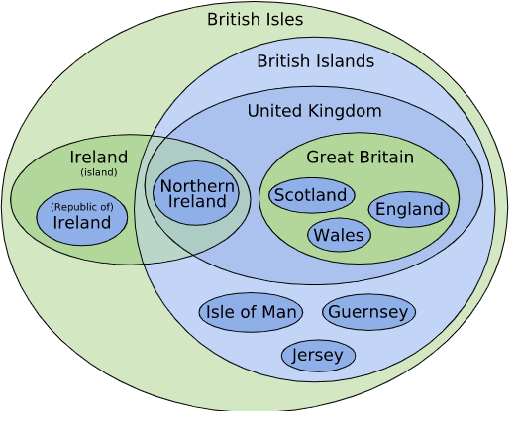

Slide 3
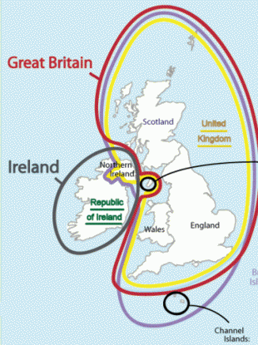

Slide 4

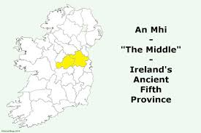

Slide 5
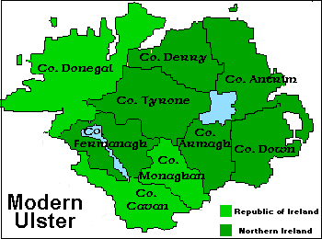

Slide 6
Some humorous sortings-out of this complicated geography
NPR clip (runtime 5:14)
Ook? (runtime 2:01)

