Slide 1
The Physical Geography of Ireland

Slide 2
Consider:
Thinking geographically:
How does the physical geography of this region (latitude, climate, topography, soils, vegetation, geology, waterways etc.)
enable particular patterns of human settlement and particular ways of living
and discourage others?

Slide 3
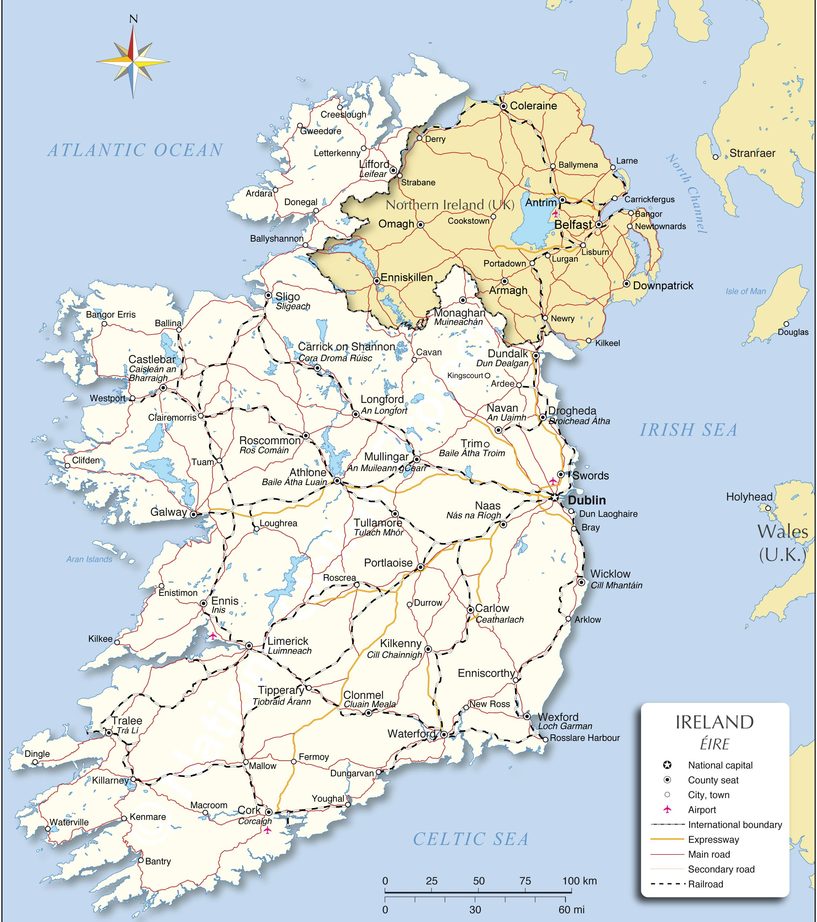
Ireland (Eire)
Northern Ireland (UK)
Republic of Ireland

Slide 4
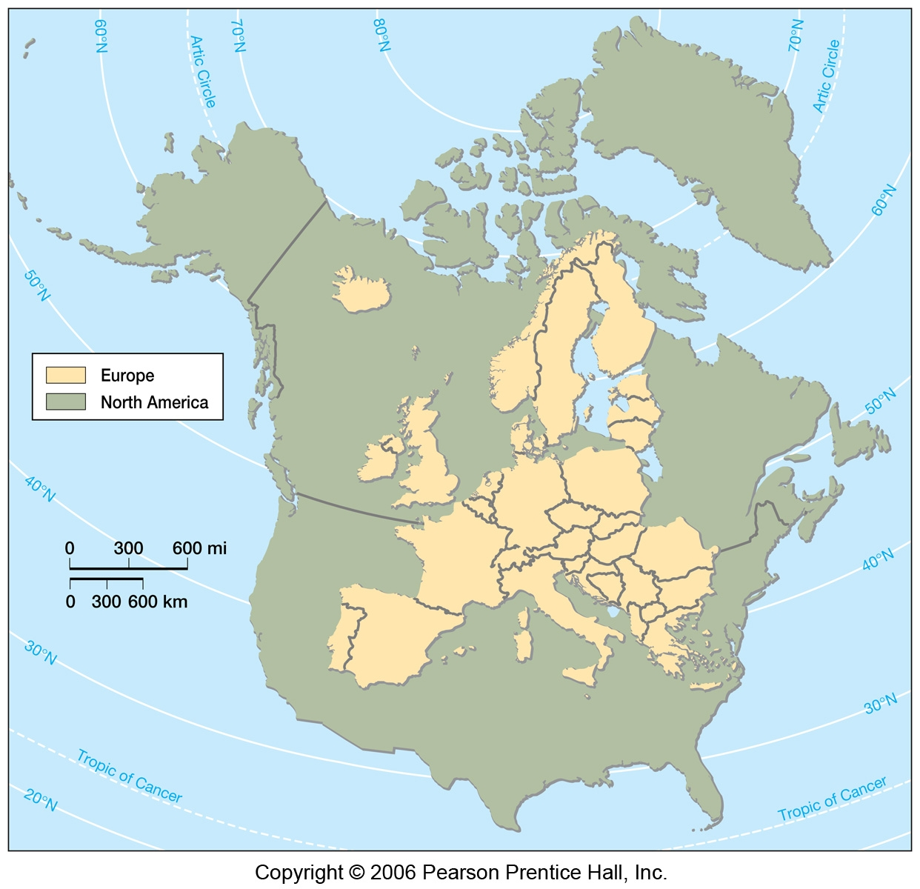

Slide 5
The Origins of Ireland
Tectonic plate activity → basement rock
Erosion and weathering
Glaciation during Ice Ages

Slide 6
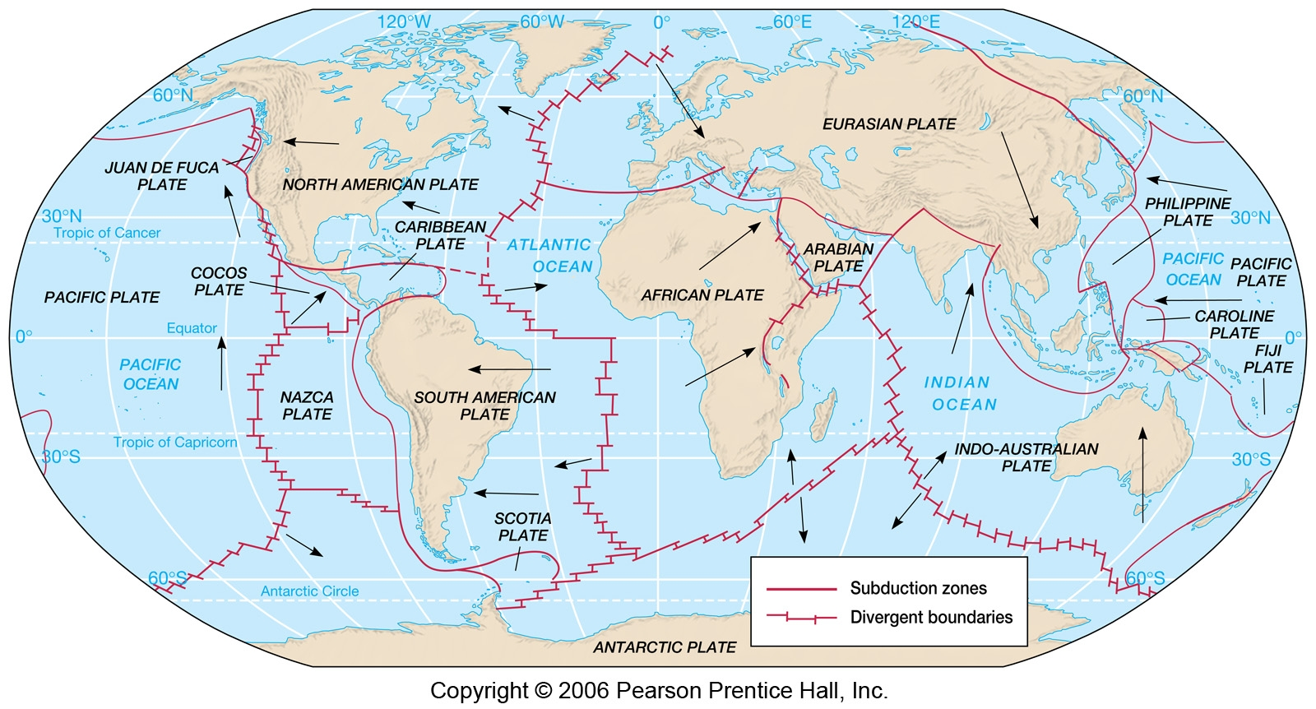

Slide 7
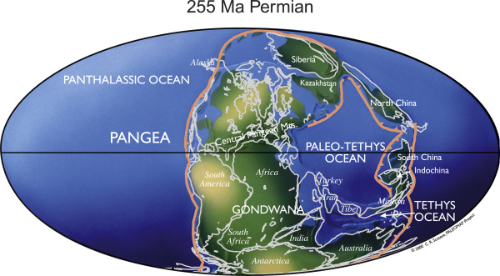
Tectonic plates: 650m years in 4 minutes
Animation of the supercontinents: https://www.youtube.com/embed/uLahVJNnoZ4?end=275
Saga of the supercontinents: https://www.youtube.com/watch?v=KfYn9KVya-Q

Slide 8
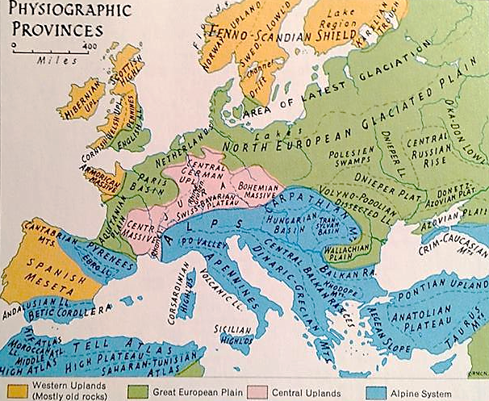
Landscape regions
Northern European Plain
Polders in Netherlands
Central Uplands
Mineral resources
Alpine System
Pyrenees, Alps, Carpathians, Apennines
Caledonian Highlands
UK, Ireland, Scandinavia;
fjords

Slide 9
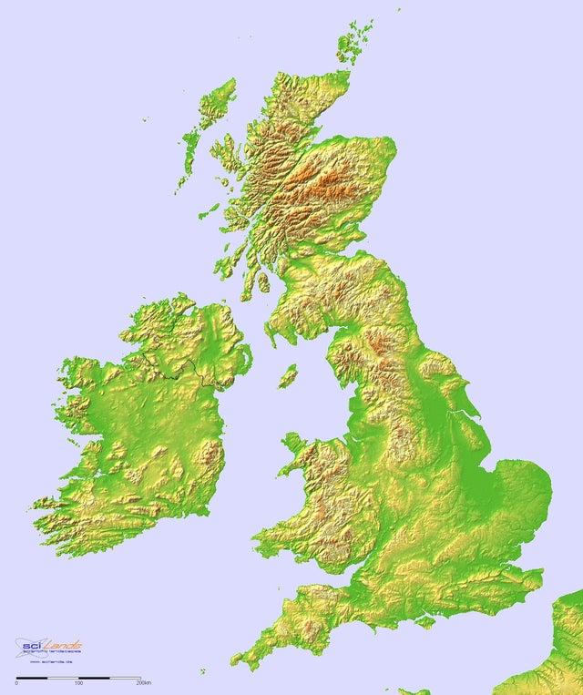
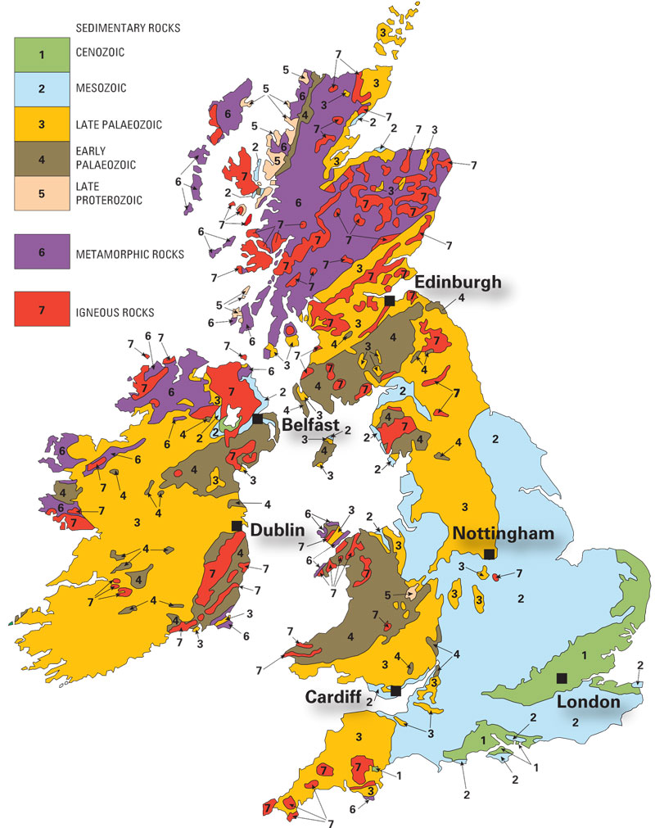
Caledonian Highlands in British Isles

Slide 10
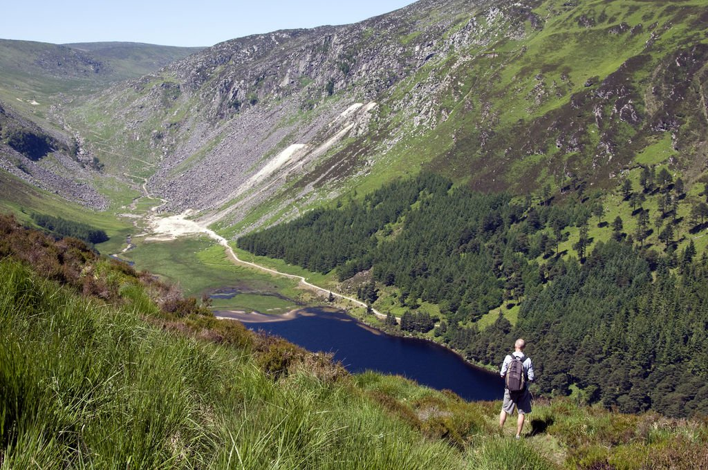
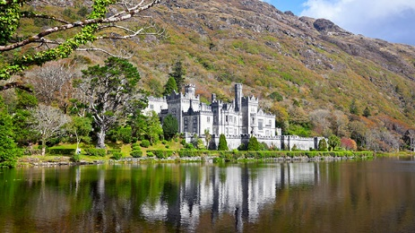
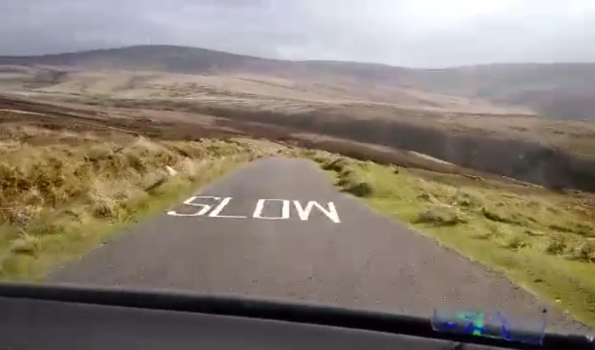
Wicklow Mts and Connemara

Slide 11

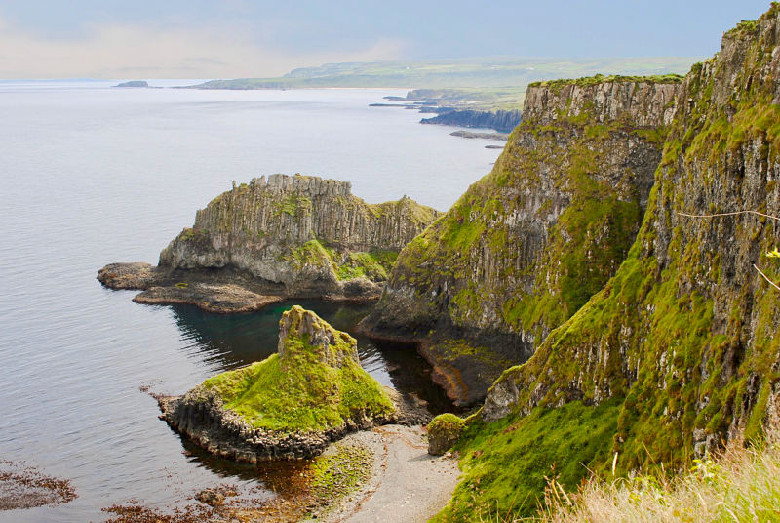
Antrim Plateau

Slide 12
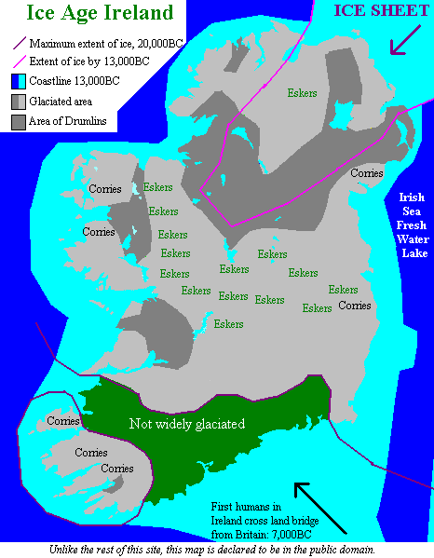
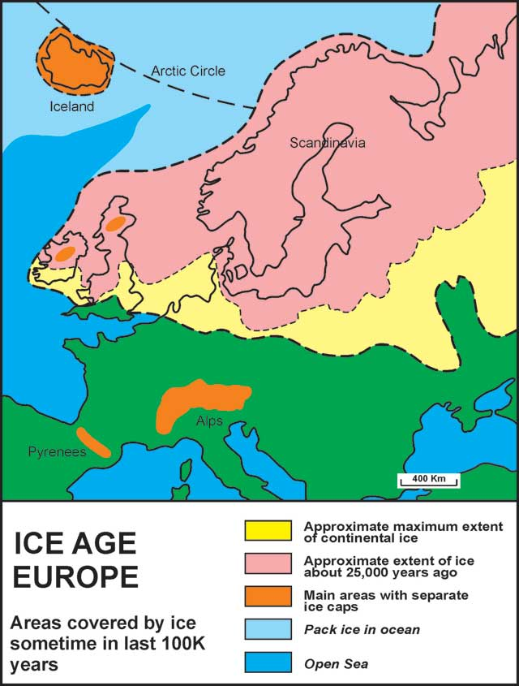

Slide 13
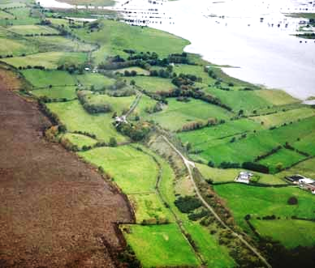
Esker at Clonmacnoise

Slide 14
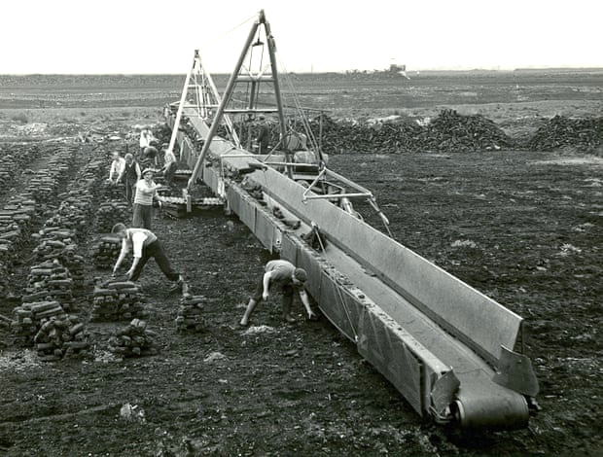
Cutting peat

Slide 15
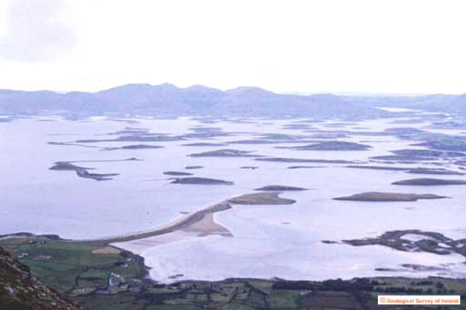
Drumlins in Clew Bay, Co. Mayo

Slide 16
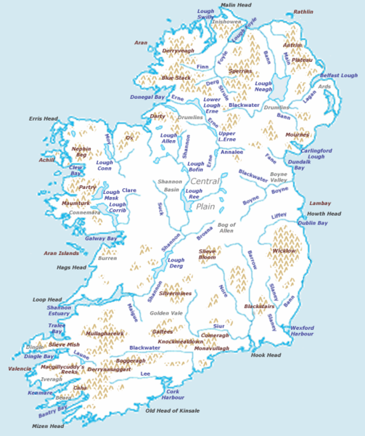
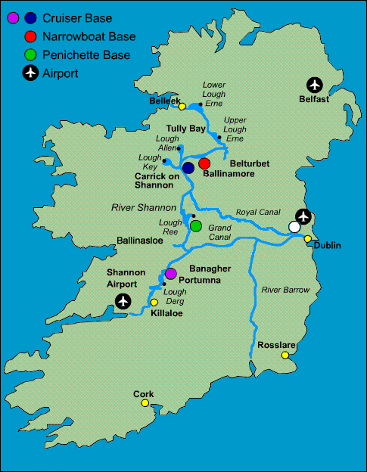
Waterways: Rivers and Canals

Slide 17
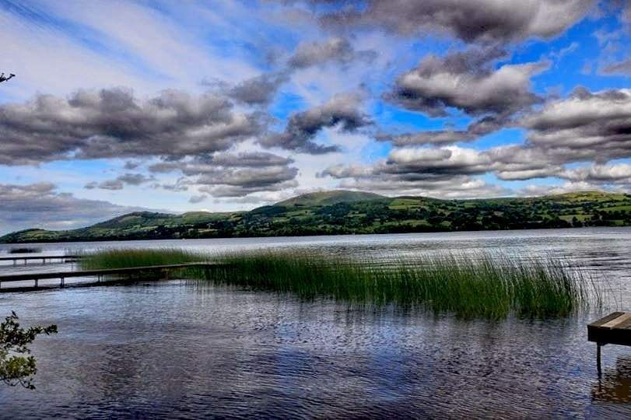
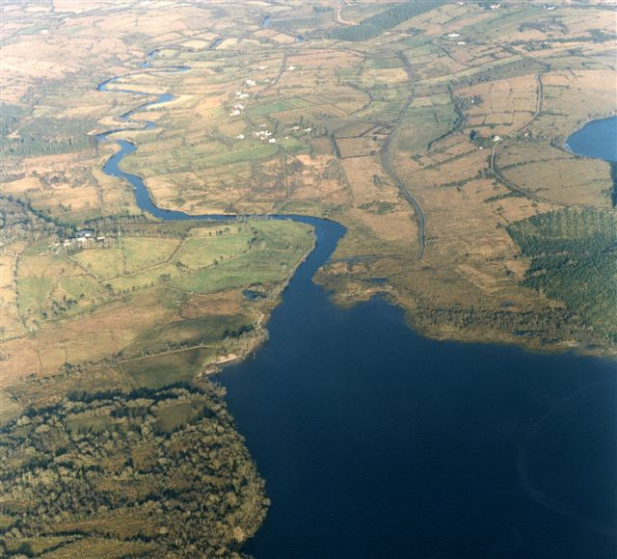
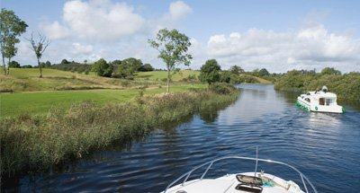
The Shannon River

Slide 18
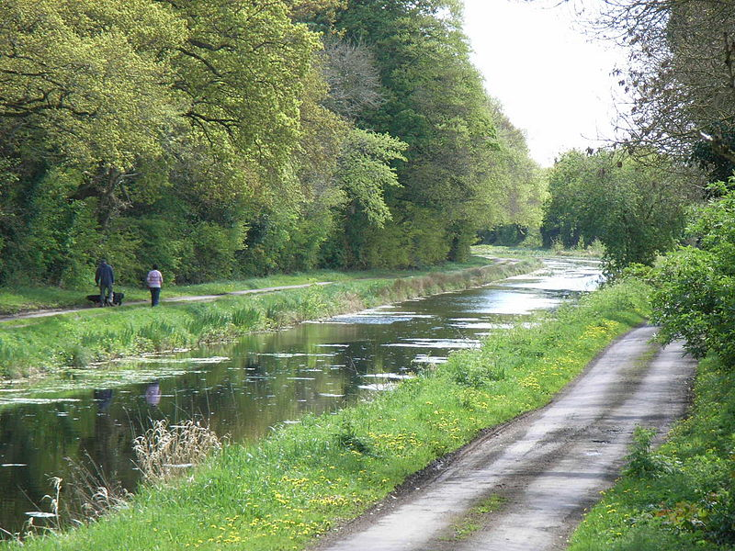
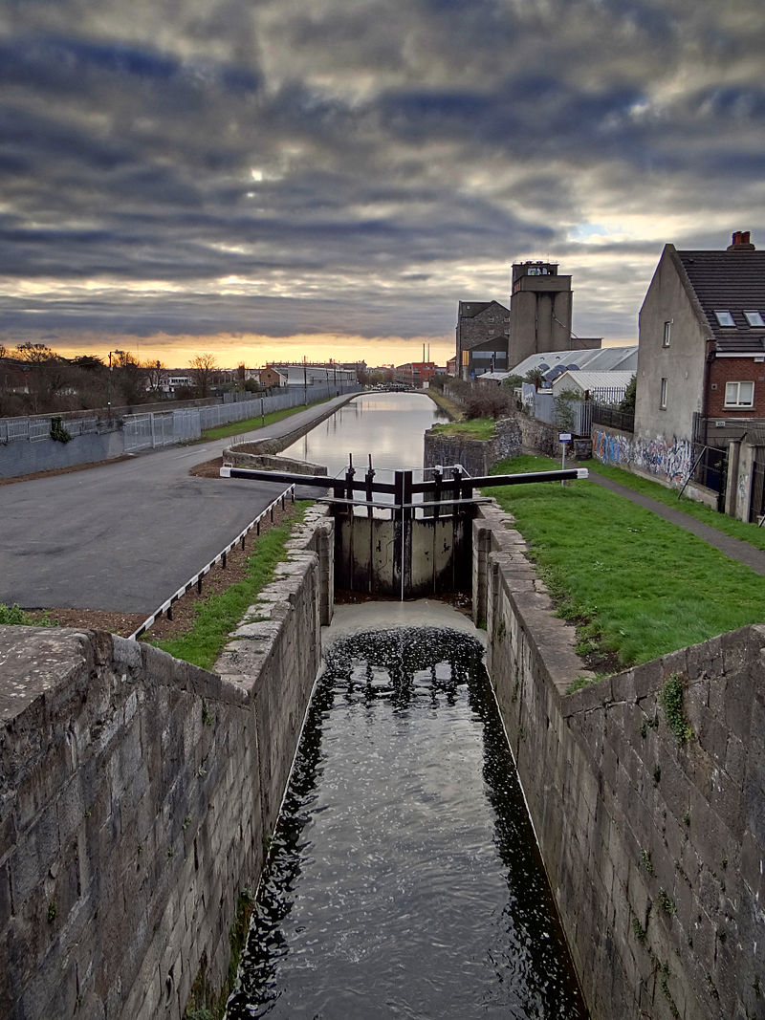
The Royal Canal

Slide 19
Weather and Climate

Slide 21
The Gulf Stream: moderating climate
City | Latitude | Sept. avg high temp °F
Boston | 42° | 73
Madrid | 41° | 79
Edmonton | 53° | 63
London | 52° | 67
Anchorage | 61° | 55
Stockholm | 59° | 63

Slide 22
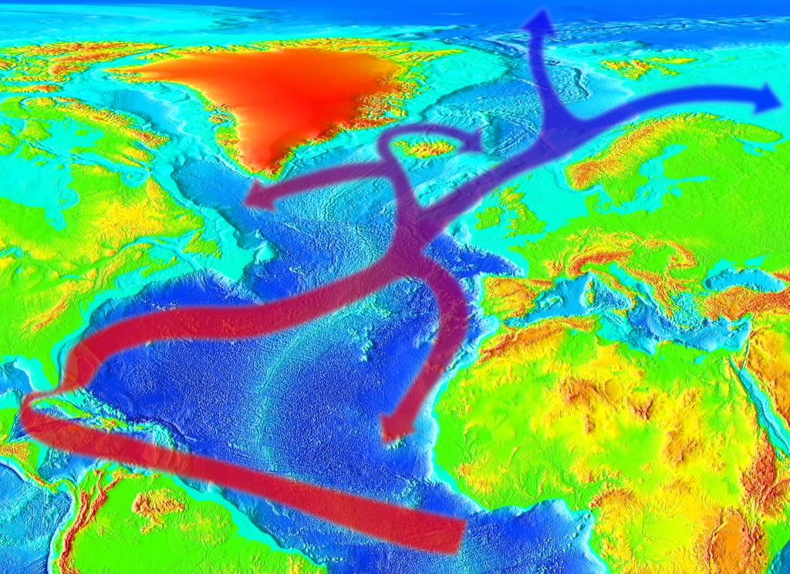
Gulf Stream and North Atlantic Drift
Gulf stream heads up East coast of US and heads across the Atlantic Ocean towards the Northeast Atlantic. This changes into the North Atlantic Drift current that brings significantly warmer water (thus temperatures) throughout Western and Northern Europe

Slide 23
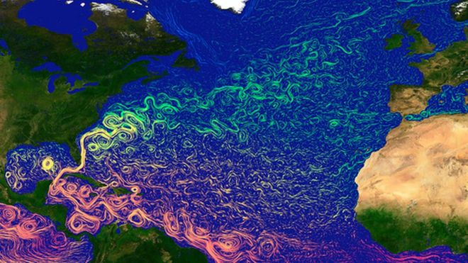
Gulf Stream
Sea surface temperatures

Slide 24
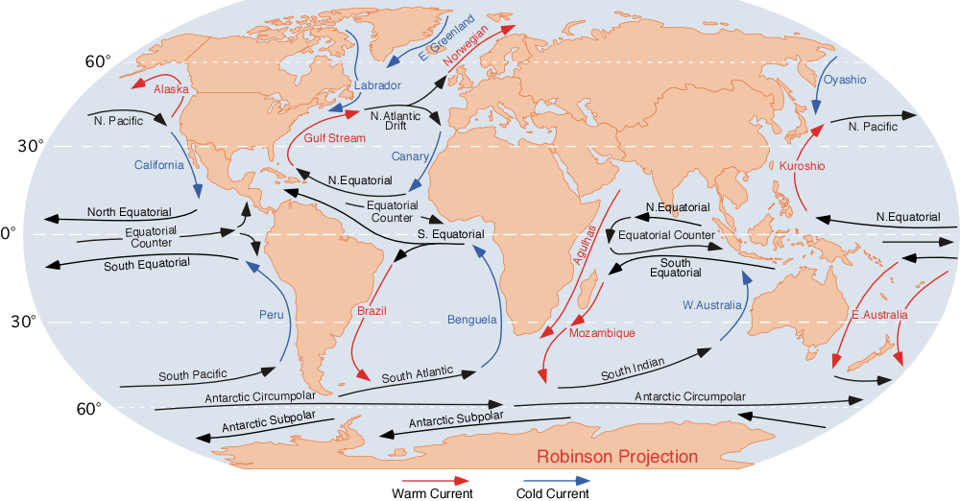
Major Ocean Currents

Slide 25
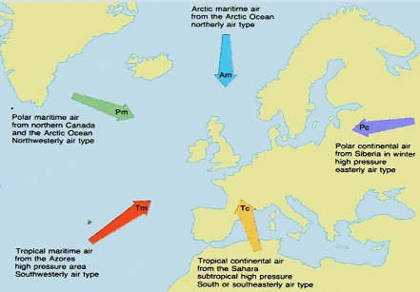
Air Masses: effect on climate

Slide 26
Air Masses: effect on climate
Maritime Polar (NW) and Maritime Arctic (N)
Cold or very cold air with moisture
Polar Continental (NE) aka Siberian High
Dry cold air
Tropical Continental (S), from Saharan Desert
Dry hot air
Maritime Tropical (SW), aka Gulf Stream
Very moist, hot air

Slide 27
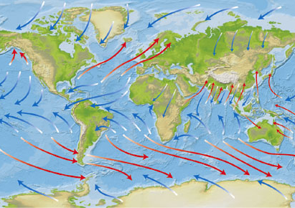
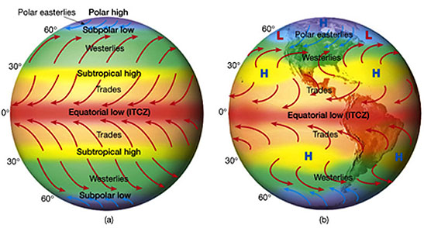
Global Scale Wind Patterns

Slide 28
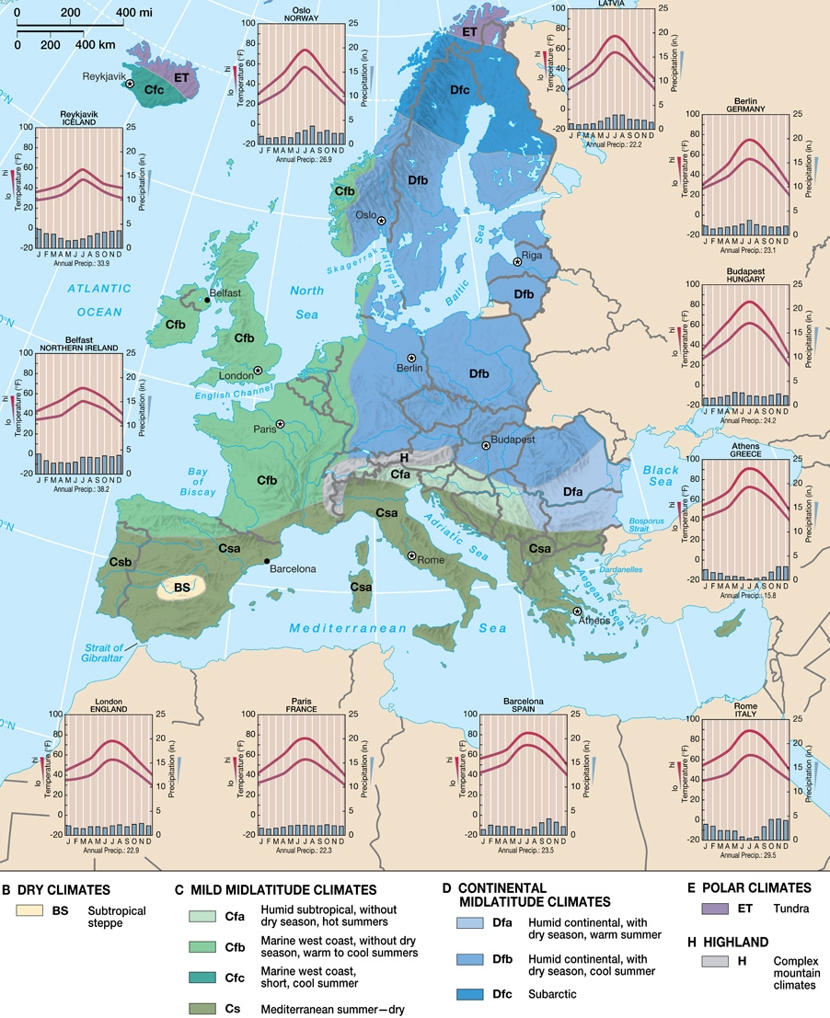
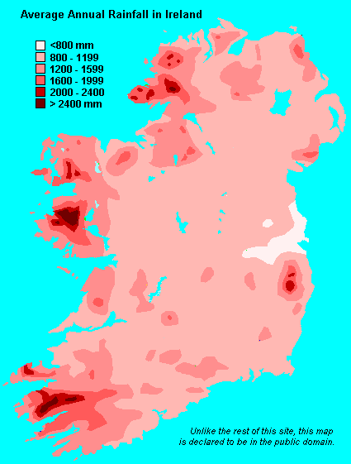
Climate Types:
Cfb: Marine west coast, without dry season, warm to cool summers.

Slide 29
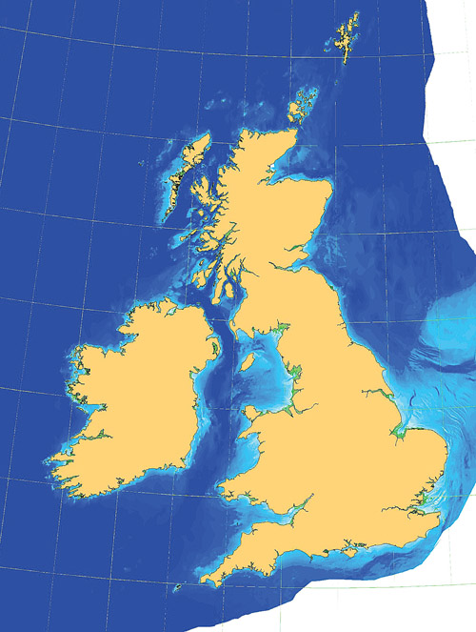
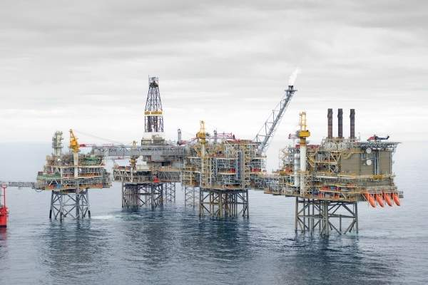
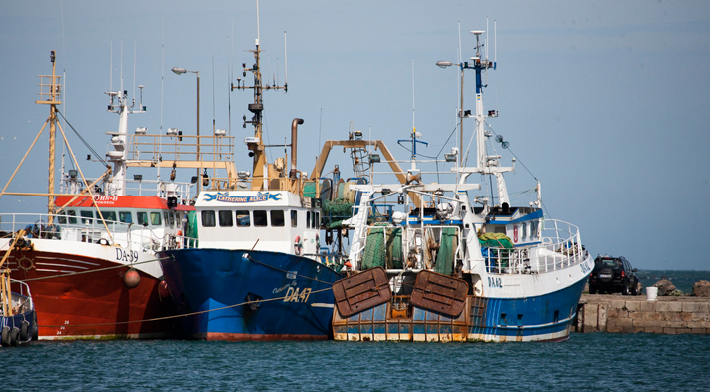
Ocean depth (bathymetry)

Slide 30
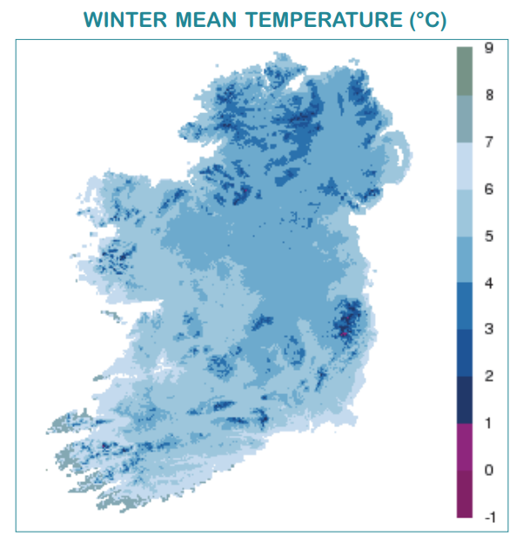
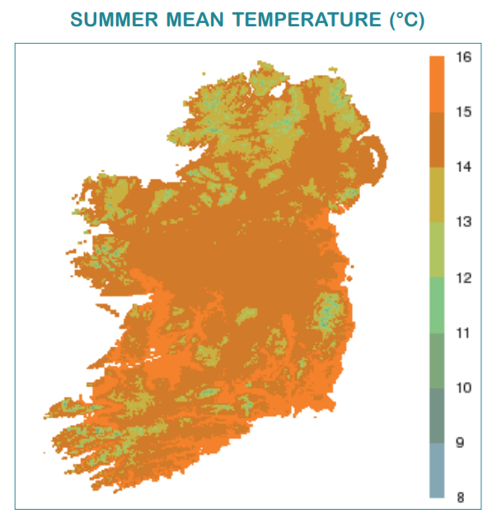
Mean Temperatures
48°f
40°f
32°f
61°f
53°f
48°f

Slide 31
Life on the Land

Slide 32
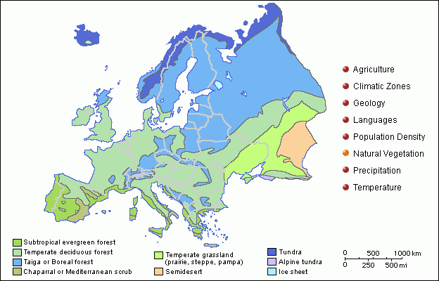
Biomes and Land Cover Types

Slide 33
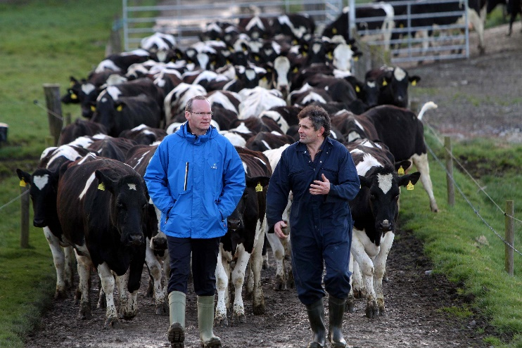
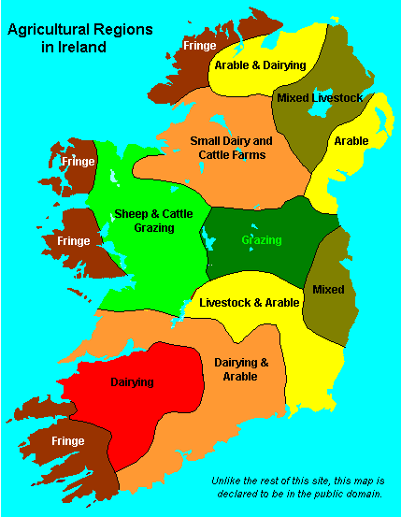
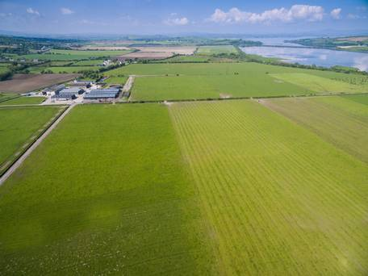
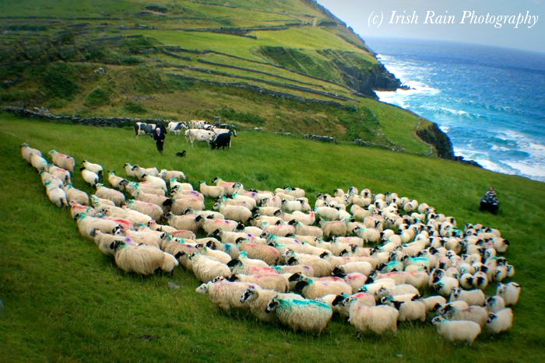
Location of agricultural areas

Slide 34
Land Use Types (Republic only)

Slide 35
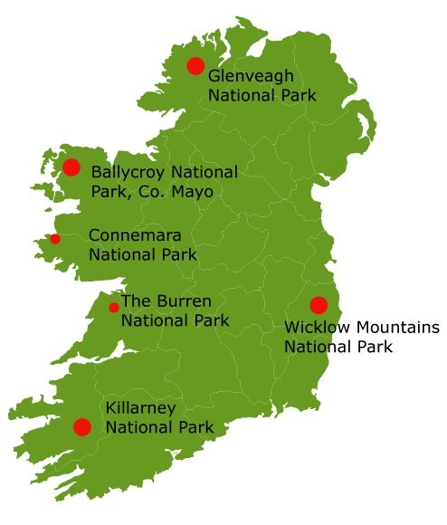
6 national parks (Republic) total 635 km²

Slide 36
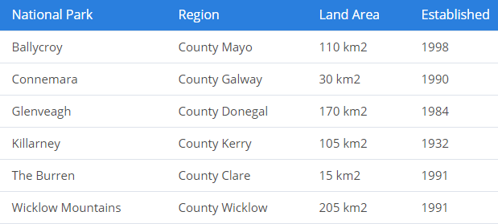
National Parks

Slide 37
Vernacular architecture

Slide 38
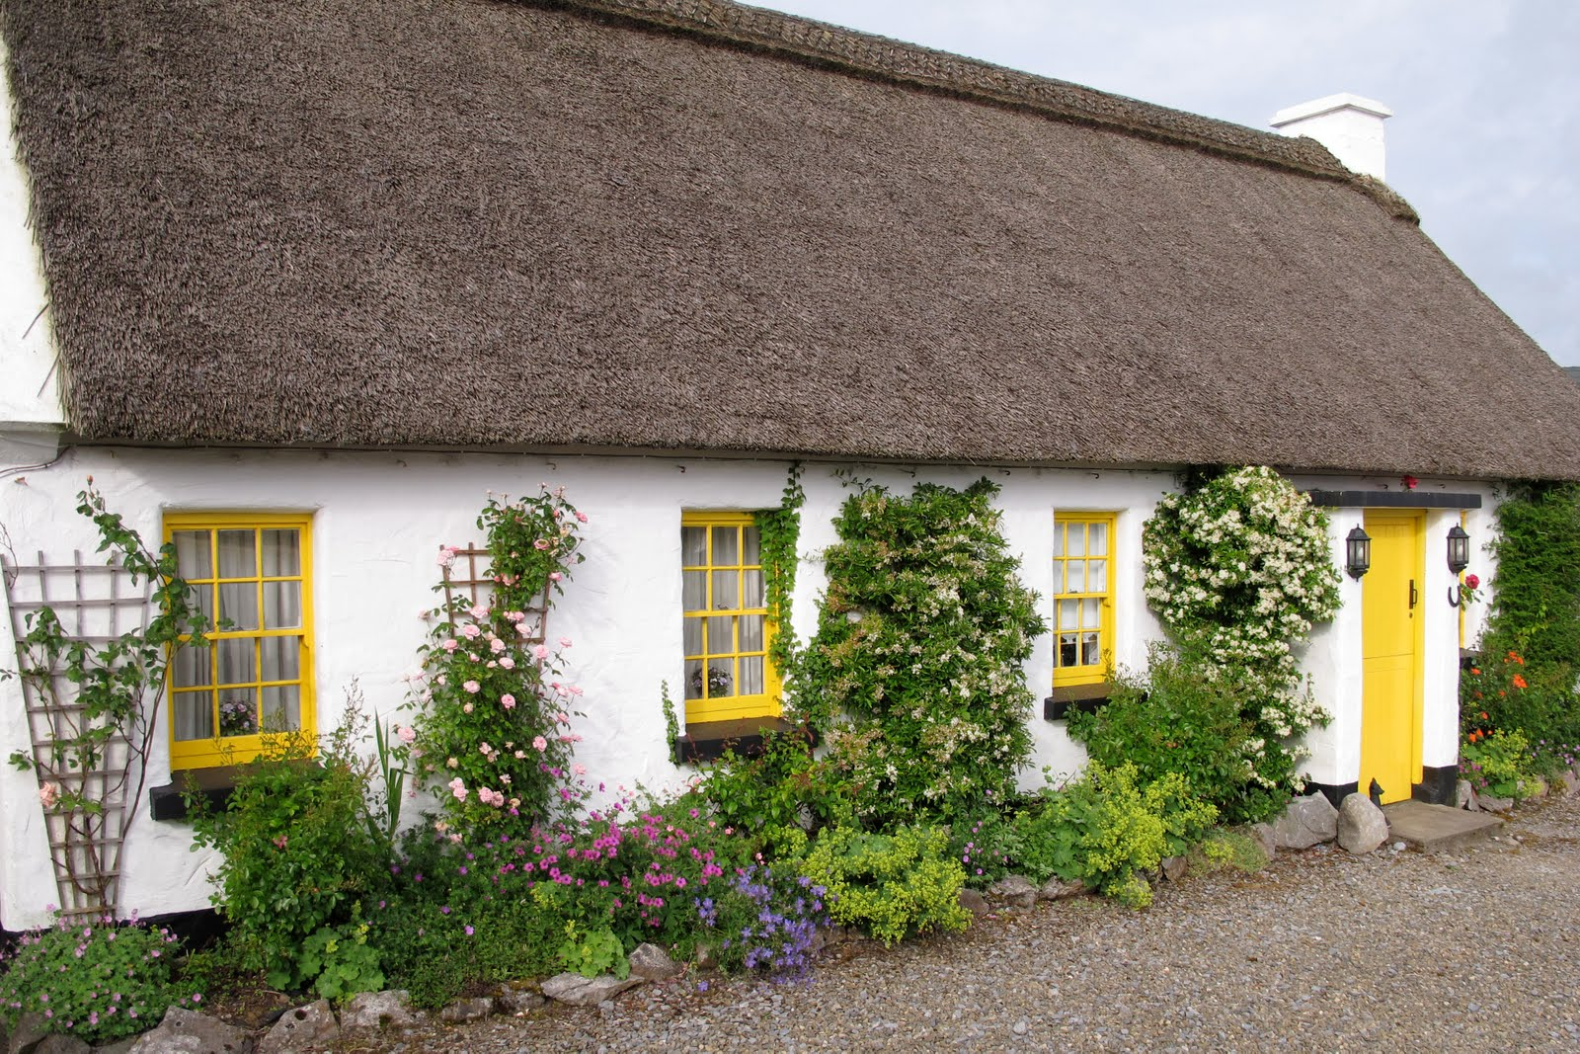

Slide 39
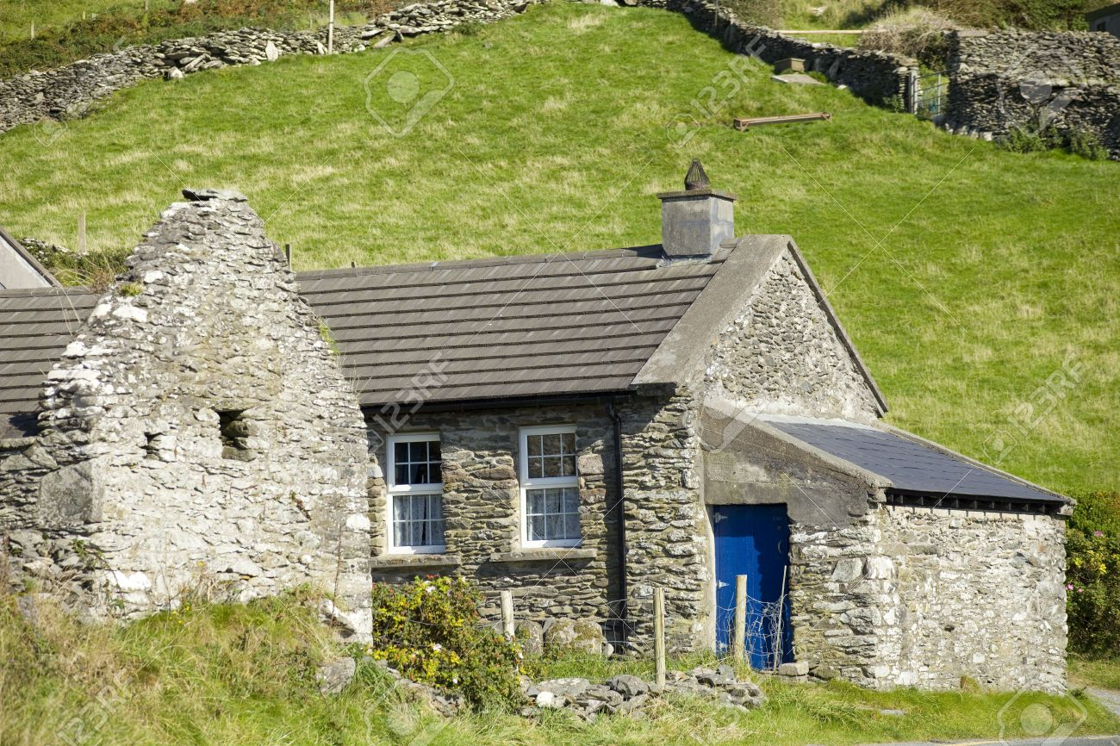

Slide 40
Student review exercise: Looking at landscapes
Based on a landscape photo, explain how humans both exploit and adapt to environmental conditions.
How did the Irish shape the landscape to suit their own needs?
How did they take advantage of the particular resources of a place to create unique landscapes and ways of living?

Slide 42
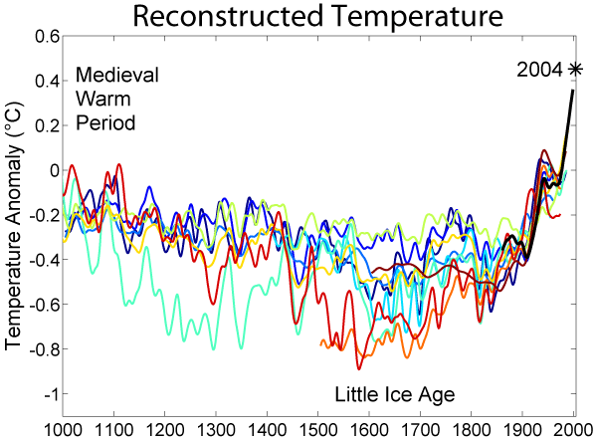

Slide 43
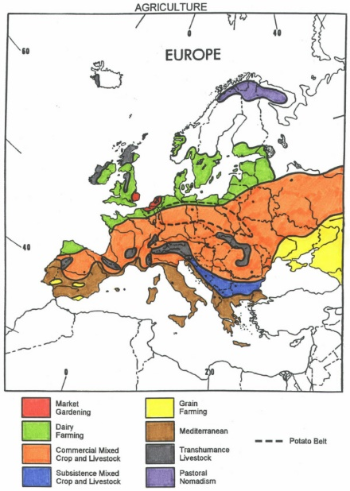

Slide 44
Air Masses
What is an Air Mass?
An extensive body of air that has relatively uniform temperature and humidity derived from a source region
Source Region
The place where an air mass “gets” its temperature and humidity characteristics
Air needs to “sit” over this area to “get” humidity & temp (air stagnates over this area and acquires characteristics)

Slide 45
Air Masses
Source Region
Humidity: Large uniform areas
Land = Continental = Dry
Water = Maritime = Humid
Temperature: Latitude
Arctic = Very Cold
Polar = Cold
Tropical = Warm
Equatorial = Hot

Slide 46
Source Regions
mA = maritime arctic
mP = maritime polar
mT = maritime tropical
mE = maritime equatorial
cA = continental arctic
cP = continental polar
cT = continental tropical
cE = continental equatorial

Slide 47
Source Regions
mA = maritime arctic
mP = maritime polar
mT = maritime tropical
mE = maritime equatorial
cA = continental arctic
cP = continental polar
cT = continental tropical
cE = continental equatorial
mA = maritime arctic
mP = maritime polar
mT = maritime tropical
mE = maritime equatorial
cA = continental arctic
cP = continental polar
cT = continental tropical
cE = continental equatorial

Slide 48
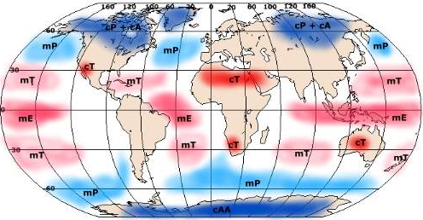
Air Masses
cP + cA
cP + cA
cP

Slide 49
