Slide 1
Demographics:
Population and Settlement Patterns

Slide 2
Outline:
Population size
Change over time
Growth rates and age/sex distributions
Immigration
Spatial distribution
Urbanization

Slide 3
Current Population Size
Republic of Ireland: 5 million (2018 est.)
  Of which: 1.2m (24%) live in metro Dublin
Northern Ireland: 1.8 million (2011 census)
  Of which: 673,000 (37%) live in metro Belfast
  Northern Ireland: only 2.9% of the UK population
Total island population: 6.8 million

Slide 4
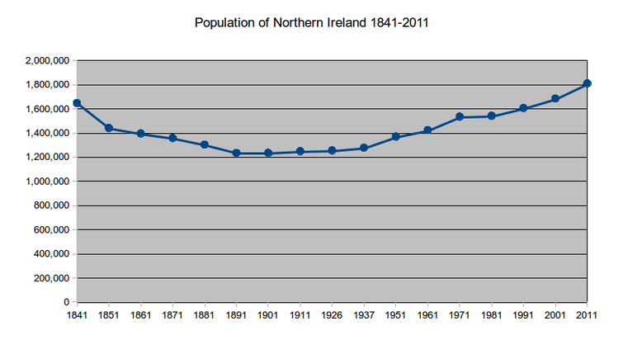
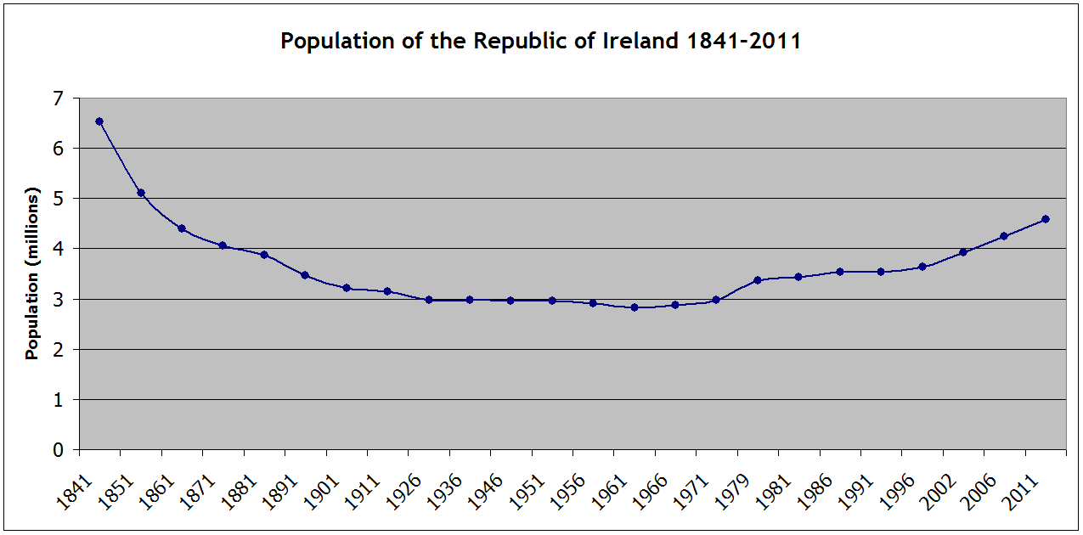

Slide 5
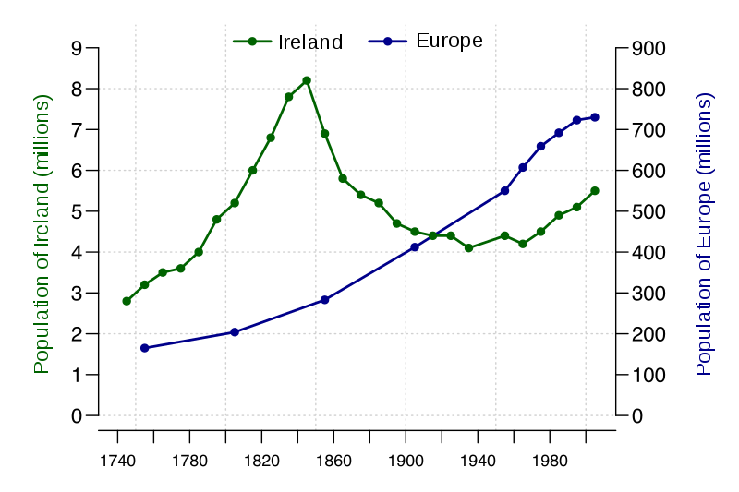

Slide 6
Trends in fertility rates
Year | Total fertility rate
1860 | 3.51
1880 | 3.31
1900 | 3.04
1920 | 3.20
1940 | 2.43
1960 | 3.78
1980 | 3.25
2000 | 1.89
2018 | 1.75

Slide 7
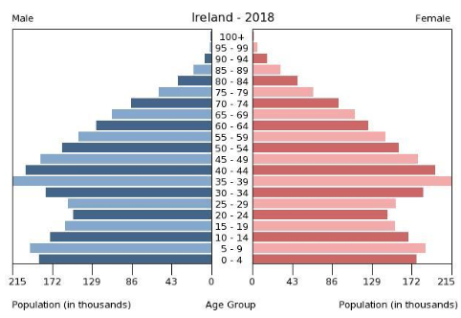
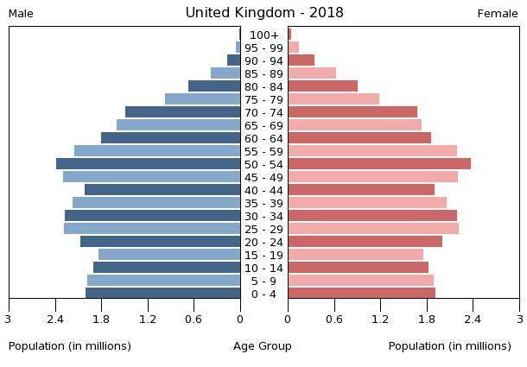
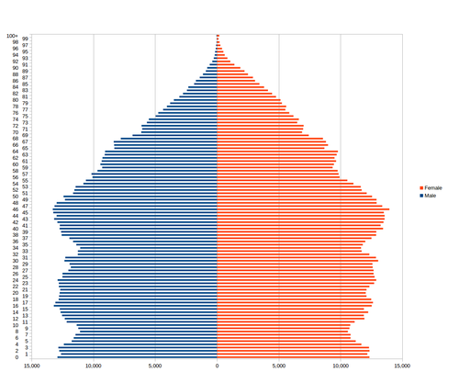
Population Pyramids

Slide 8
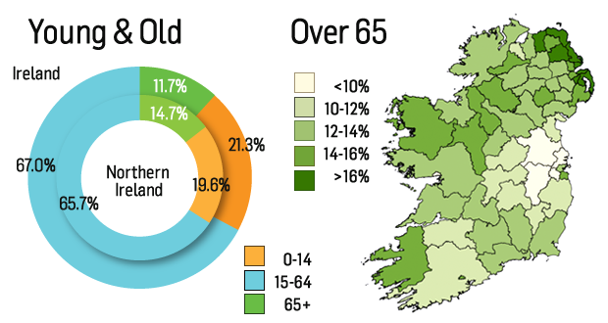

Slide 9
Country of Origin of Foreign-Born Residents in Rep. of Ireland

Slide 10
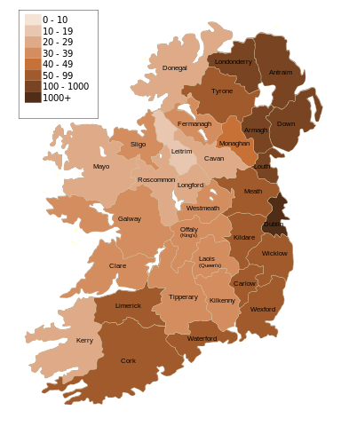
Population density, people/km²

Slide 11
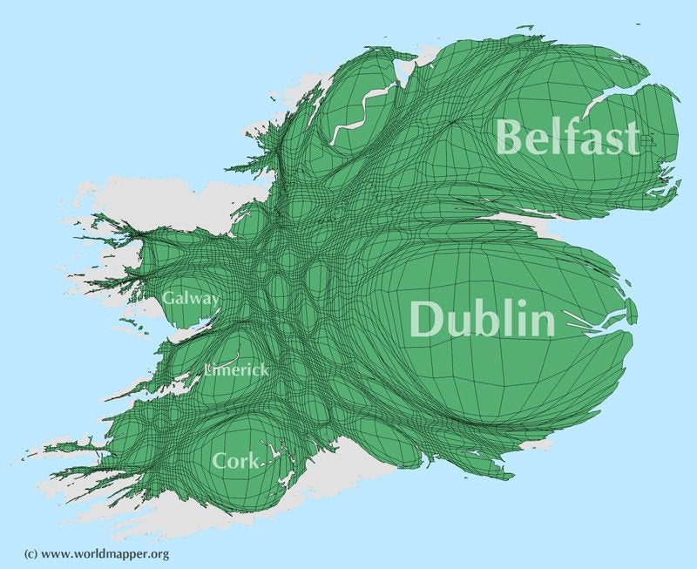

Slide 12
Comparative urbanization rates
Geographical unit | Urbanization (% of total population)
Netherlands | 91.5
United Kingdom | 83.4
Europe | 74.0
Italy | 70.4
Republic of Ireland | 63.2

Slide 13
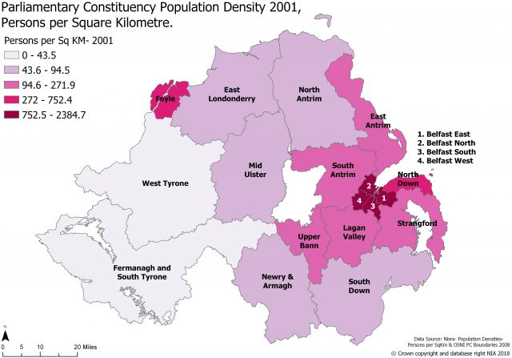
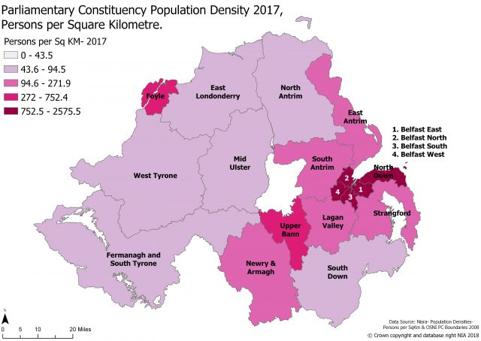
Rural to urban migration

Slide 14
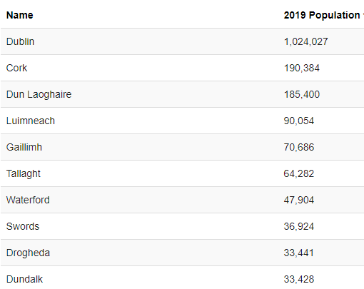
Largest cities
Belfast 295,000; Derry/Londonderry 107,900

