Slide 1
Culture in Ireland

Slide 2
Outline
Language
Religion
Music

Slide 3
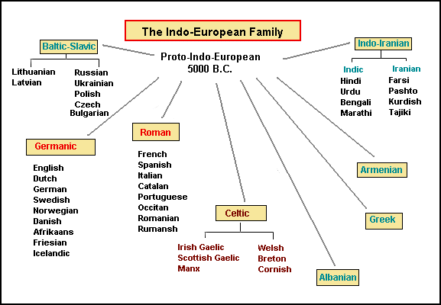
The Celtic Language Family Tree

Slide 4
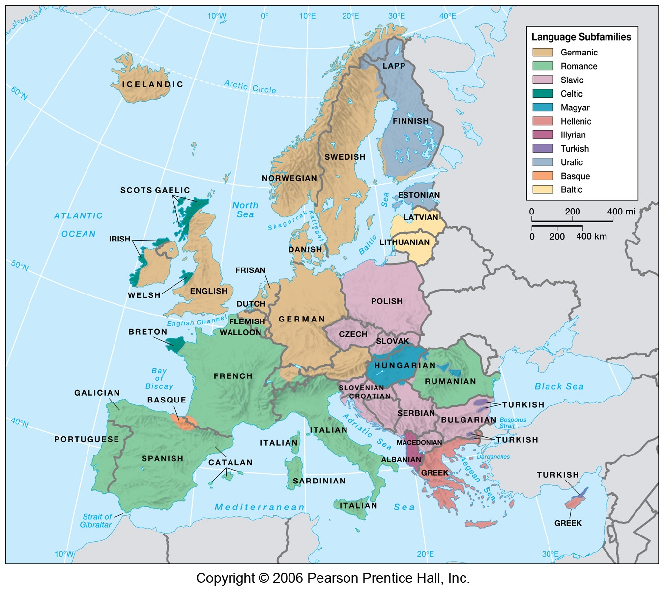

Slide 5
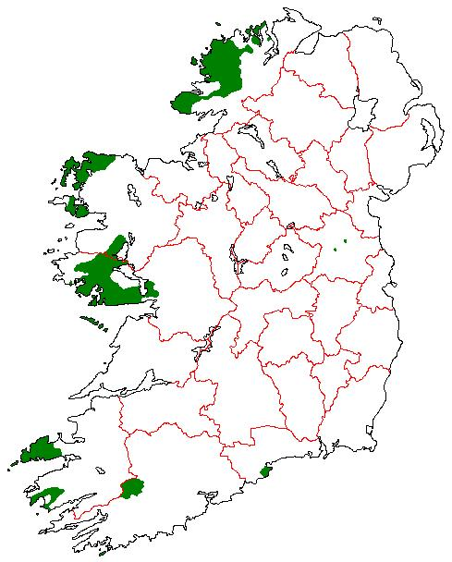
Gaeltacht (1956)

Slide 6
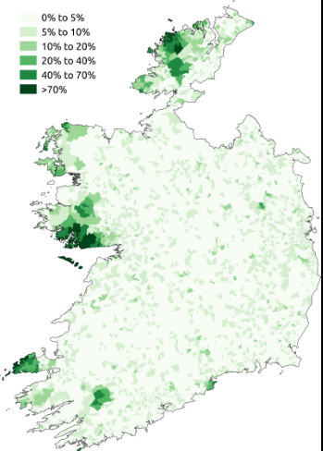
% speaking Irish daily outside of schools Source: 2011 census

Slide 7
Irish language and the oral tradition
From the documentary film In Search of the Trojan War (1985):
John Henry speaks ONLY Irish: https://www.youtube.com/watch?v=UP4nXlKJx_4
Comedian Des Bishop on learning Irish:
https://www.youtube.com/watch?v=pbb8EoSVVyU
https://www.youtube.com/watch?v=LwF-9SJCWFg

Slide 8
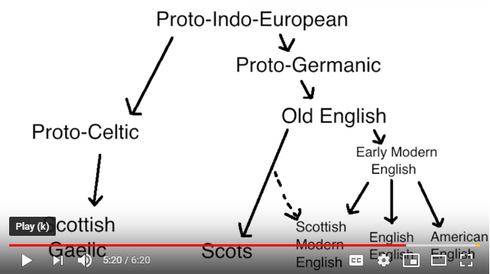
Ulster Scots ≠ Scottish Gaelic!

Slide 9
Ulster Scots v. Scottish Gaelic
https://www.youtube.com/watch?v=fj4w6SCn2ZM (Ulster Scots)
https://www.youtube.com/watch?v=ROoWGPsyzFg (Scottish Gaelic)

Slide 10
Religion

Slide 11
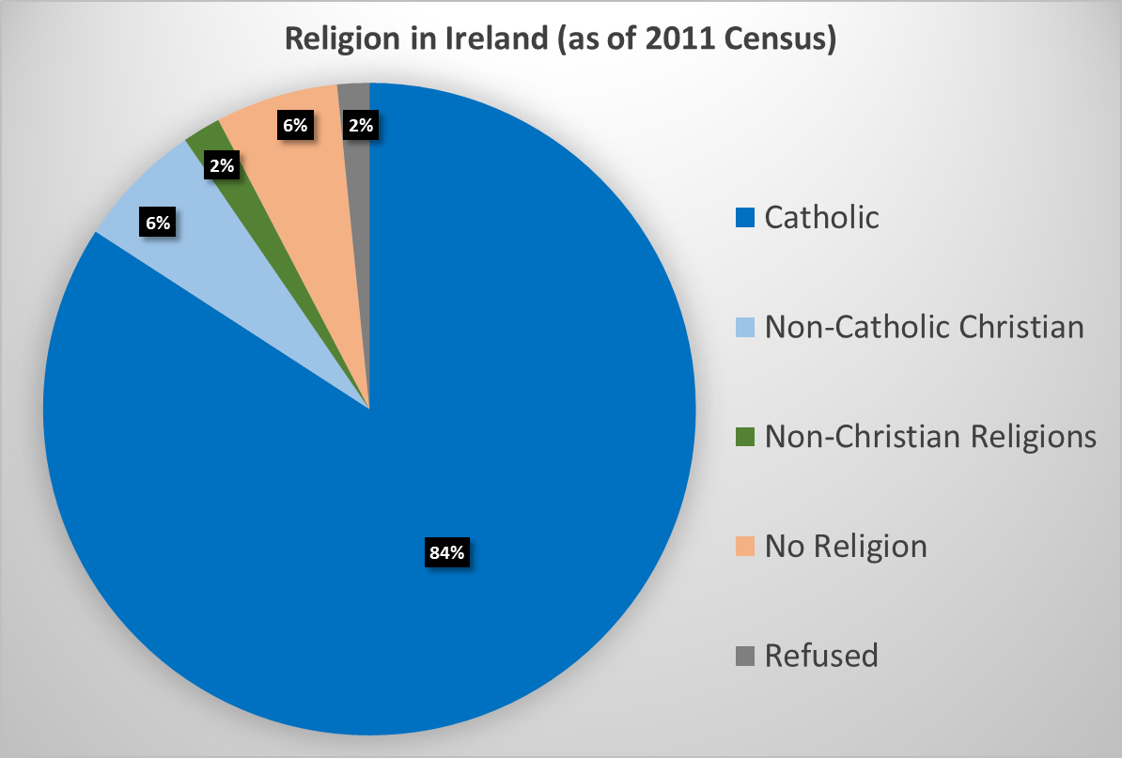
Religious affiliation in the Republic

Slide 12
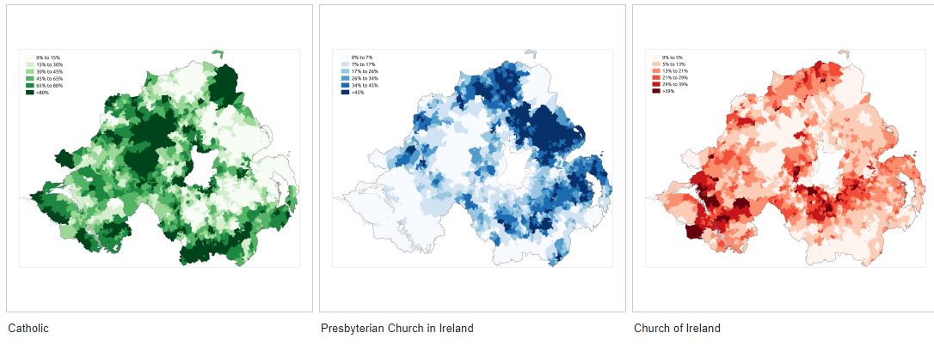
Religious affiliation in Northern Ireland

Slide 13
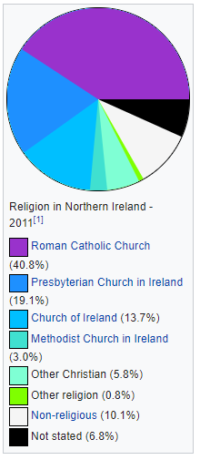
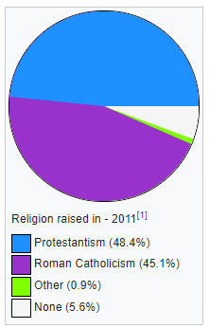
Faith tradition vs belief

Slide 14
Music

Slide 15
Politics and song intertwined:
“Four green fields”
https://www.youtube.com/watch?v=Cfdvb-0B3qs
The “four green fields” are the provinces of Ireland
Lyrics: https://www.irishsongs.com/lyrics.php?Action=view&Song_id=122
“The fields of Athenry”
https://www.youtube.com/watch?v=YS0dUvEXx3g
A man who stole food for his family during the Great Famine is exiled on a prison ship bound for Australia
Lyrics: https://genius.com/The-dubliners-the-fields-of-athenry-lyrics

