Slide 1
The Irish Economy

Slide 2
Outline
“Toolkit” for quantifying economic development
Sectoral structure of the Irish economy
Current economic issues:
The Great Recession and Ireland’s debt crisis of 2008-2012
The future of social welfare systems
Brexit: trade and borders

Slide 3
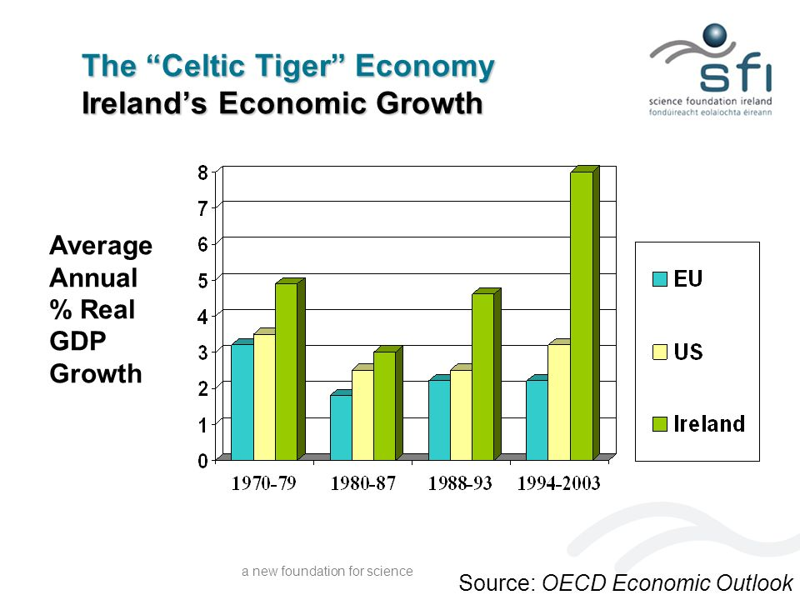

Slide 4
Key questions:
Where are the spatial differences in prosperity and social well-being, and why do they exist?
What is the structure of the Irish economy?
How has it developed?
How is it changing?
What are the challenges that these economies face?
Is the commitment to social welfare systems sustainable, given the changing demographics? (connection to earlier work on pop and migration)
What are the implications of Brexit both for the Republic and for Northern Ireland?

Slide 5
Measuring and comparing economies

Slide 6
What is economic development?
Economic development is the process by which a State (or other geographical unit) improves the economic, political, and social well-being of its people.

Slide 7
How do we measure ED?
Prosperity
Social Well-being
GDP
GDP per capita
GNI
GNI per capita
Purchasing Power Parity adjustment (PPP)
Unemployment
Inequality
Health
Infant mortality
Life expectancy
Caloric intake
Education
Years of school
Literacy rate
Gender Equity
Women in workforce
Women in elected positions

Slide 8
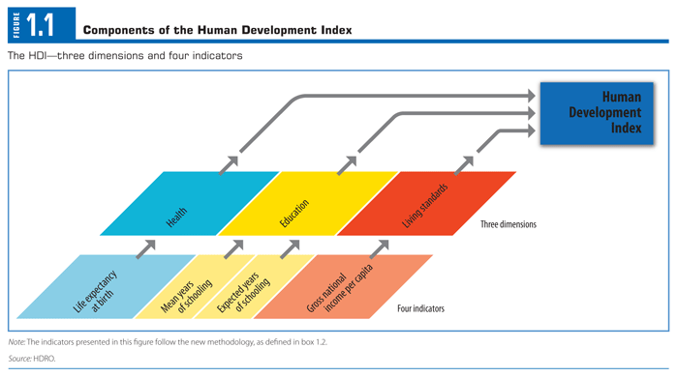
UN Human Development Index. Source: http://hdr.undp.org/en/statistics/hdi/

Slide 9
2018 HDI Rankings
1 Norway
2 Switzerland
3 Australia
4 Ireland
5 Germany
6 Iceland
7 Hong Kong/Sweden
9 Singapore
10 Netherlands
11 Denmark
12 Canada
13 United States
14 UK
15 Finland
16 New Zealand
17 Belgium
18 Liechtenstein
19 Japan
20 Austria

Slide 10
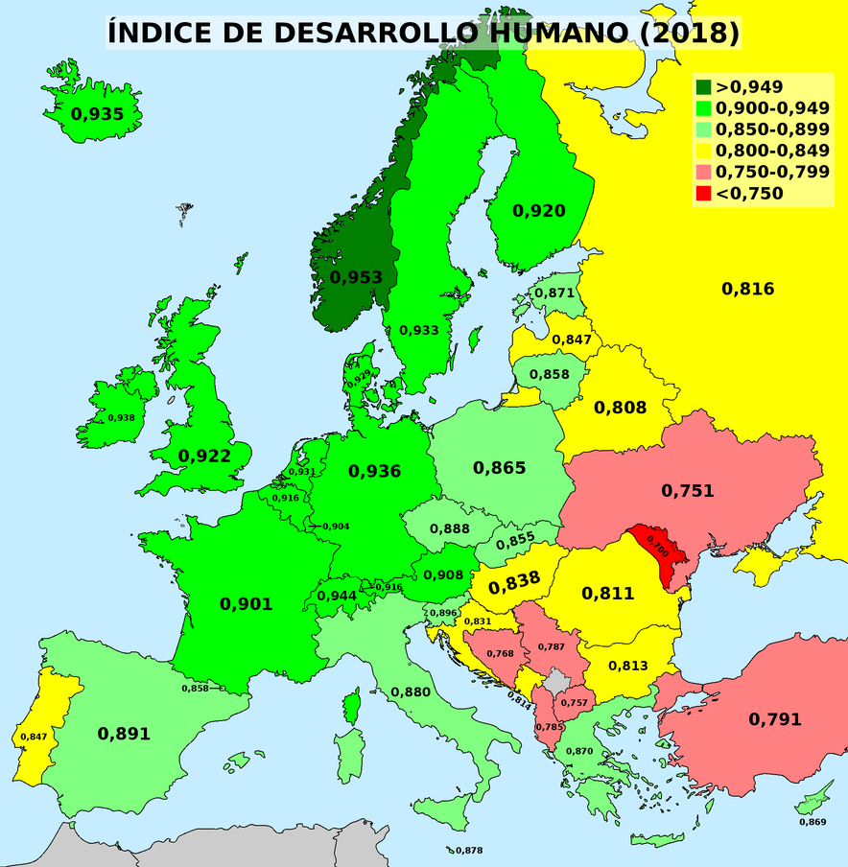
HDI in comparative perspective

Slide 11
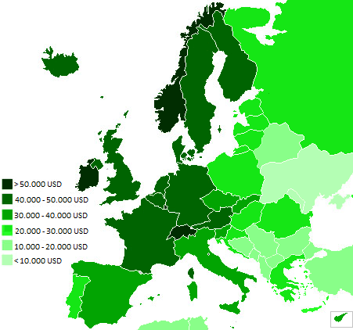
Components: GDP per capita (2016)

Slide 12
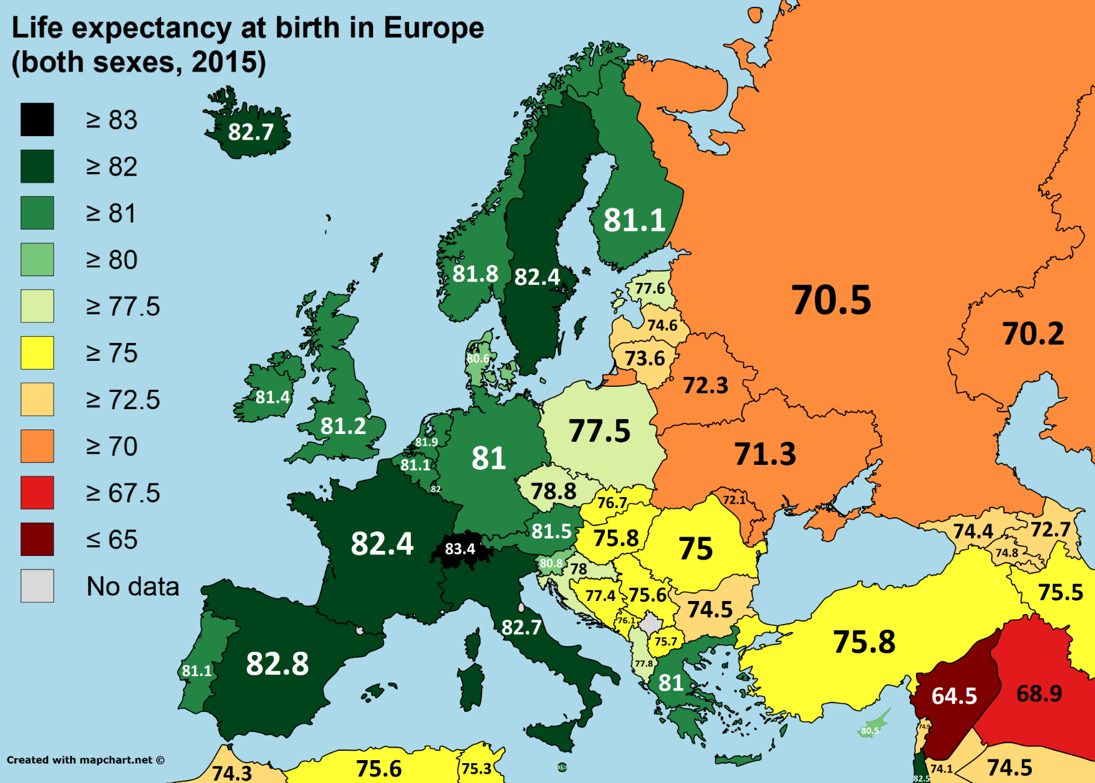
Components: Life expectancy (2015)

Slide 13
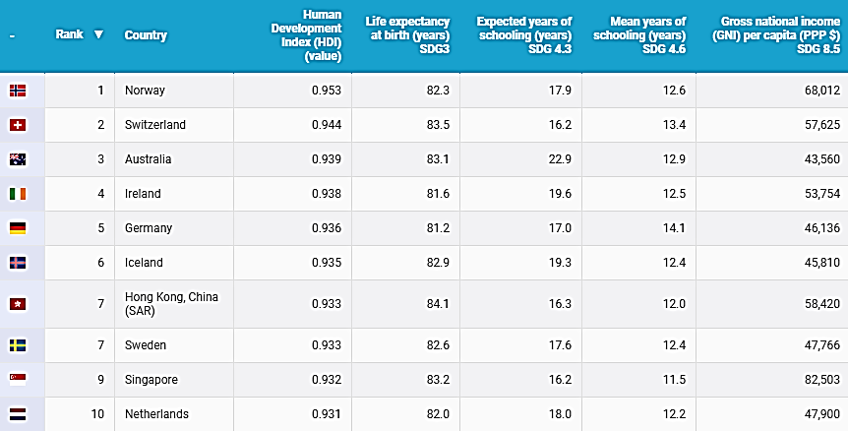

Slide 14
Hans Rosling
200 years, 200 countries, 4 minutes…
http://www.youtube.com/watch?v=jbkSRLYSojo&playnext=1&list=PLC795A4416B983021

Slide 15
Sectoral structure of economies

Slide 16
Economic Sectors
Primary
Agriculture, fishing, forestry, mining
Secondary
Manufacturing
Tertiary
Trade and Services
Quaternary
Information industries

Slide 17
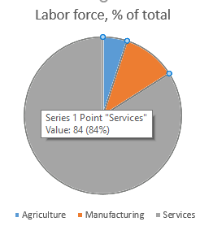
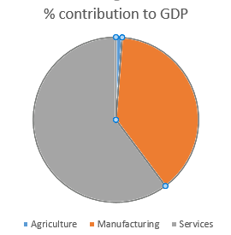
Sectoral contributions, Republic of Ireland

Slide 18
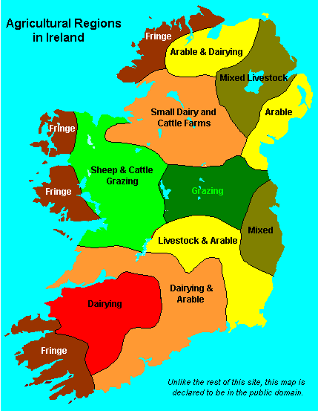
Location of agricultural areas

Slide 19
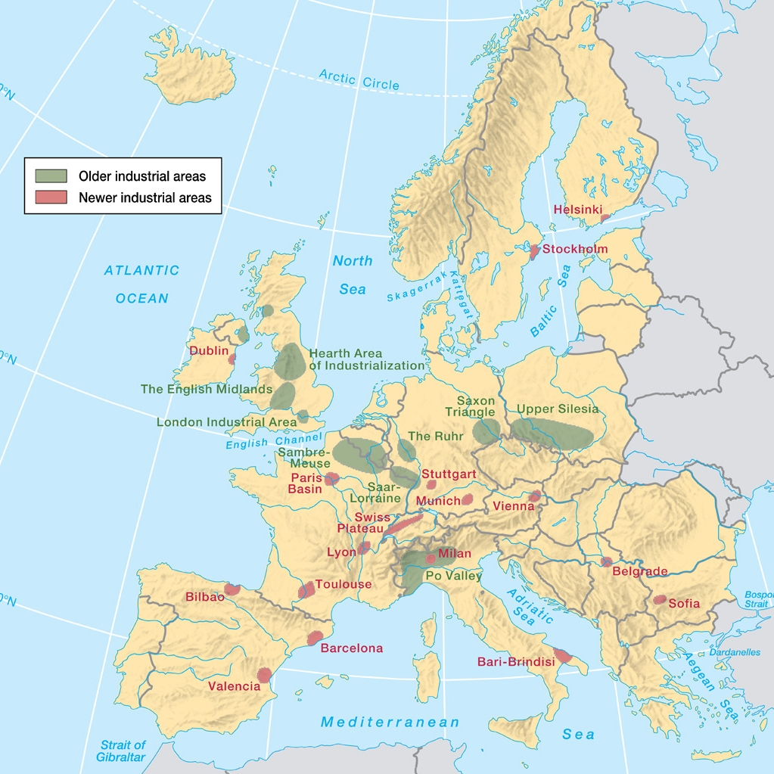

Slide 20
Tertiary: services
Redistribution
Transport of goods and people
Wholesale and retail trade
Producer services (B2B)
Finance, insurance and real estate (FIRE)
Tourism/Hospitality

Slide 21
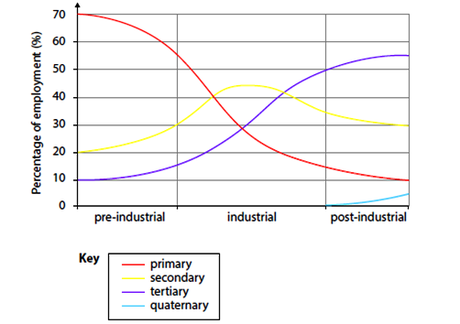
Clark-Fisher Hypothesis

Slide 22
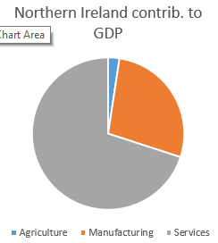
Sectoral contributions, Republic of Ireland

Slide 23
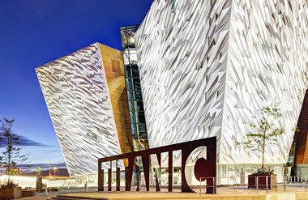
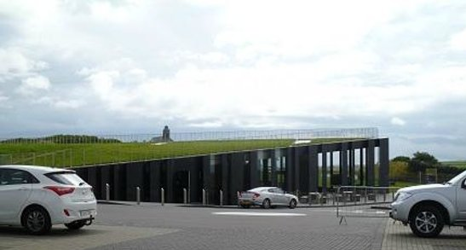
Tourism in Northern Ireland

Slide 24
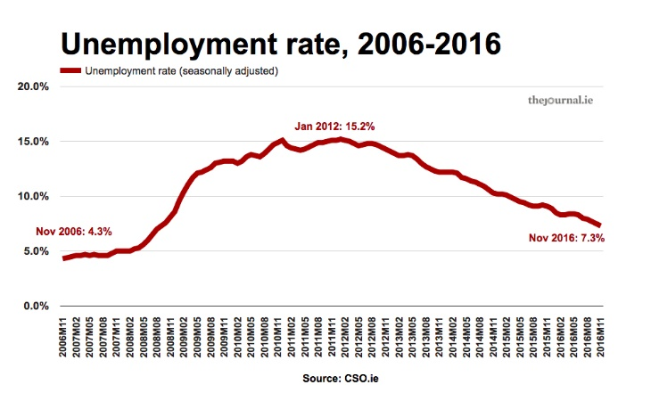

Slide 25
The European Debt Crisis

Slide 26
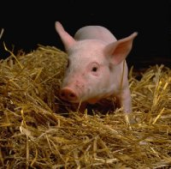
Looking for scape-goats? How about scape-PIIGS?
Portugal
Ireland
Italy
Greece
Spain

Slide 27
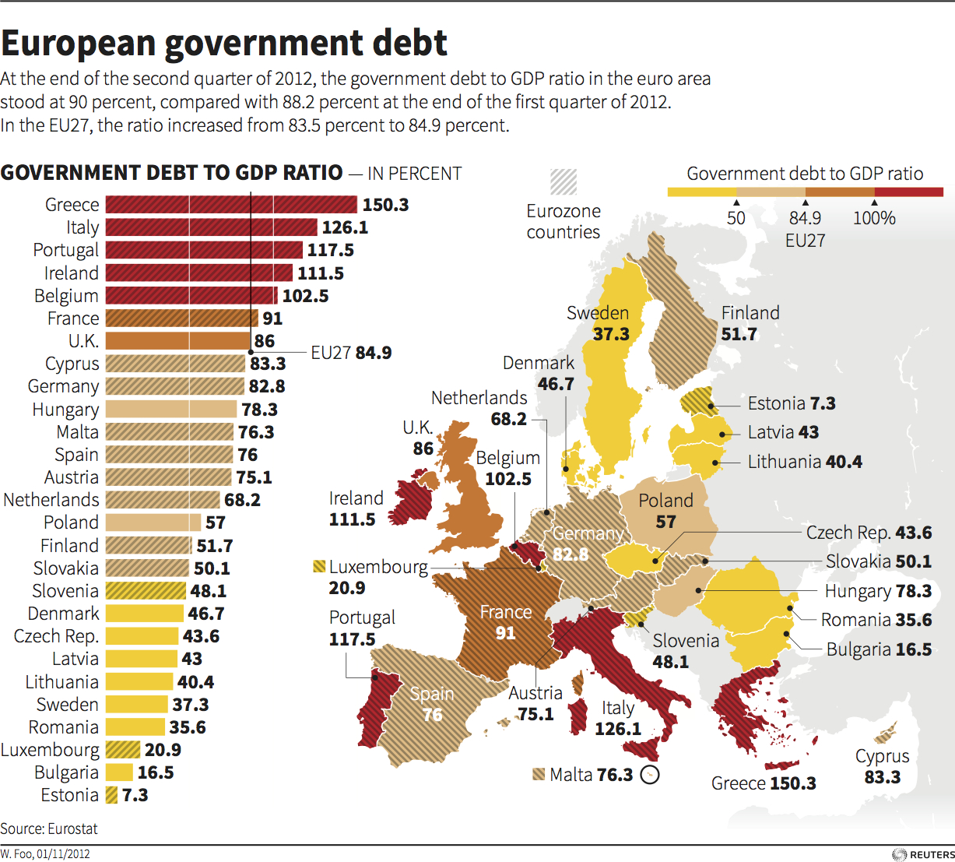

Slide 28
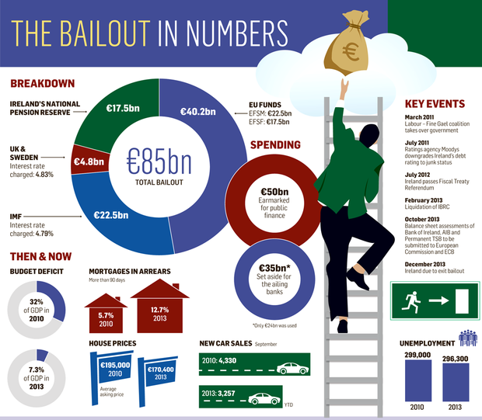

Slide 29
Attracting the multi-nationals
Finance:
Citi, 1996; Deutsche Bank, 1991; HSBC, 2000; State Street, 1996;Mastercard, 2009; PayPal, 2003; and more.
Digital and games:
Google, 2003; Yahoo, 2003; eBay, 2004; Amazon; 2005; Facebook, 2008; Twitter, 2011; LinkedIn, 2010; Electronic Arts, 2010; and Zynga, 2010

Slide 30
Social Welfare Spending

Slide 31
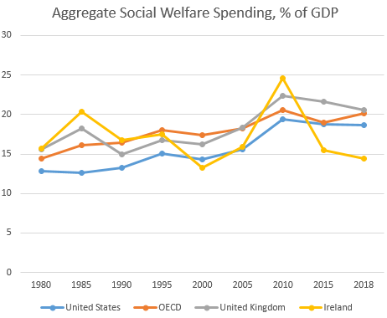

Slide 32
The Problem of Brexit

Slide 33
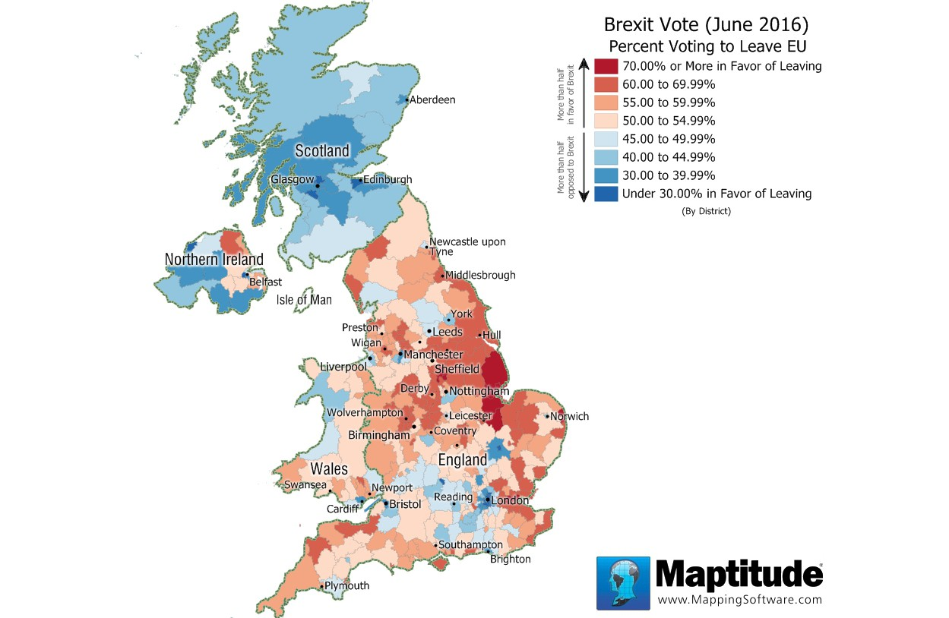

Slide 34
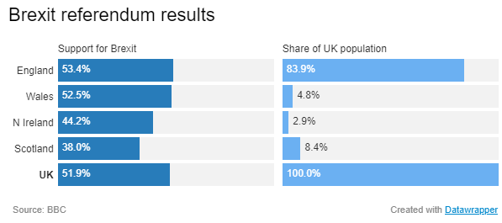

Slide 35
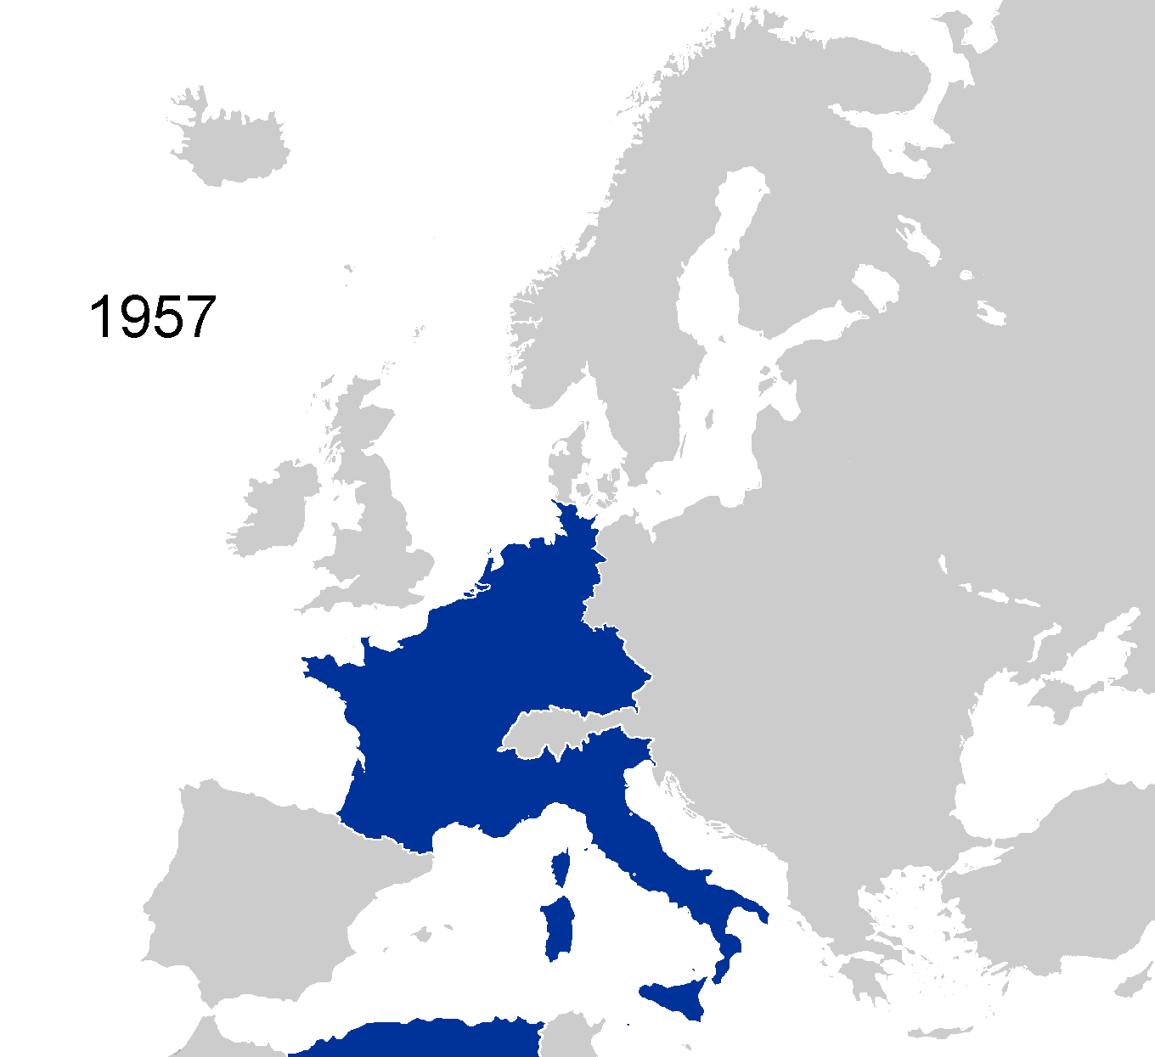

Slide 36
Enlargements (“widenings”)
1973: UK, Ireland and Denmark (9)
1981: Greece (10)
1986: Spain and Portugal (12)
1995: Austria, Sweden, and Finland (15)
Also, a larger Germany since Reunification
2004: 10 countries in central/eastern Europe (25)
2007: Romania and Bulgaria (27)
2013: Croatia (28)

Slide 37
Increasing integration (“deepenings”)
European Monetary System: the “eurozone”
Formation of the European Central Bank
12 of the 27 member states use the euro, €
Removal of border checks → “Schengen zone”
Networks of regional interests across national borders
Common policy in areas like environmental regulation and agricultural policy (CAP).
Beginnings of common military and foreign policy

Slide 38
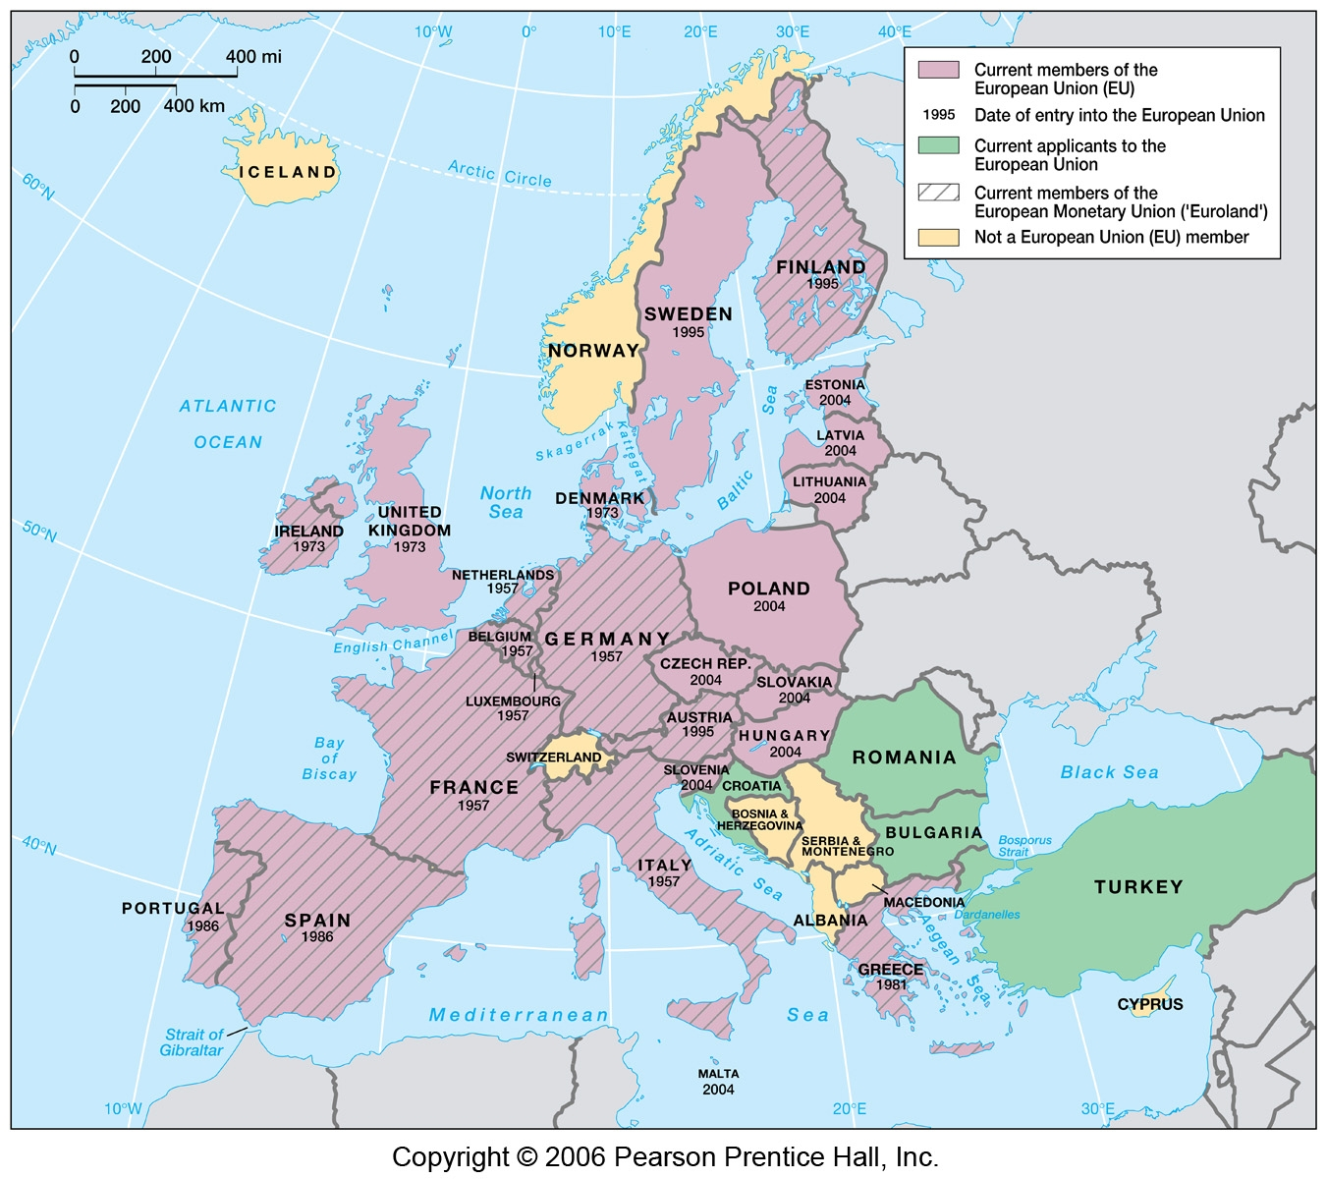


Slide 39
Brexit options:
No-deal deal
Soft Brexit
May retain customs union/common market
Backstop option: to prevent a hard border in Ireland
Another referendum vote

Slide 40
Huge Uncertainties!
Border between Republic and Northern Ireland
Trade agreements between UK/EU and/or UK/EU member countries
Ability for EU citizens to work in the UK and vice versa
Financial settlement UK must make to EU upon leaving

