Slide 1
Ancient settlements and cultures

Slide 2
‘Cheat sheet’ for prehistory
Mesolithic Ireland (8000BC-4000BC)
Hunter-gatherers
Neolithic Ireland (4000BC-2500BC)
Agriculture, husbandry, and surviving monumental passage tombs like Newgrange
Bronze Age Ireland (2500BC-500BC)
Weapons, tools, and fine gold-smithing
Iron Age Ireland (c. 500BC-400AD)
Arrival of the Celts
Conversion to Christianity beginning c 431 AD
The “Golden Age” of monastic life, 500-795 AD

Slide 3
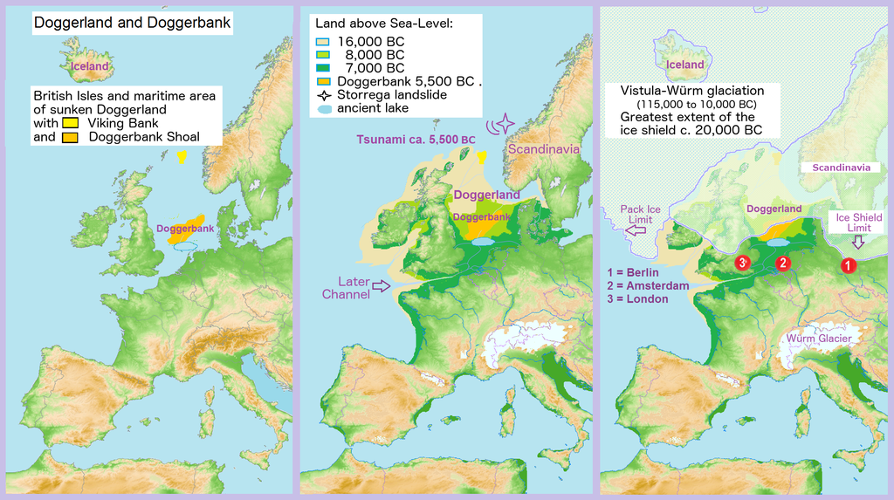
Doggerland

Slide 4
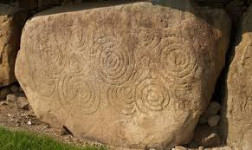
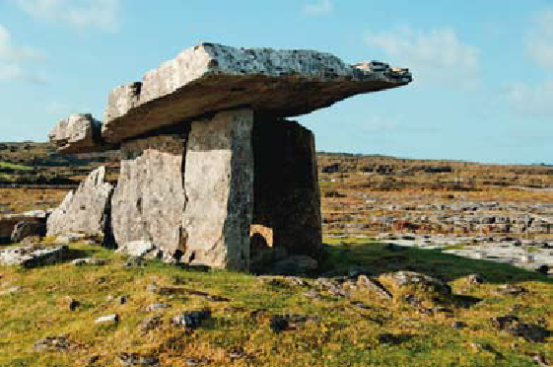
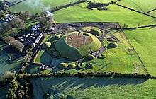
Neolithic farmers

Slide 5
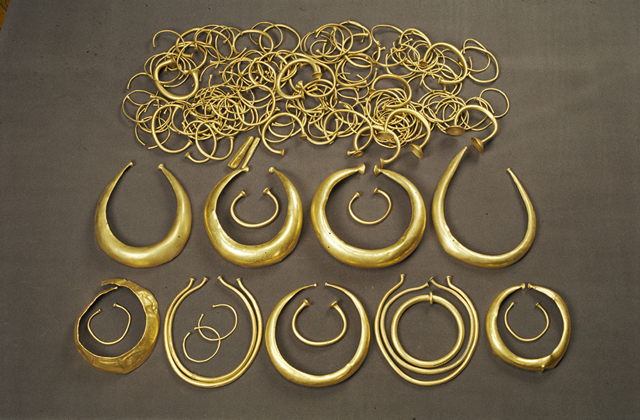
Bronze Age metalwork

Slide 6
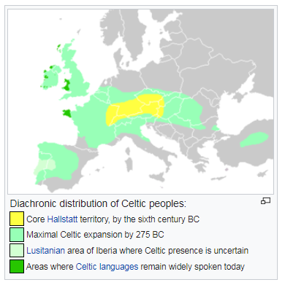
The Celtic invasion, c. 500-275 BC

Slide 7
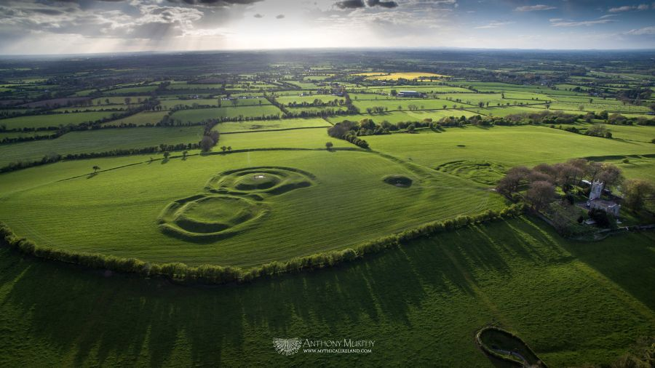
Celtic earthworks: the Hill of Tara

Slide 8
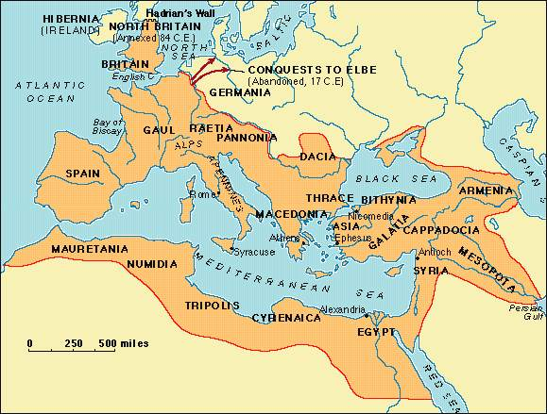
Maximum extent of Roman Empire

Slide 9
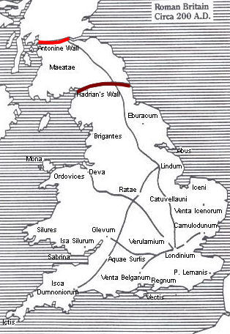
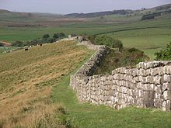
Defending the Roman Empire

Slide 10
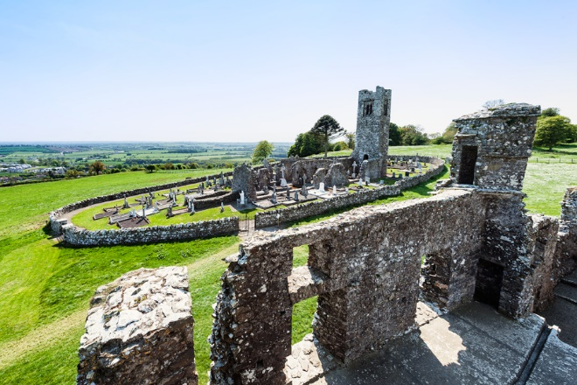
Irish Christianity beginning c 431

Slide 11
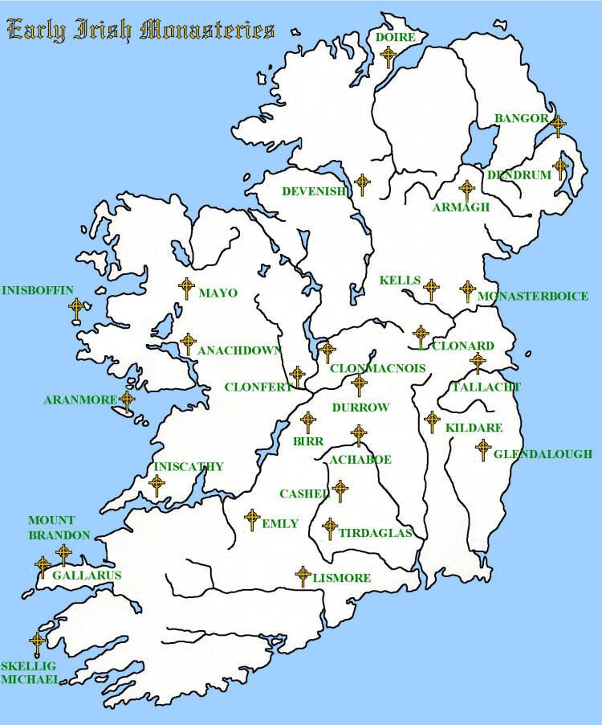
Monasteries

Slide 12
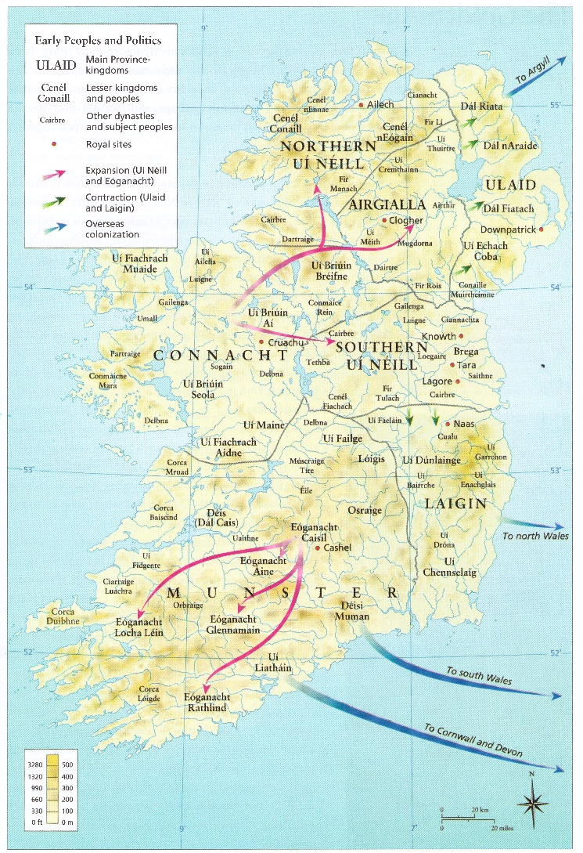
Politics of territorial organization

Slide 13
Waves of invasion: Vikings, Normans, and Scots/British

Slide 14
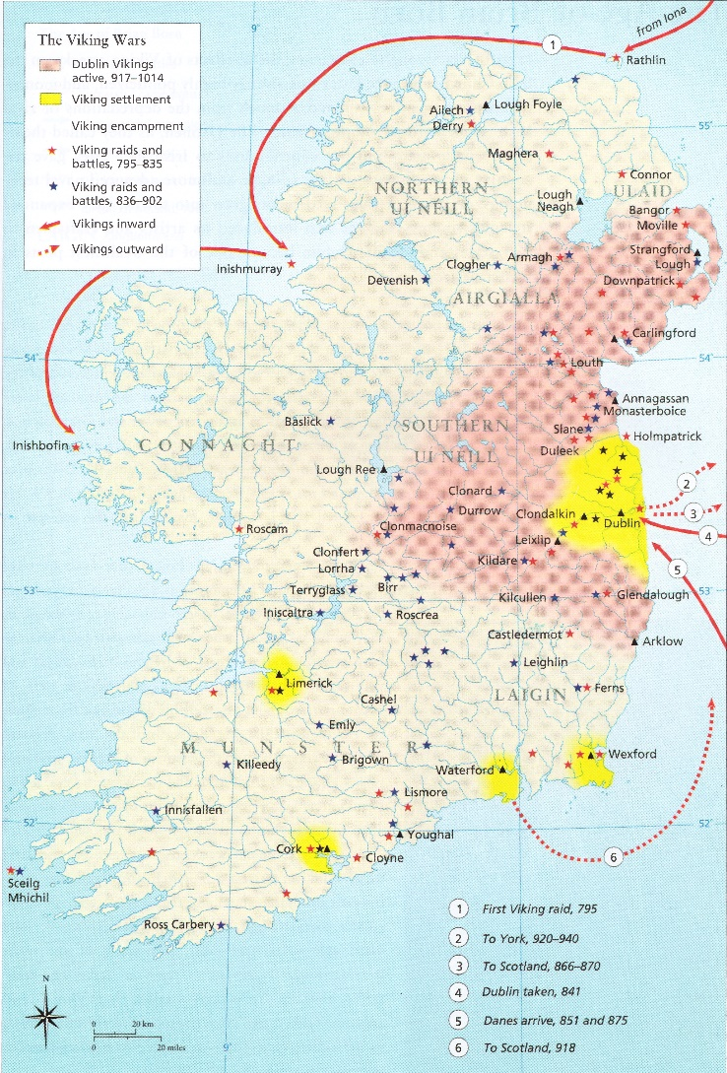
Viking invasions

Slide 15
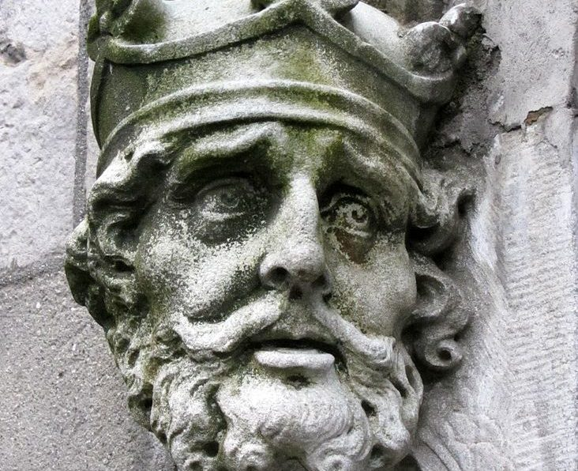
Brian Boru, high king and Emperor

Slide 16
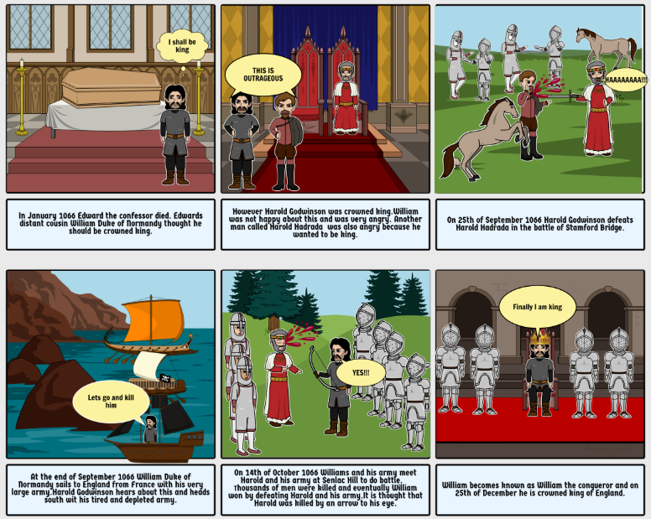

Slide 17
1155: Pope Adrian IV:
“We regard it as pleasing and acceptable to us that you should enter that island [Ireland] for the purpose of enlarging the boundaries of the Church, checking the descent into wickedness, correcting morals and implanting virtues, and encouraging the growth of the faith of Christ…and that the people of that land receive you honorable and respect you as their lord.”

Slide 18
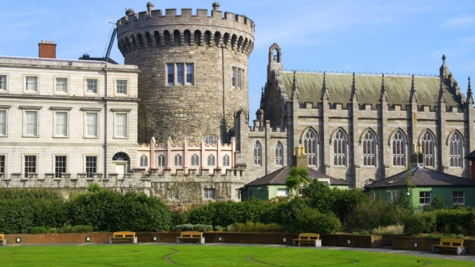
Dublin Castle

Slide 19
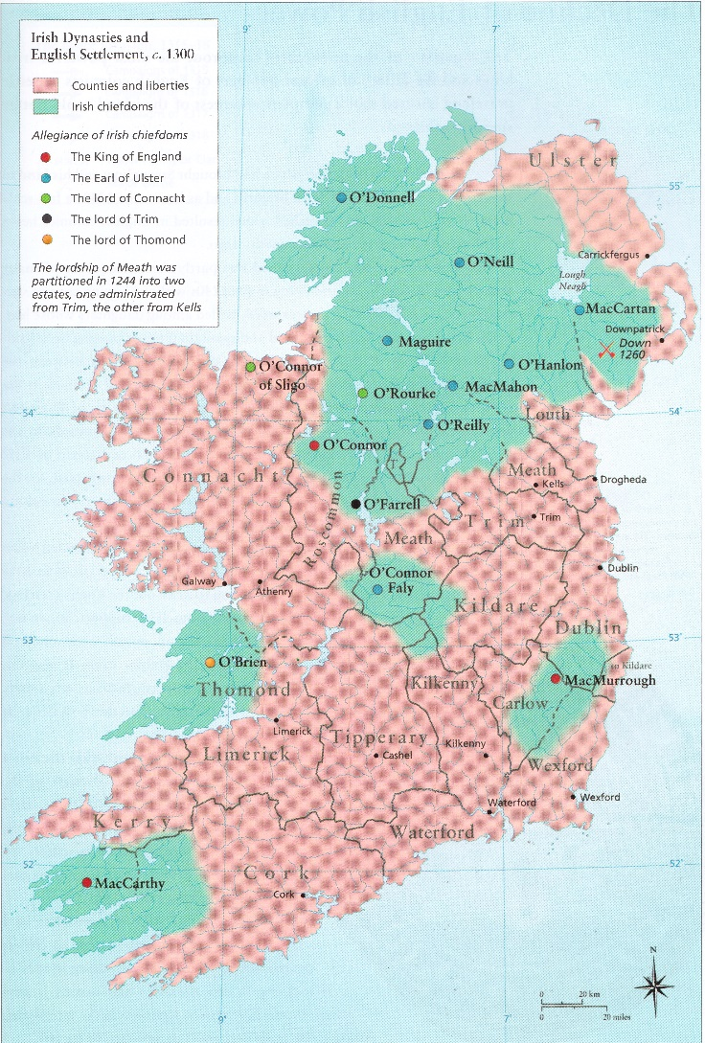
Shifting alliances

Slide 20
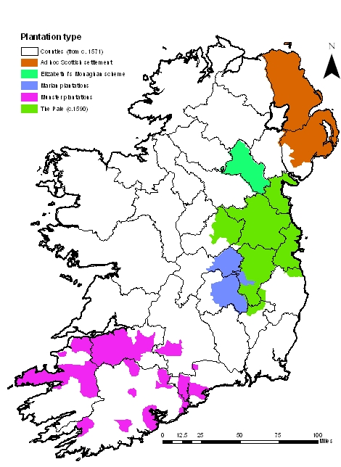
Tudor and Stuart Plantations

Slide 21
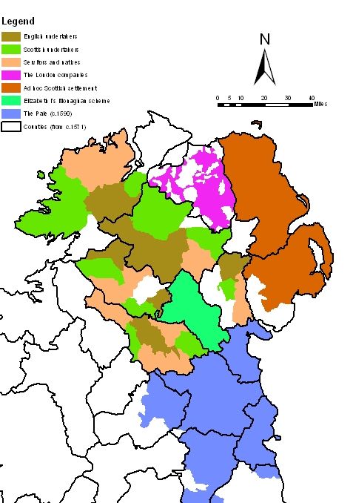
Ulster Plantations 1603-1613

Slide 22
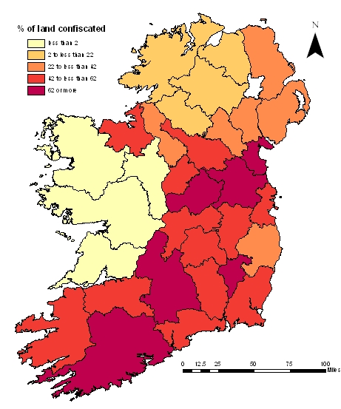
Cromwell’s land seizures

Slide 23
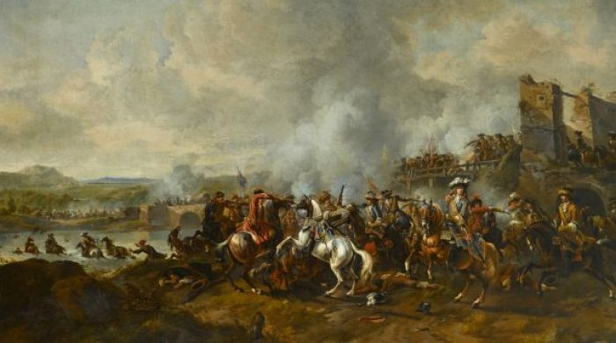
Battle of the Boyne, 1690

Slide 24
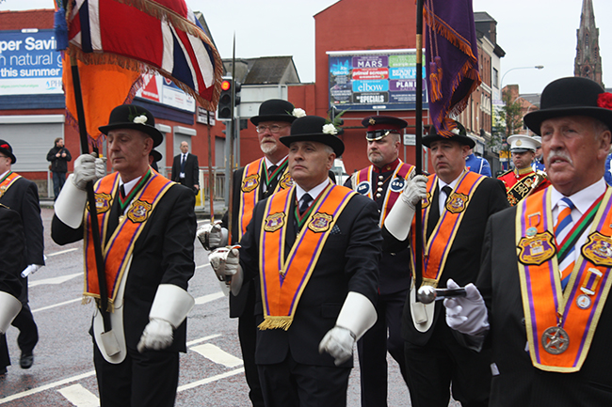
Orange Order

Slide 25
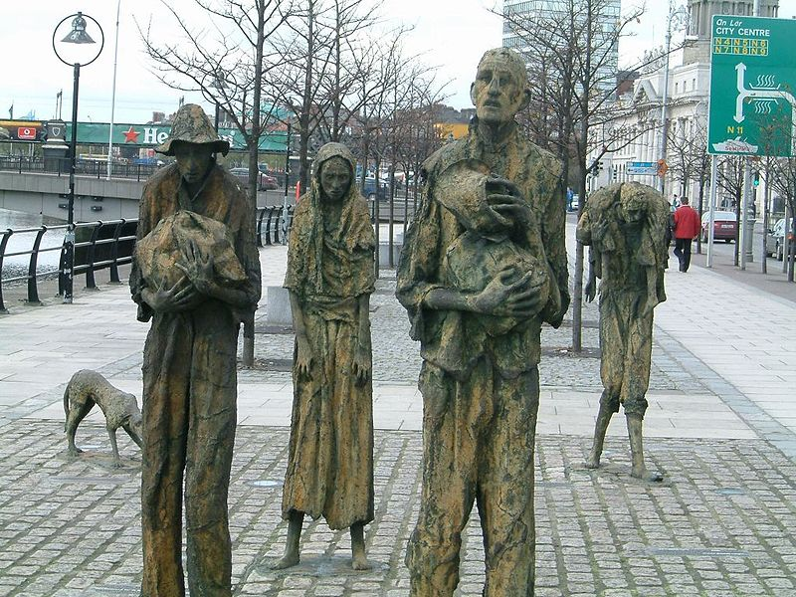
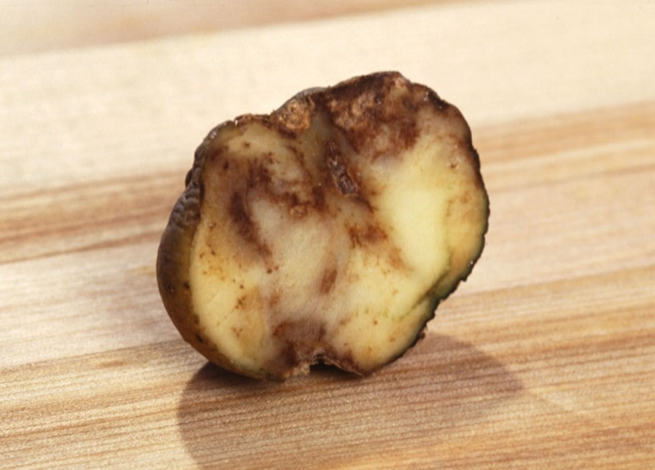
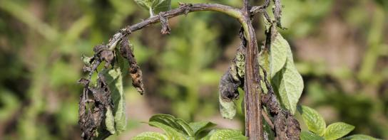
Great Famine 1845-51

