Slide 1
Introduction:
The Netherlands in European Context

Slide 2
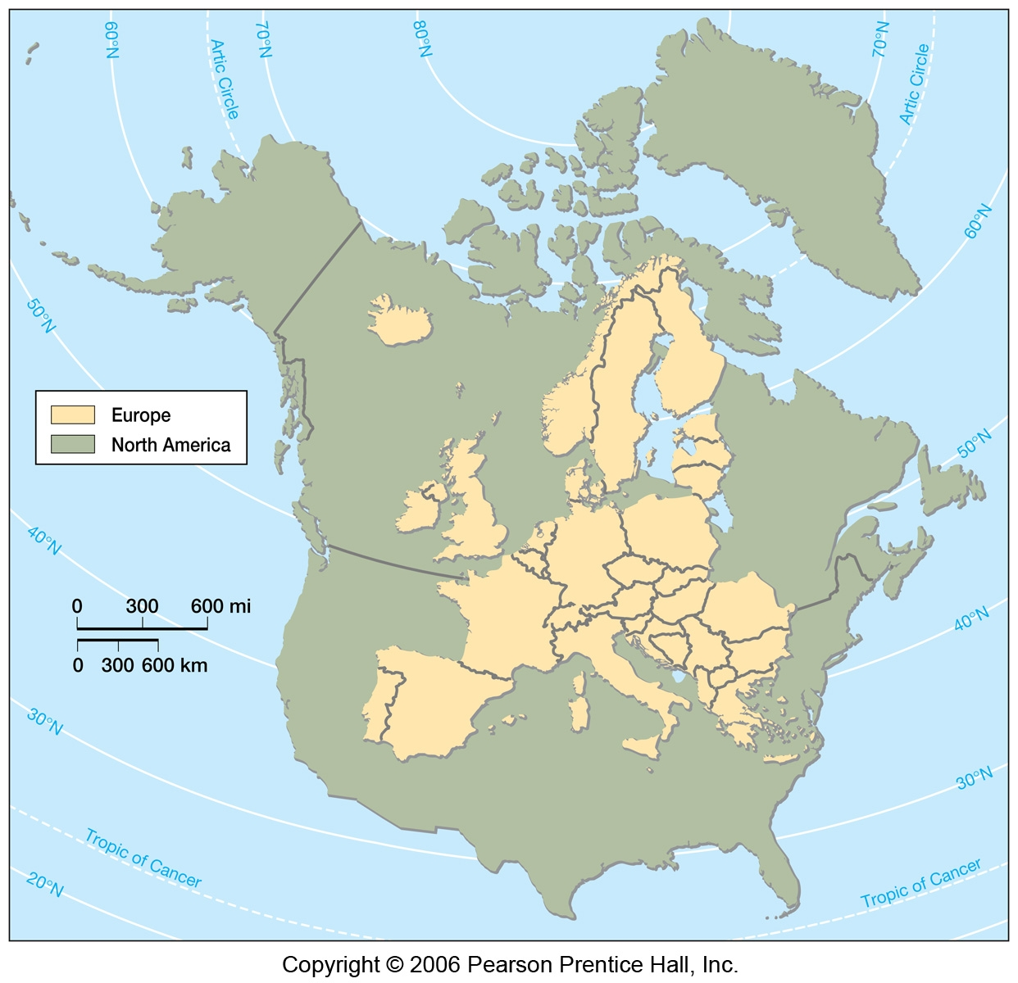
North America
and Europe
Same
scale and latitude

Slide 3
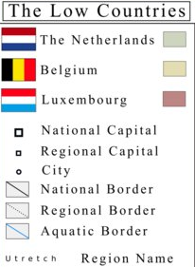
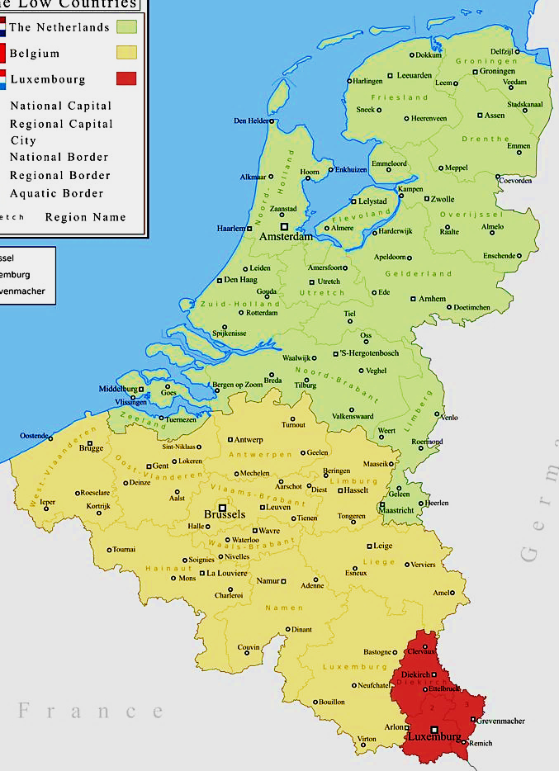

The Low Countries
https://cjr413.deviantart.com/art/The-Low-Countries-Political-Map-741451199

Slide 4
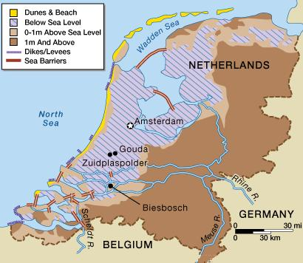
Land Elevation and Reclamation

Slide 5
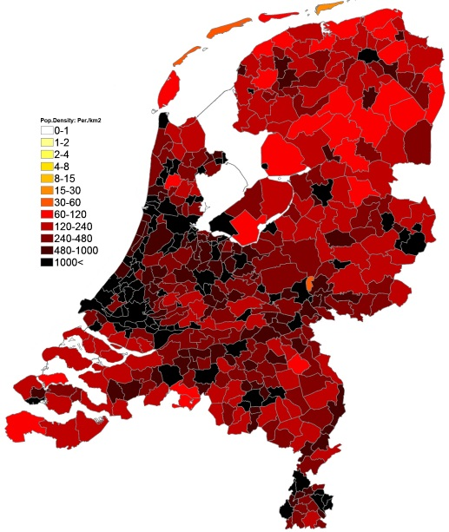
Population Density (2014) (pop/Km²)
http://popdensitymap.ucoz.ru/news/60_population_density_administrative_boundaries_map_of_netherlands/2014-09-22-73

Slide 6
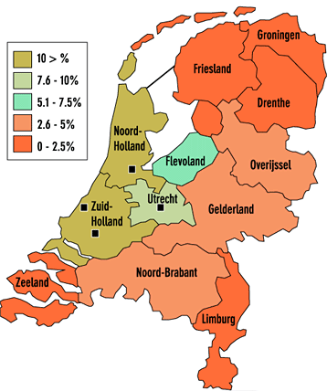
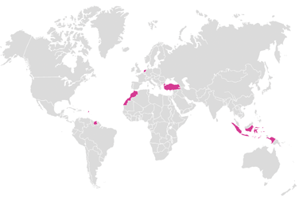
Percent recent non-European immigrants living in Netherlands
The Netherlands and the five most important (non-Western) migration countries. The majority of non-Western immigrants come originally from Turkey, Surinam, Morocco and Western Sahara, and the Netherlands Antilles and Aruba (people from the former Dutch Indies, Japan and Indonesia are considered ‘Western’)
https://www.ucl.ac.uk/dutchstudies/an/SP_LINKS_UCL_POPUP/SPs_english/multicultureel_gev_ENG/pages/allochtonen.html

Slide 7
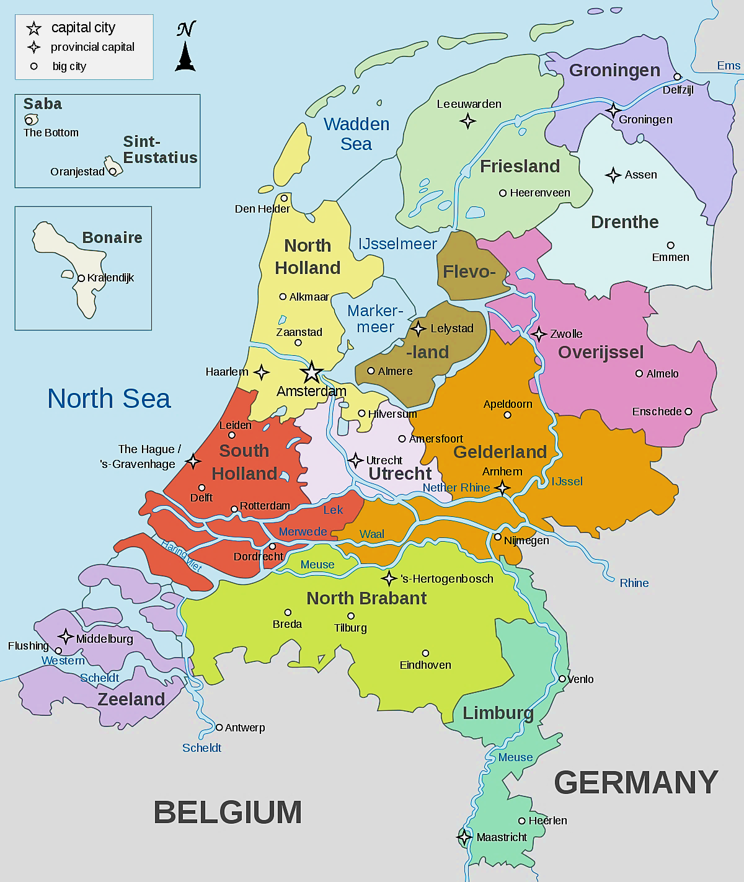
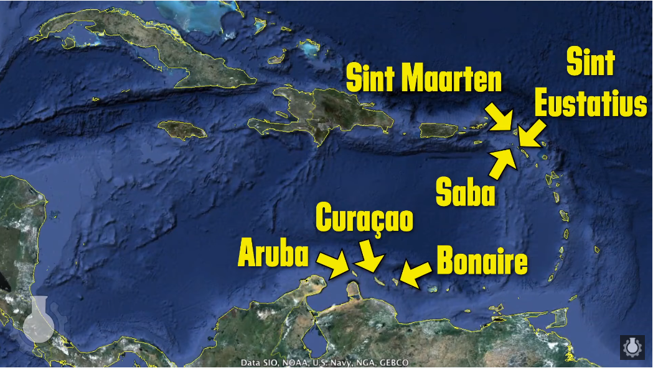
The Kingdom of The Netherlands:
12 Provinces
in Europe and
6 affiliates in the Dutch Caribbean

Slide 8
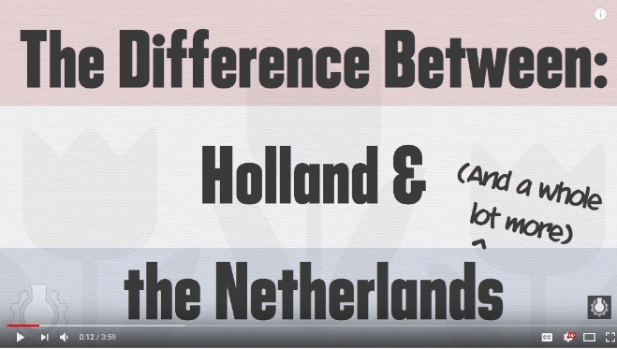
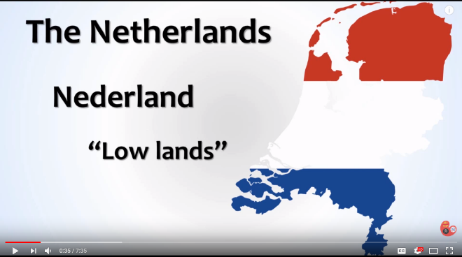
Political Subdivisions and Territories
https://www.youtube.com/watch?v=eE_IUPInEuc
runtime 4:00
https://www.youtube.com/watch?v=R-VDmZ1t2Ik
runtime 7:35

Slide 9
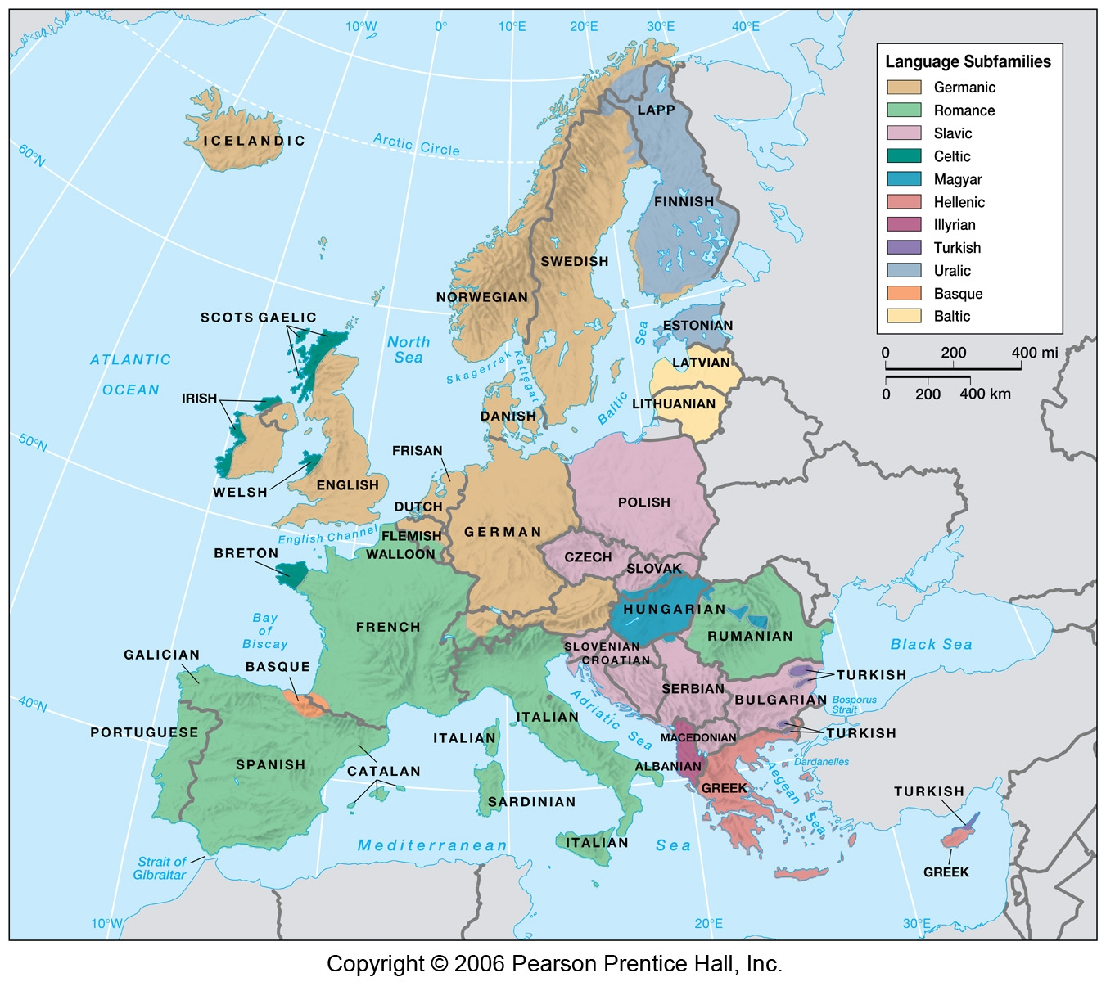
Political Subdivisions and Territories

Slide 10
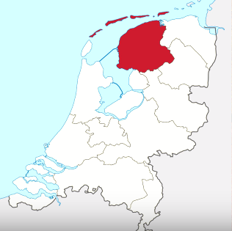
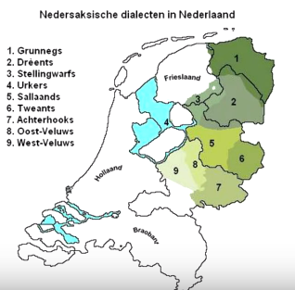
Related languages and dialects
Friesian and Limburgish
Low Saxon
Friesian
Limburgish

Slide 11
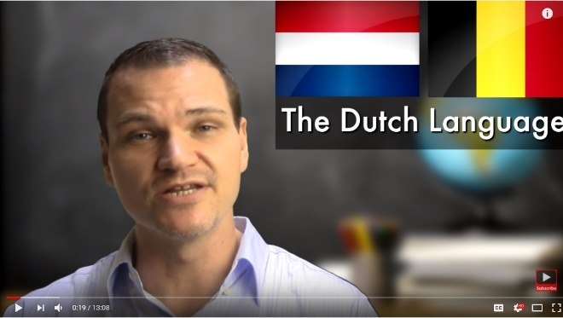
Language Families,
History and Development
Plus some grammar and pronunciation
https://www.youtube.com/watch?v=rBbQW1KzWQA
runtime 13:00

Slide 12
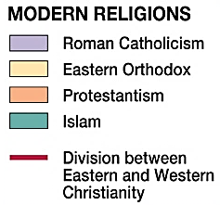
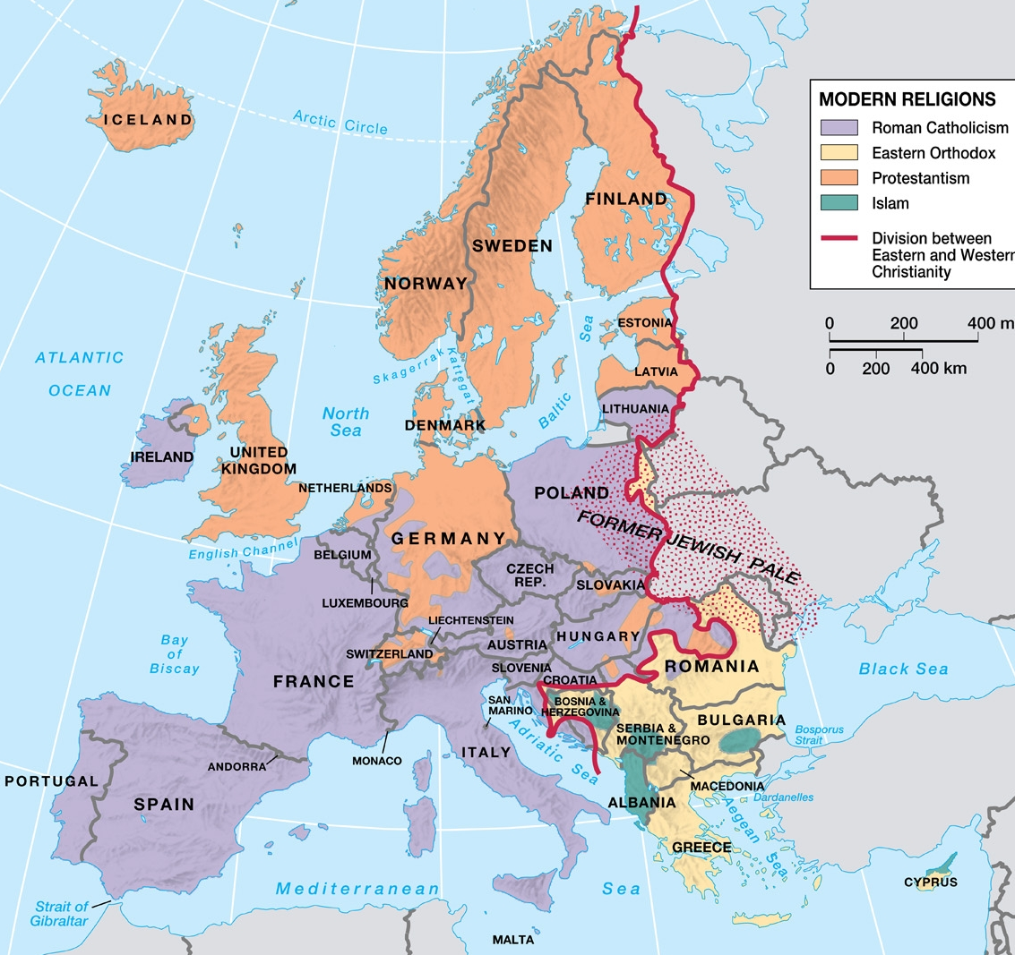
Modern Religions in Europe

Slide 13
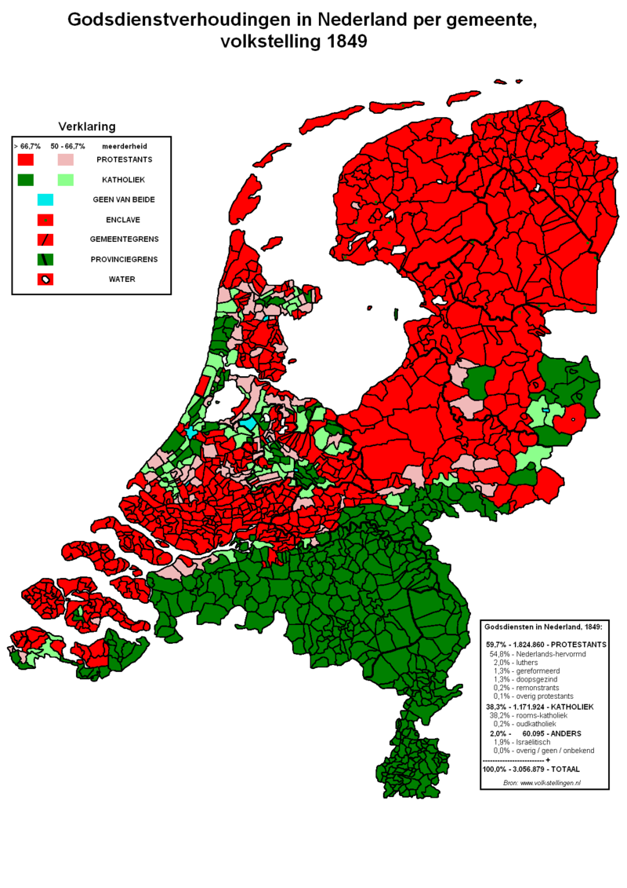
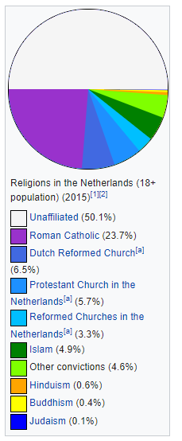
Religion, then and now
2015
Unaffiliated
Protestant
Catholic
1849

Slide 14
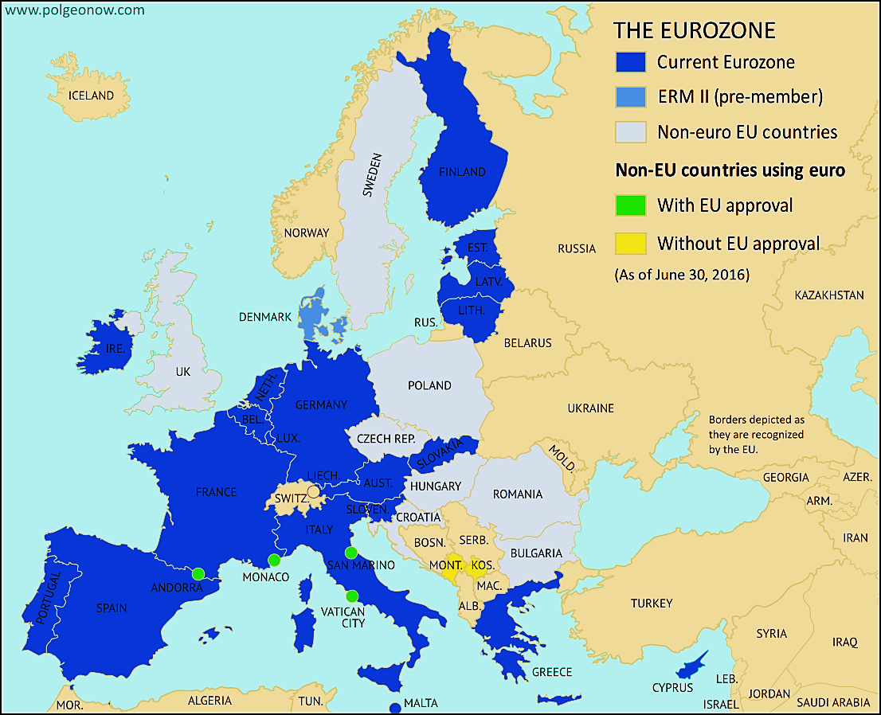
http://www.polgeonow.com/2014/08/map-which-countries-use-euro-plus-this.html

Slide 15
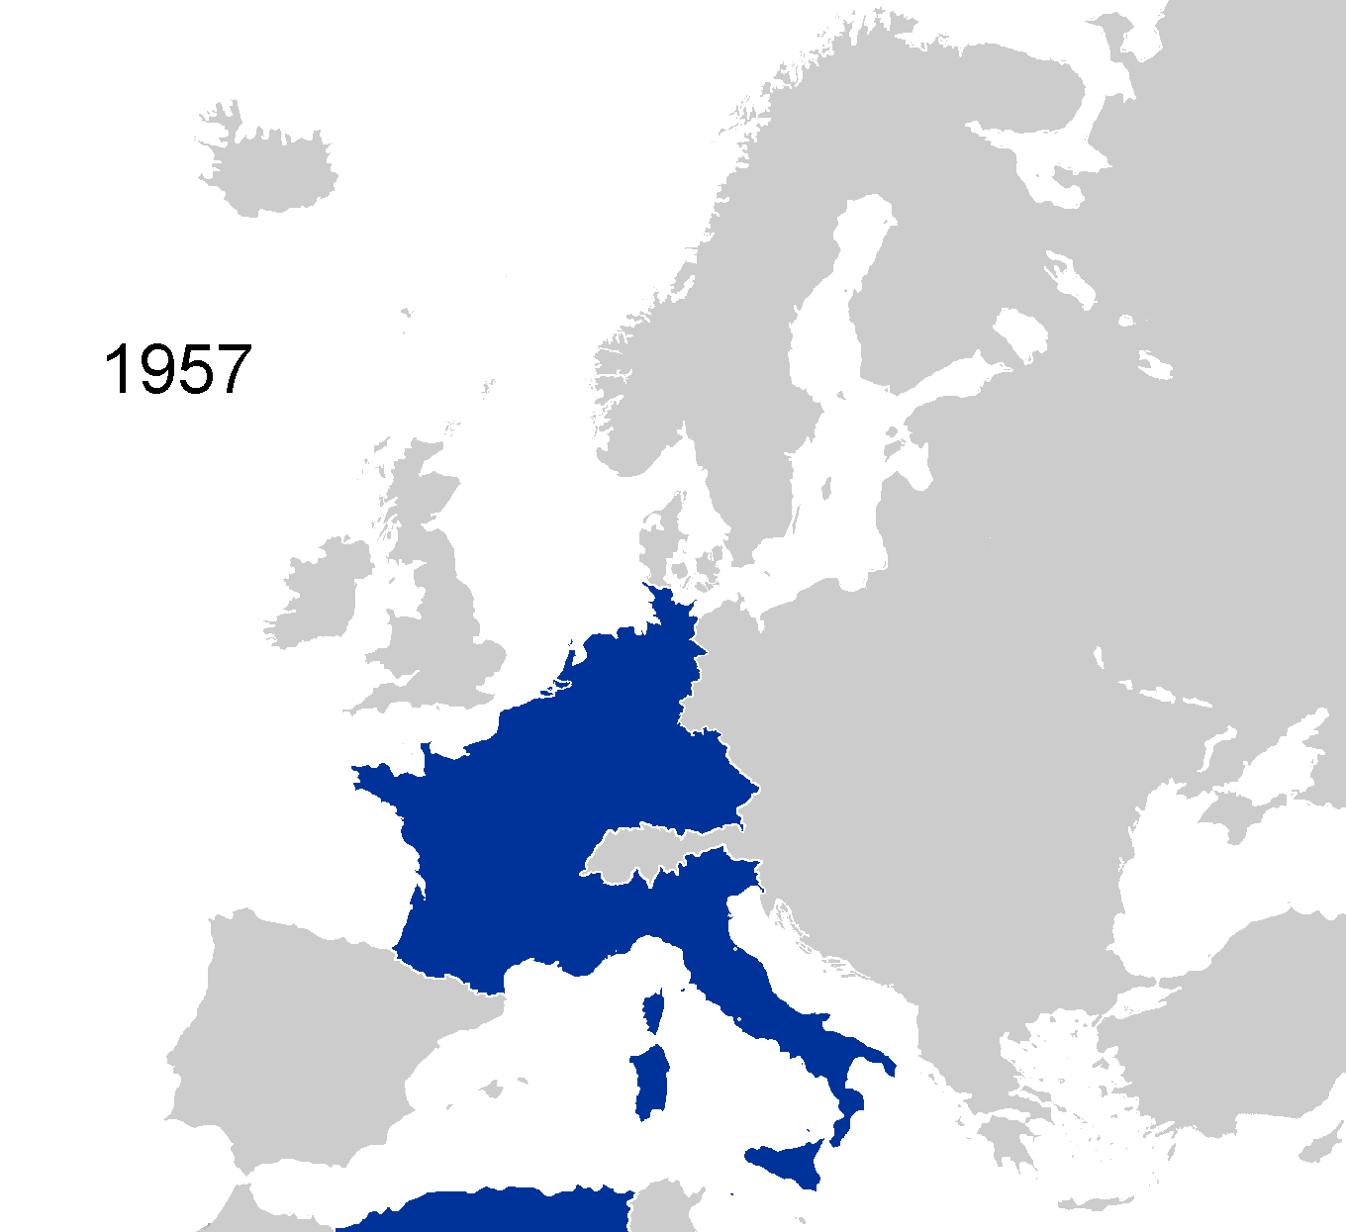
EU Timeline

Slide 16
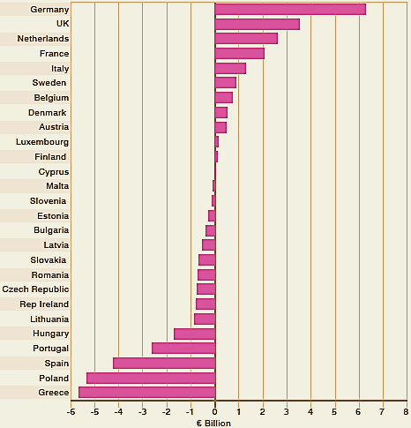
EU Net Contributions/Receipts, 2007
Givers
Takers

Slide 17
Labor Force by Economic Supersector

Slide 18
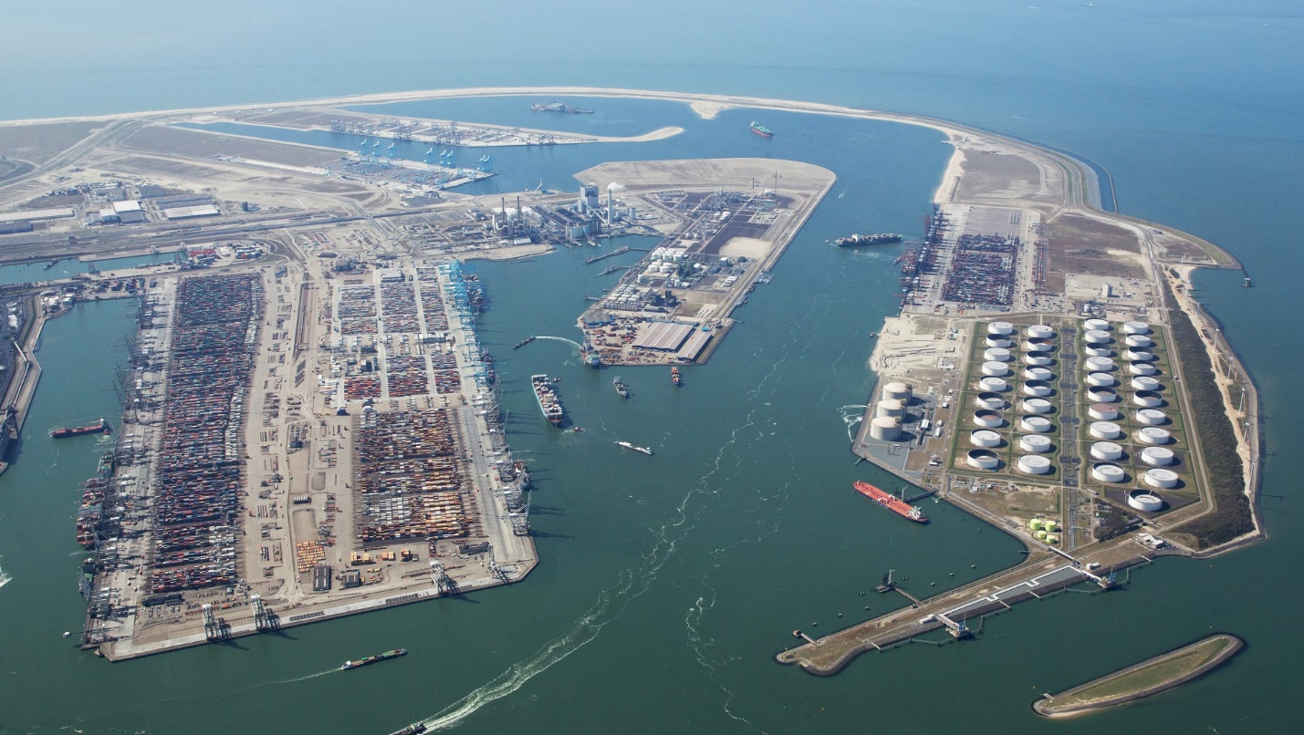
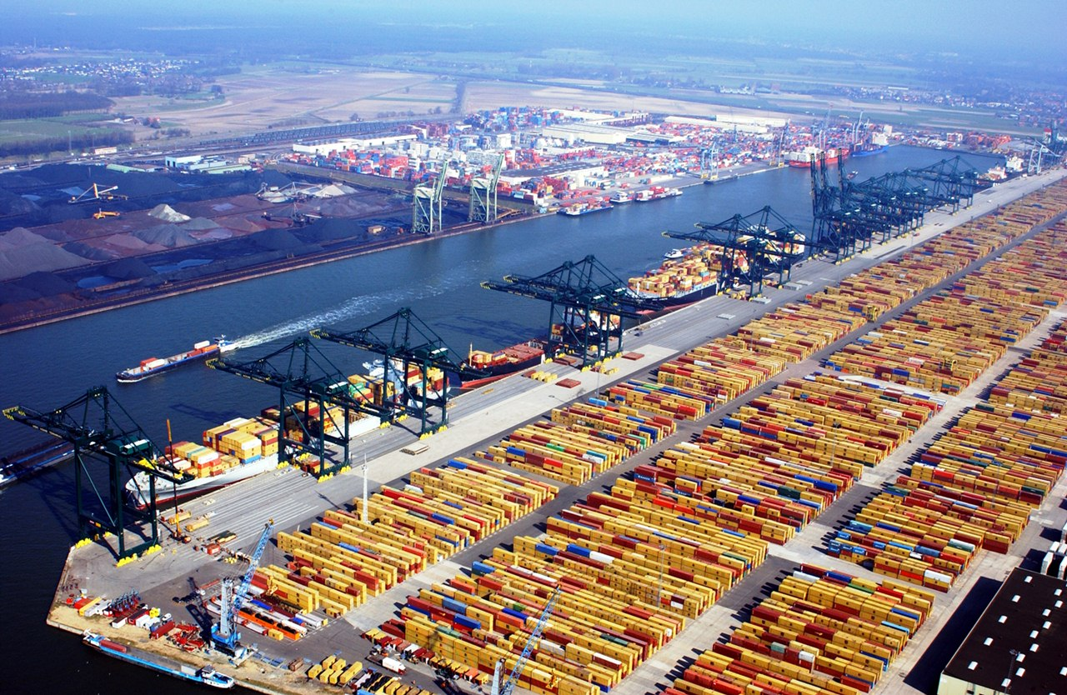
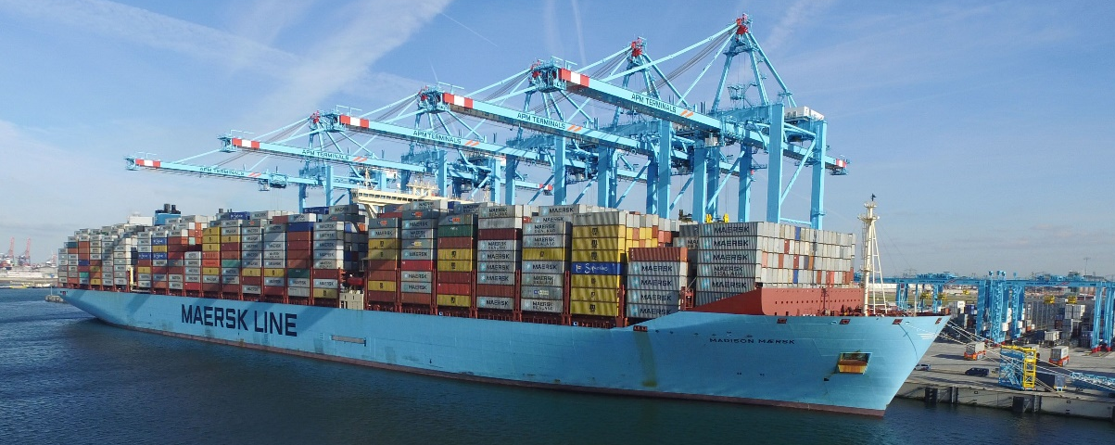
Port of Rotterdam
`
Europe’s largest port

Slide 19
END SHOW

Slide 20
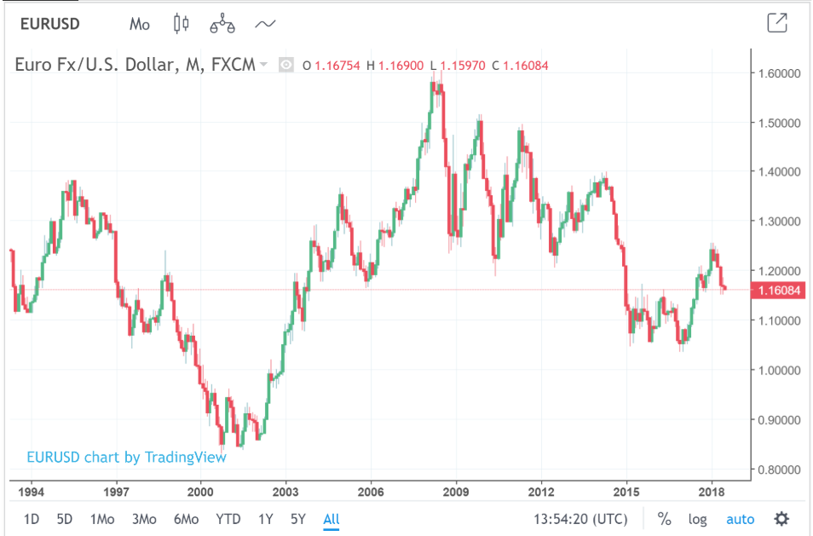

Slide 21
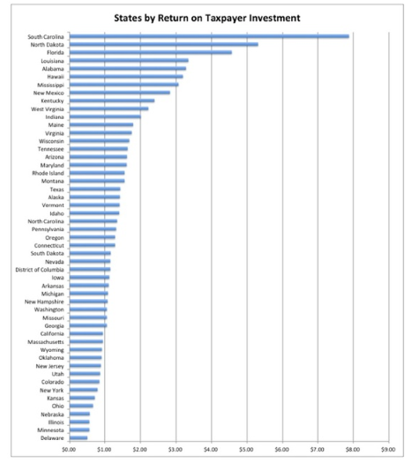

Slide 22
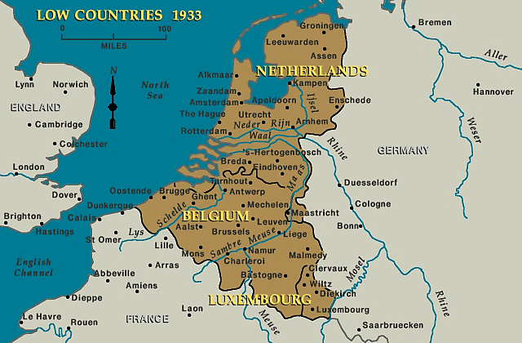
The Low Countries

Slide 23
