Slide 1
Physical and Environmental
Geography of the Netherlands

Slide 2
Physical Geography Takeaways
The Netherlands is one of the most altered landscapes in the world
From a place not at all well-suited for human settlement, the Dutch were able to make one of the most powerful and expansive countries in Europe.
That power is no match for the power of nature!

Slide 3
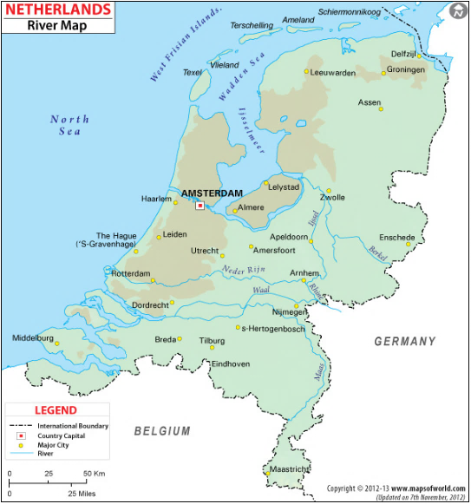

Slide 4
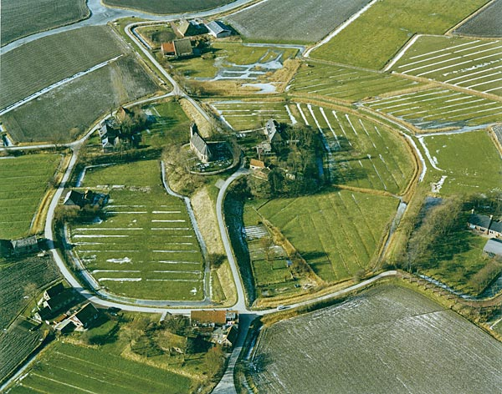
Terp, Friesland

Slide 5
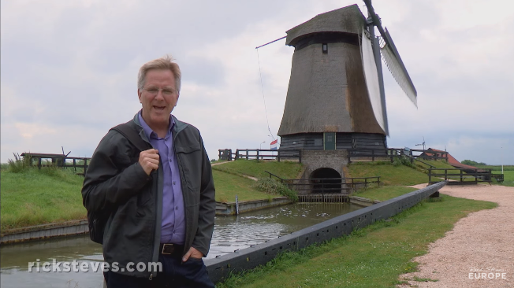
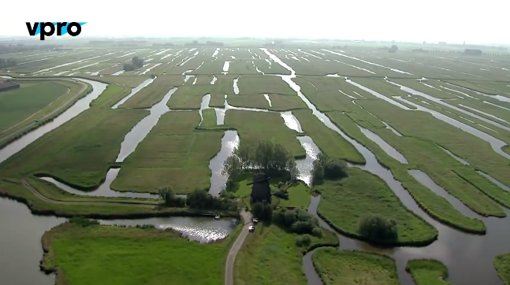
Reclaiming the Land
https://www.youtube.com/watch?v=n3Dzz0vSabI
runtime 3:38
https://www.youtube.com/watch?v=NQKbTWnSOYo
runtime 1:25

Slide 6
Water Management

Slide 7
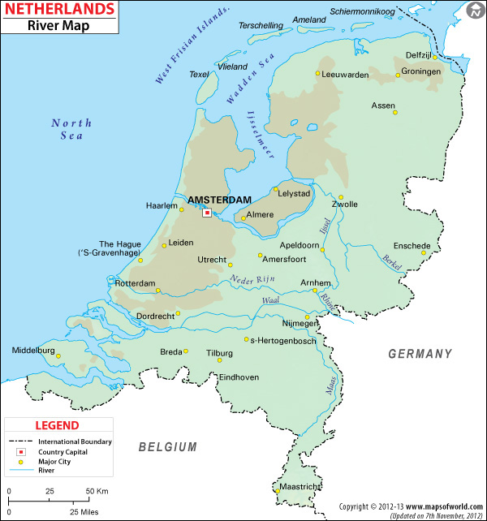
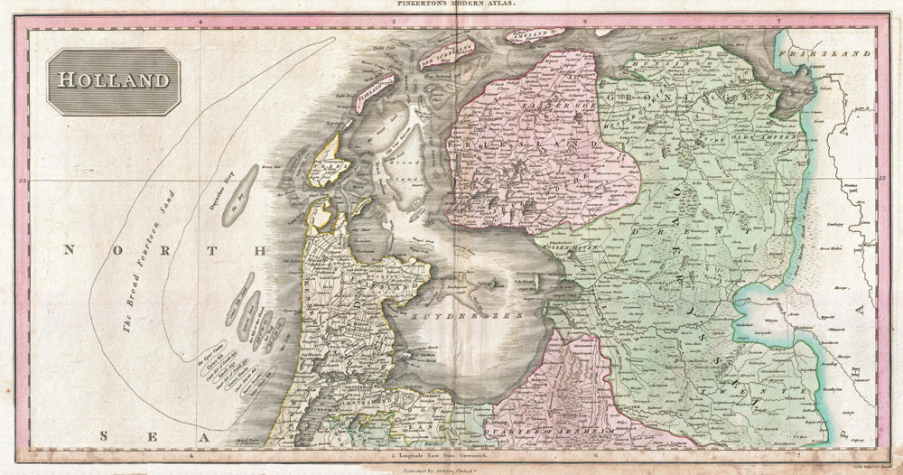
Zuider Zee to Ijsselmeer
https://skutsjezonderzorg.blogspot.com/2016/06/the-old-zuiderzee-coast.html

Slide 8
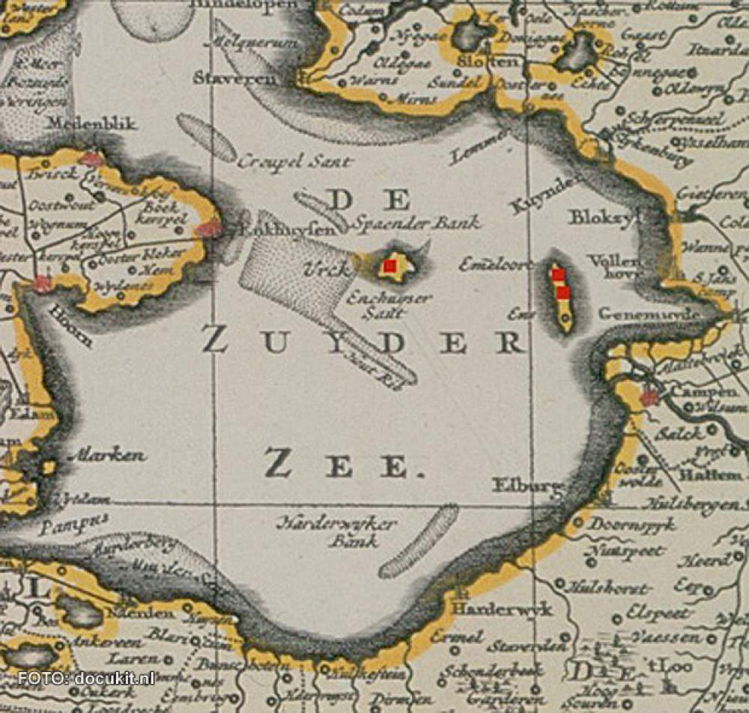
Zuider Zee to Ijsselmeer

Slide 9
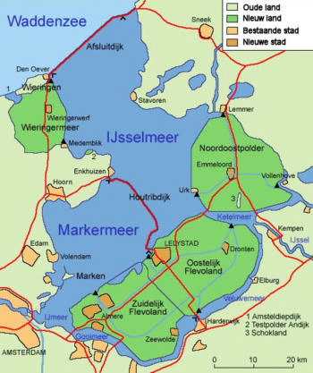
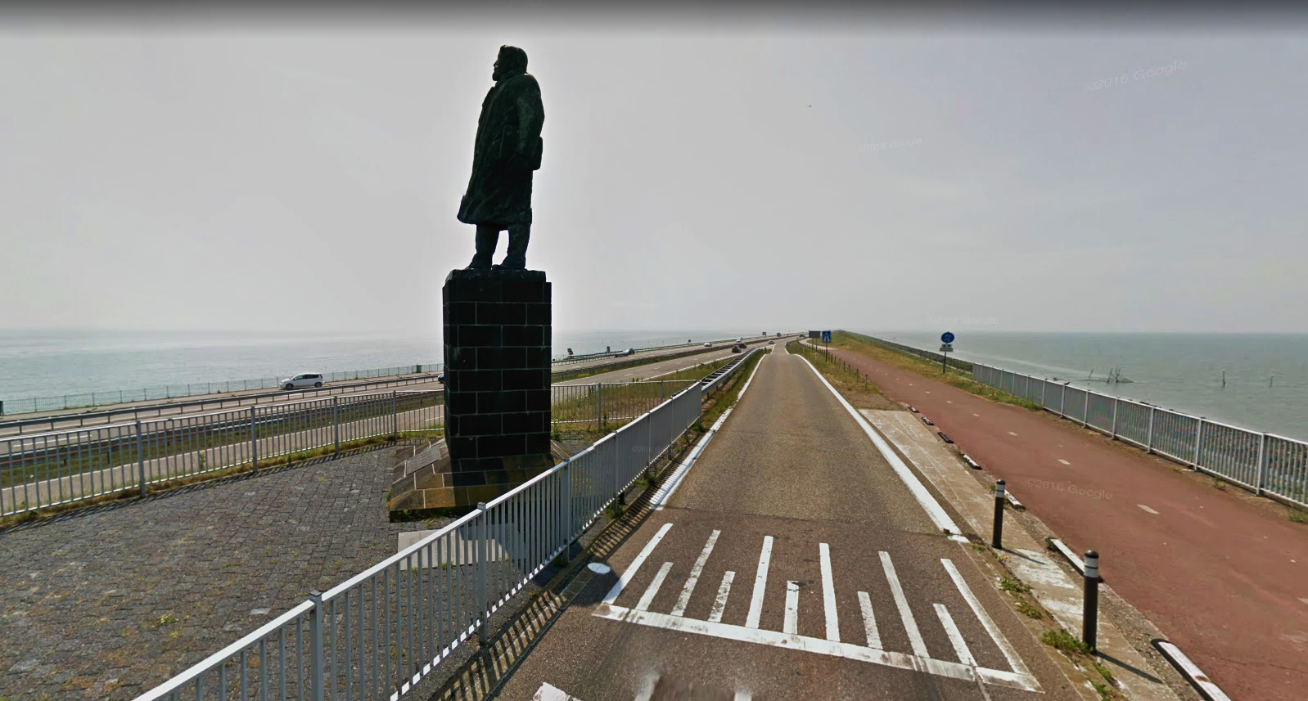
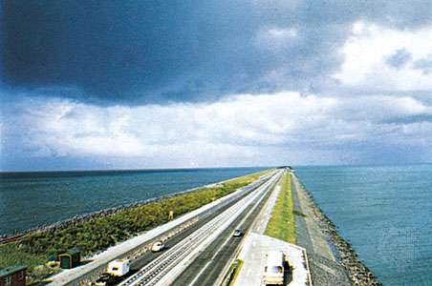
Zuider Zee to Ijsselmeer

Slide 10
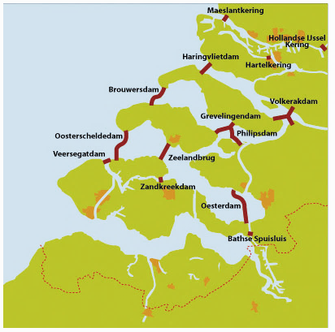
Delta Works – 1937 plan

Slide 11
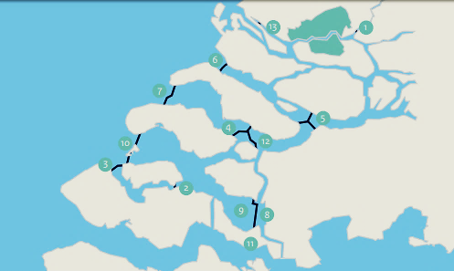
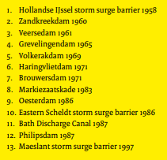
Delta Works – 1958 plan

Slide 12
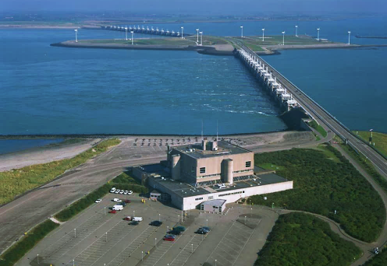
Eastern Scheldt storm surge barrier

Slide 13
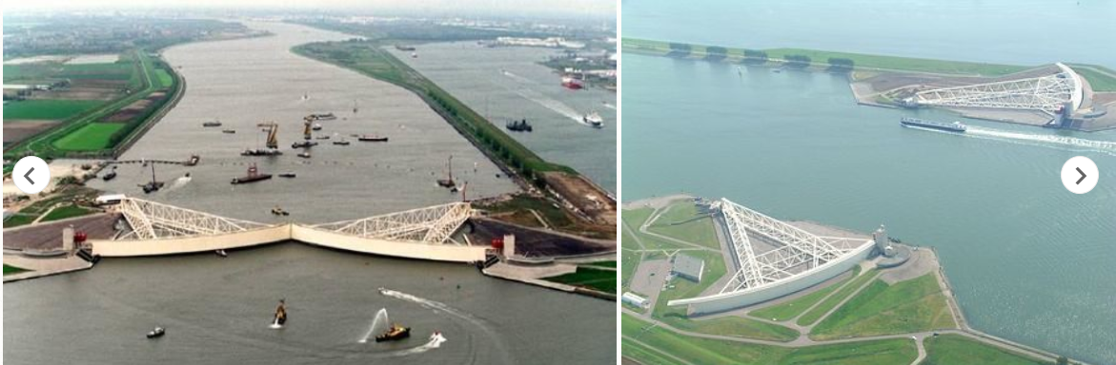
Maeslantkering barrier near Rotterdam

Slide 14
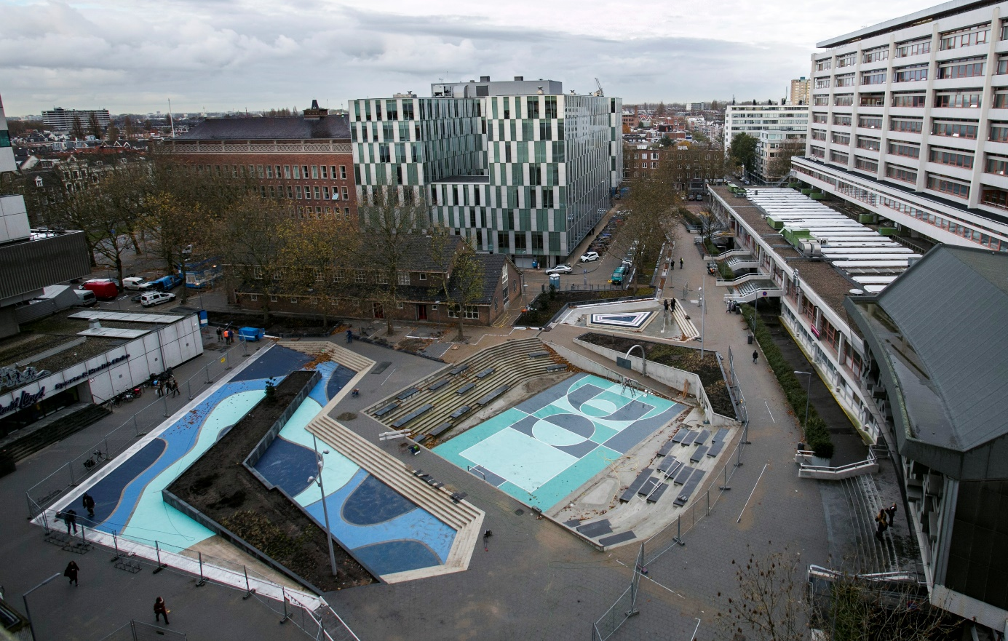
Benthemplein, Rotterdam
http://stormwater.wef.org/2014/03/first-full-scale-water-square-opens-rotterdam/

Slide 15
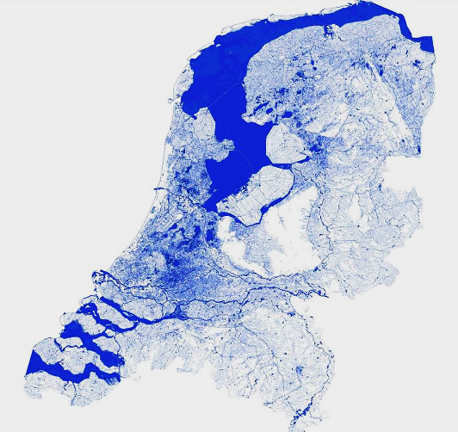
Waterways Map of
The Netherlands
https://imgur.com/gallery/GSv7L

Slide 16
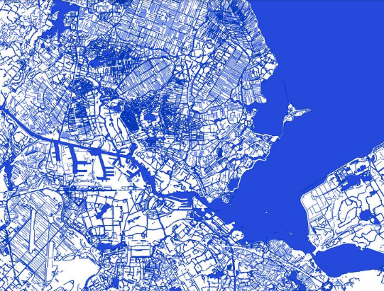
Waterways Map
Amsterdam Detail
https://imgur.com/gallery/GSv7L

Slide 17
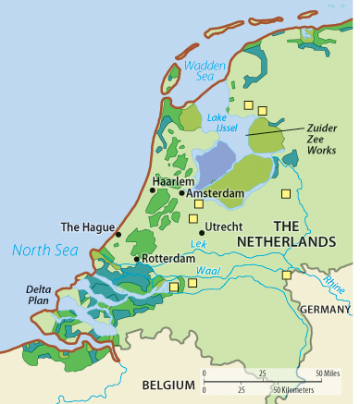
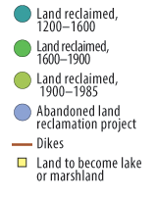
Land Reclamation History
Source: https://content.openclass.com/eps/pearson-reader/api/item/33c1ac75-46ce-4867-ae30-5281538f14a6/1/file/RubensteinCHG3-071415-MB/OPS/s9ml/chapter01/filep7000496834000000000000000000869.xhtml

Slide 18
Landforms and Ecosystems

Slide 19
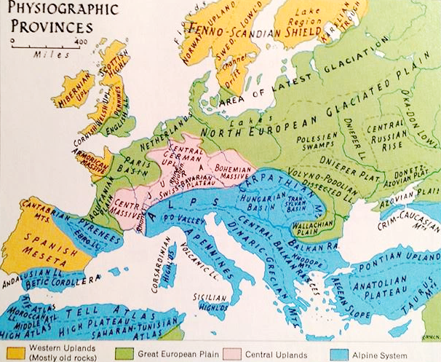
Landscape Regions
Northern European Plain
  Polders in Netherlands
Central Uplands
  Mineral resources
Alpine System
  Carpathians, Alps, Pyrenees, Apennines
Western Highlands
  UK, Scandinavia;
  Fjords

Slide 20
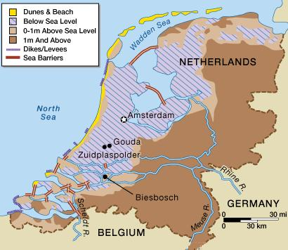
Topography and Elevation

Slide 21
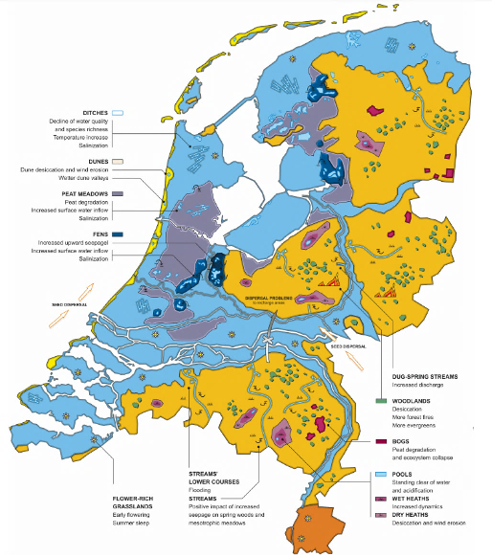
Climate Change Impacts:
Water and Natural Ecosystems
Source: P. M. Witte et al. (2012). An ecohydrological sketch of climate change impacts on water and natural ecosystems for the Netherlands: Bridging the gap between science and society. Hydrology and Earth System Sciences. 16. 3945-3957. 10.5194/hess-16-3945-2012.

Slide 22
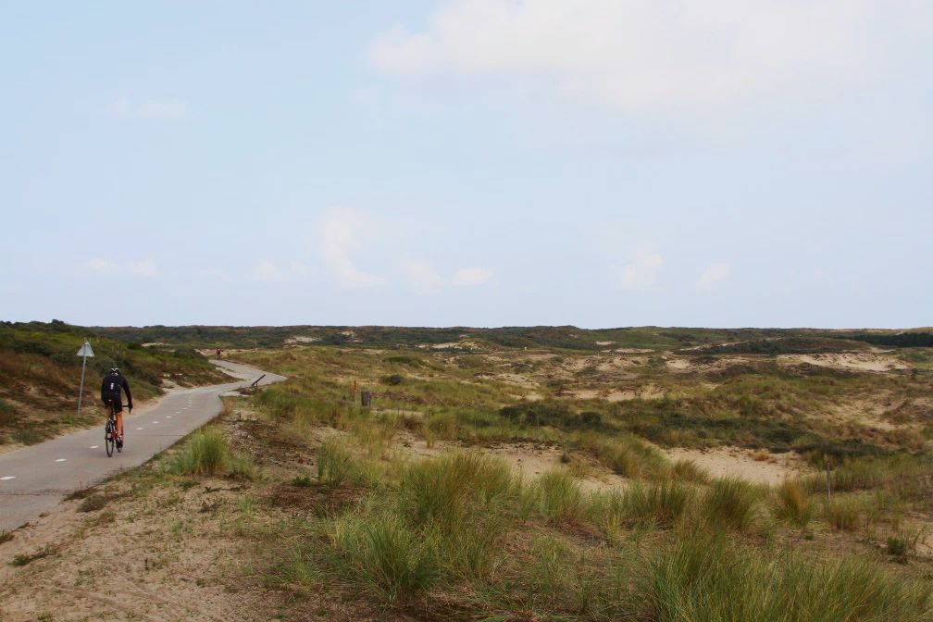
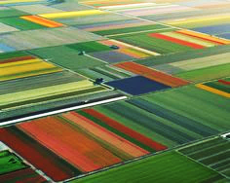
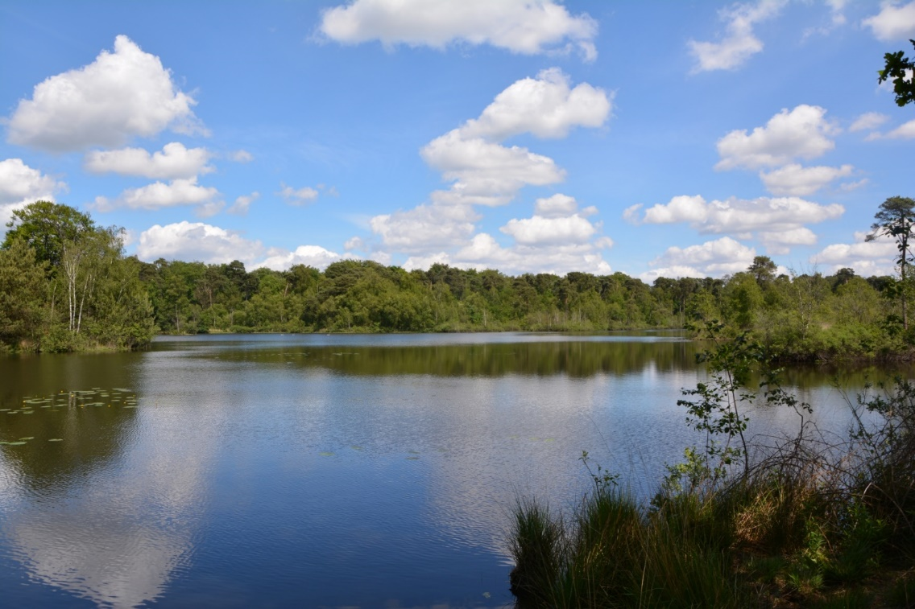
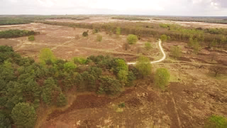
Dune
Polder
Forest Lake
Heath

Slide 23
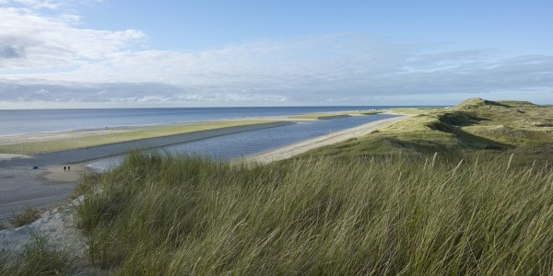
Mimicking Nature: Building Dunes
http://west8.com/projects/hondsbossche_and_pettemer_zeewering/

Slide 24
Climate

Slide 25
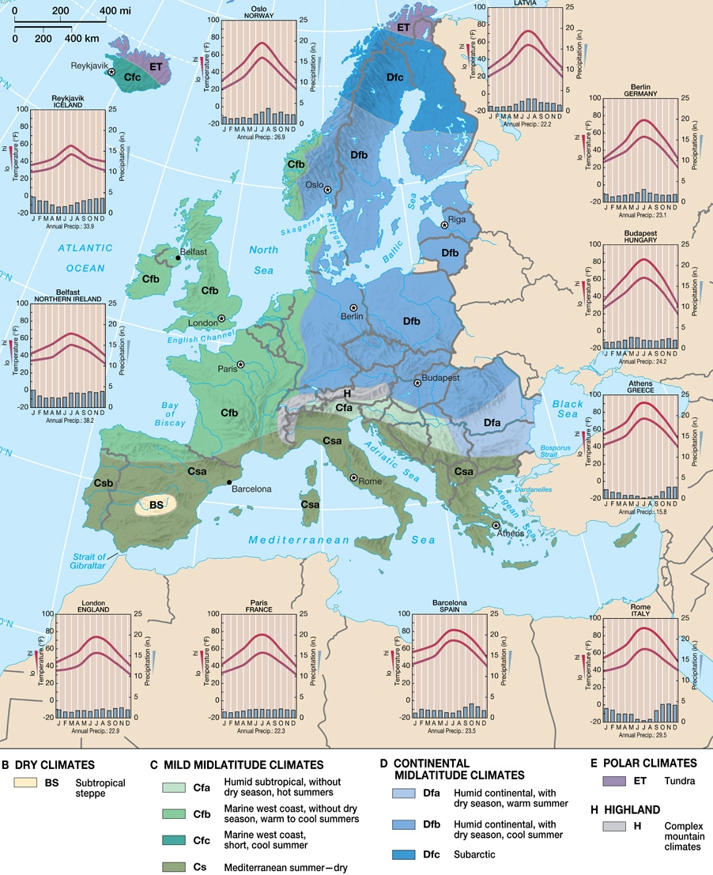
Major European
Climate Types:
Maritime
Continental
Mediterranean

Slide 26
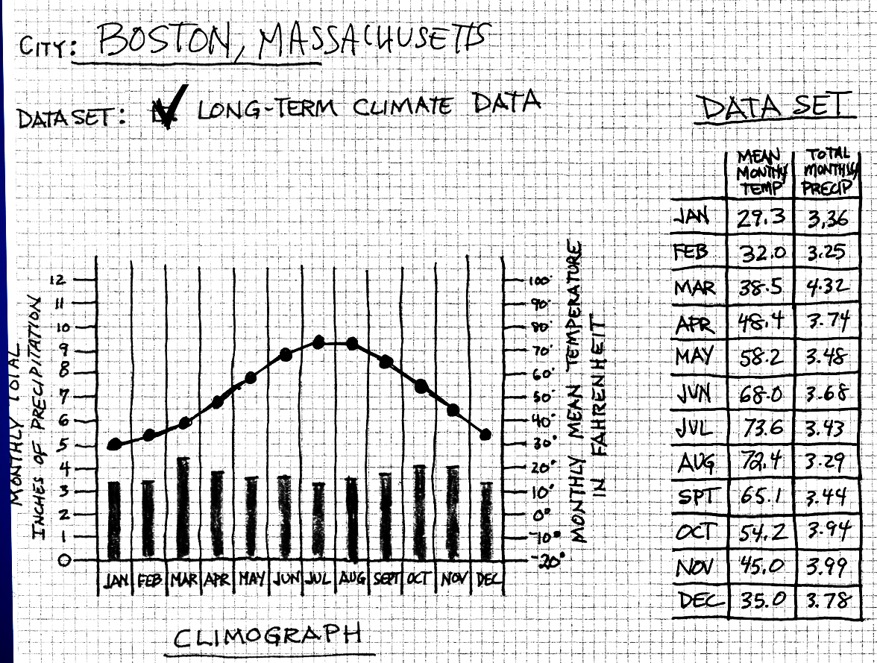
Climographs
A climograph is a graphical representation of the basic climatic parameters of monthly average temperature and monthly total precipitation, for a certain location. It is used for a quick-view of the climate of a location and as a tool to compare the climate patterns of different locations.

Slide 27
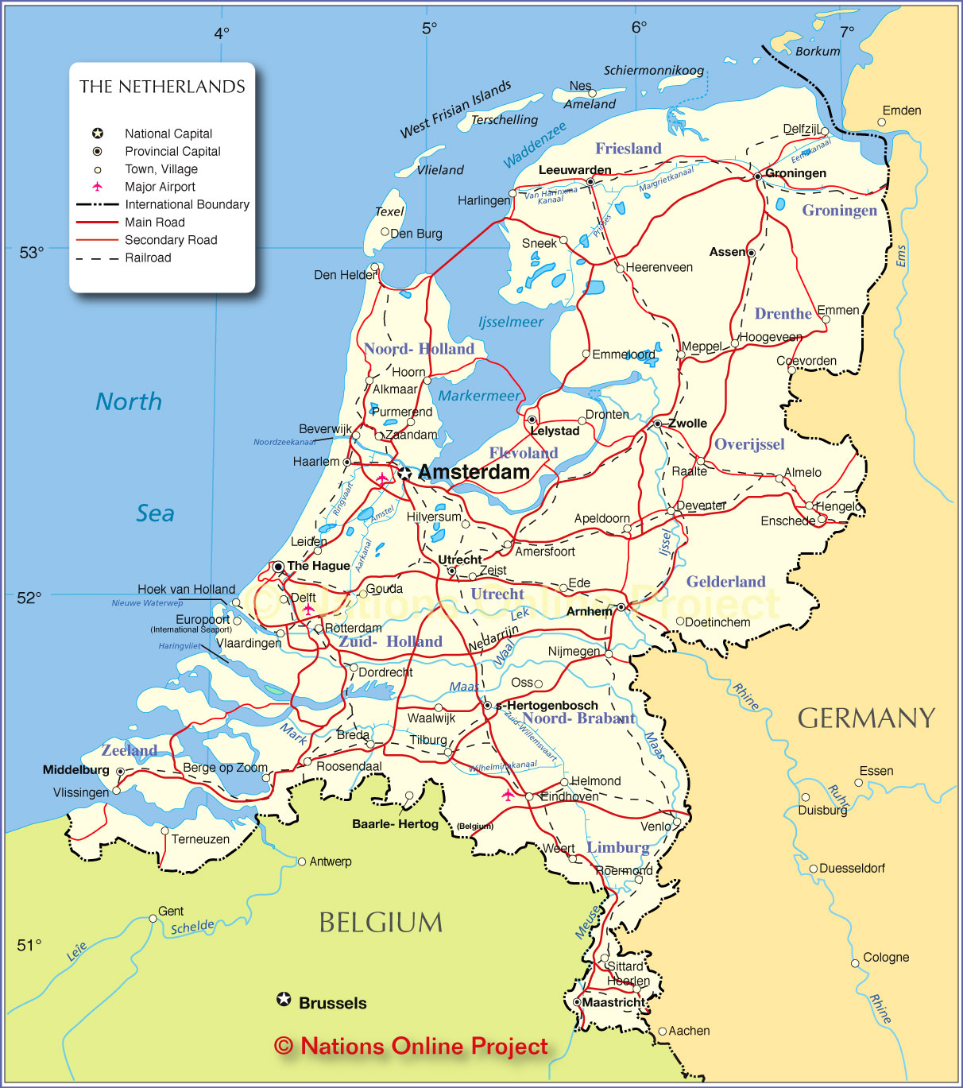
Climographs
of the
Netherlands
We will construct climographs for 6 major cities in the Netherlands.
Amsterdam
Rotterdam
Utrecht
Groningen
The Hague
Maastricht

Slide 28
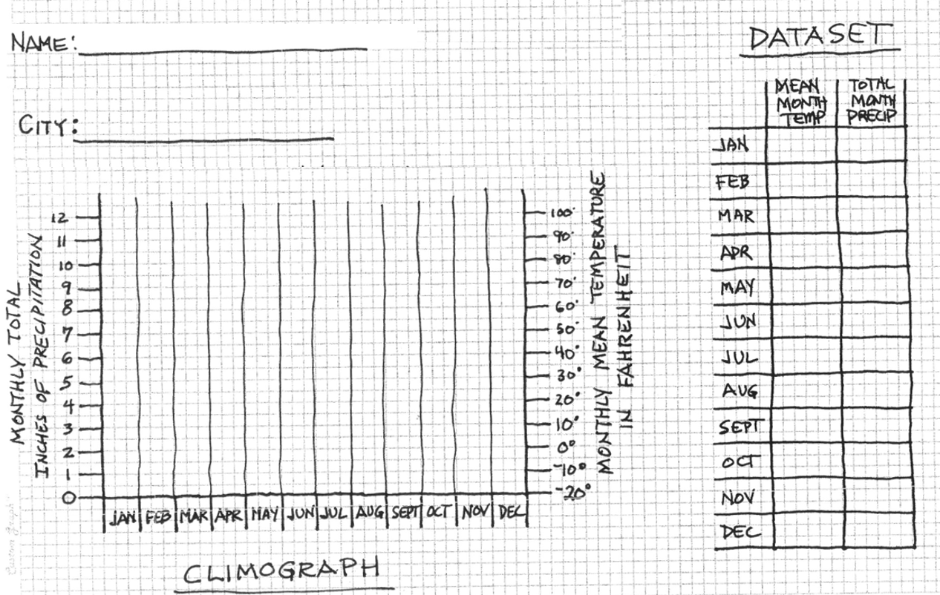
Climograph Worksheet

Slide 29
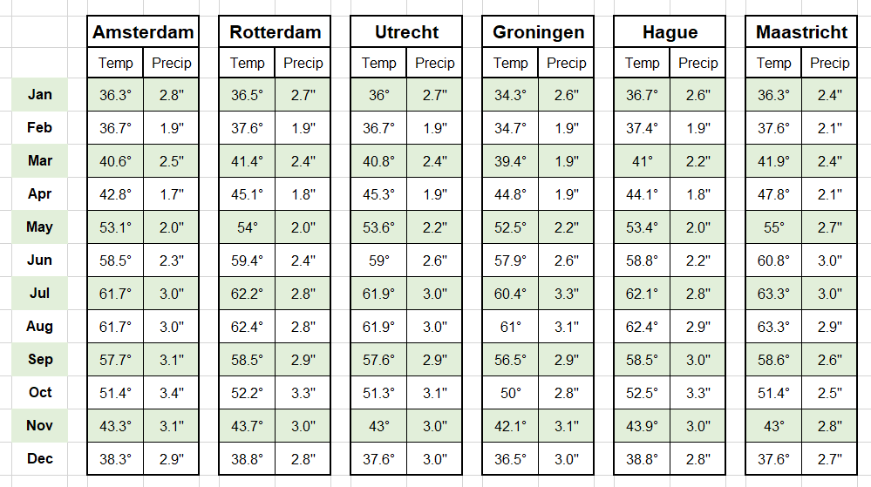
Climograph Data
Note: Data is non-metric and shown in Fahrenheit ° and inches to facilitate comparison to Boston.

Slide 30
Natural Resources

Slide 31
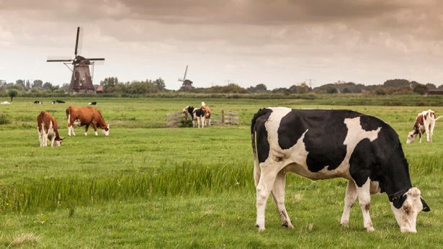
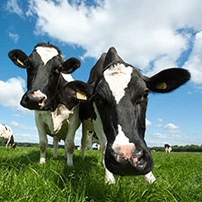
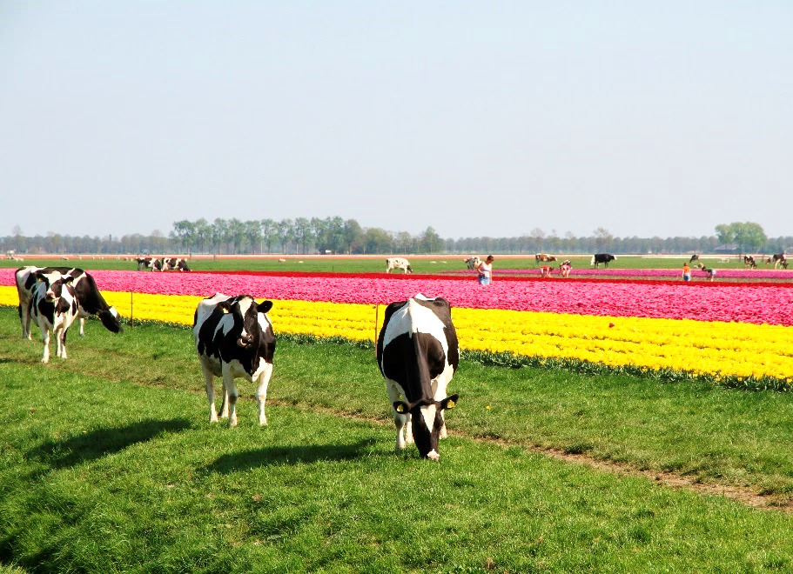
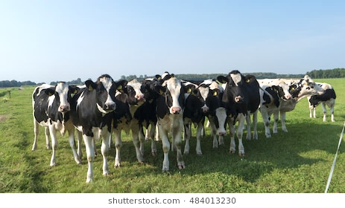
Dairy Cows in the Netherlands

Slide 32
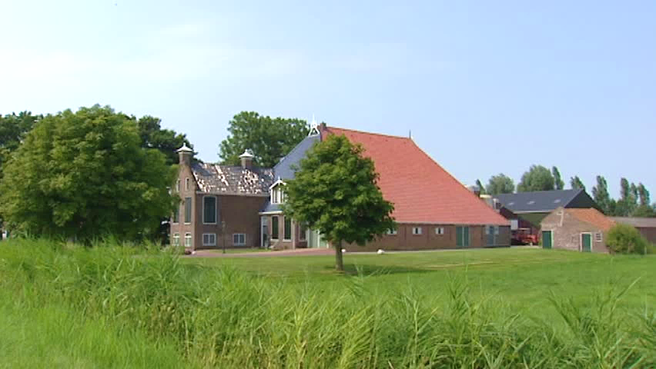
Brick/Block vs. Wood Construction

Slide 33
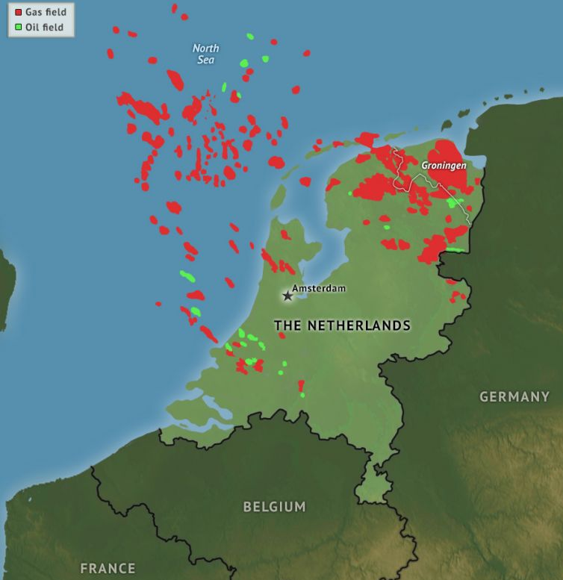

Groningen and North Sea gas and oil reserves
North Sea
Groningen
Source: https://worldview.stratfor.com/article/netherlands-conditions-are-ripe-protest

Slide 34
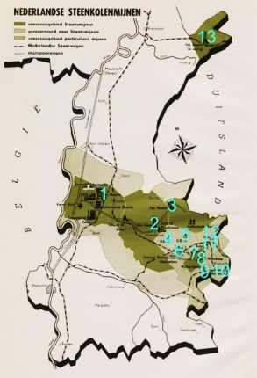
Location of
Coal Mines in Limburg

Slide 35
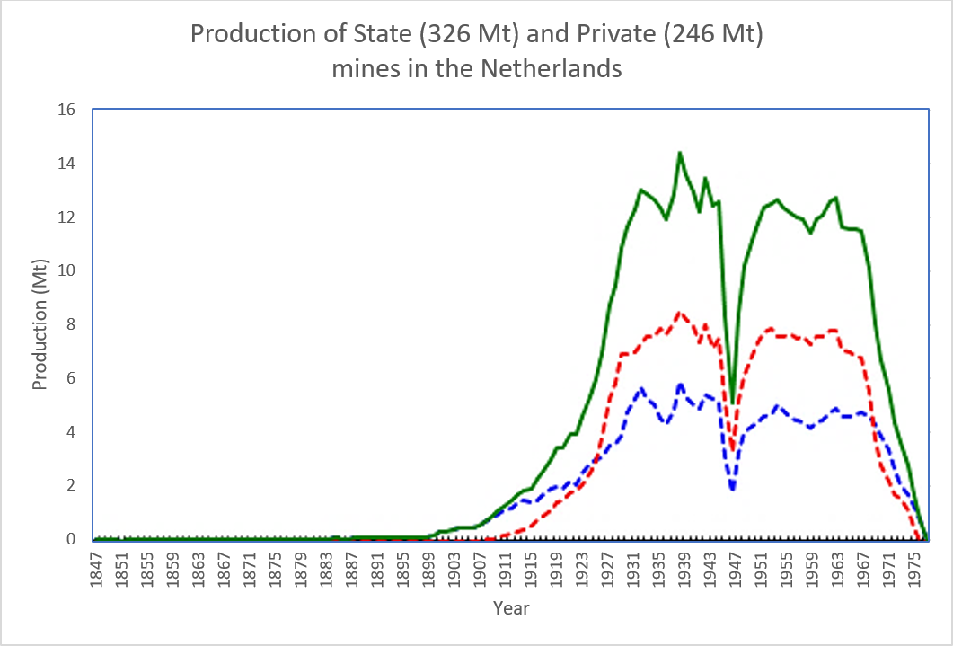

Coal Production

Slide 36
End of show

Slide 37
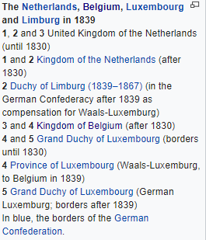
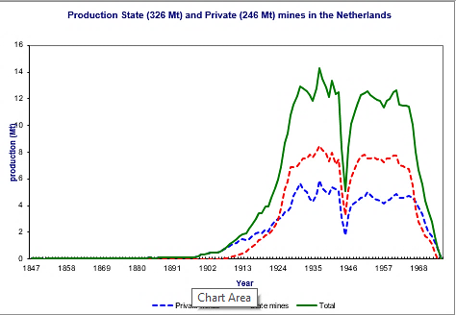
Belongs w Belgian split map in politics

Slide 38
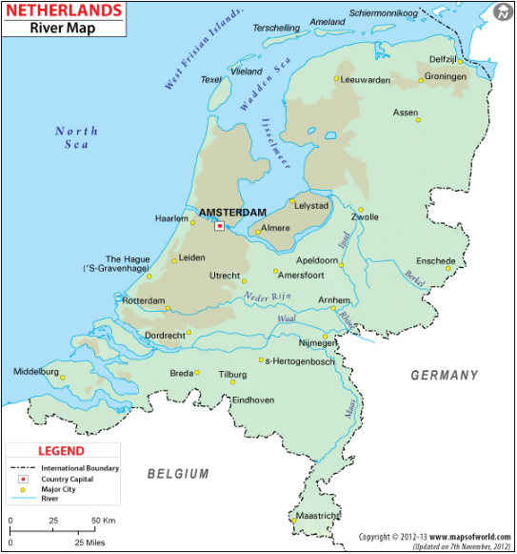
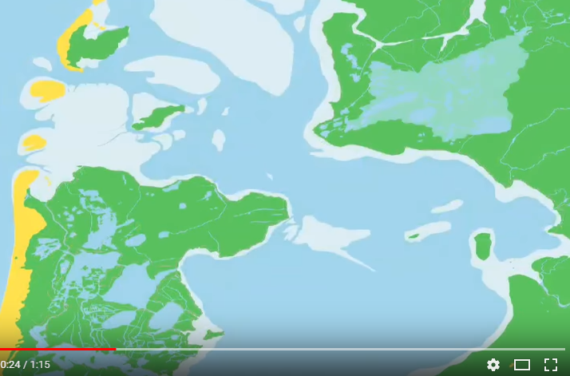
Zuider Zee, around 1250 AD (below) and today (left)

Slide 39
