Slide 1
Population and
Settlement Patterns

Slide 2
Key trends in the Netherlands
Flat (low) population growth
More population growth in suburbs
rather than in center cities
(reversing past trend of urbanization)
Suburbanization of poverty

Slide 3
Most populous European countries:
Germany 82 million 228 ppl/km²
France 61 115
UK 61 256
Italy 59 201
Spain 46 94
Poland 38 118
Romania 22 90
Netherlands 17 488
U.S. 327 35

Slide 4
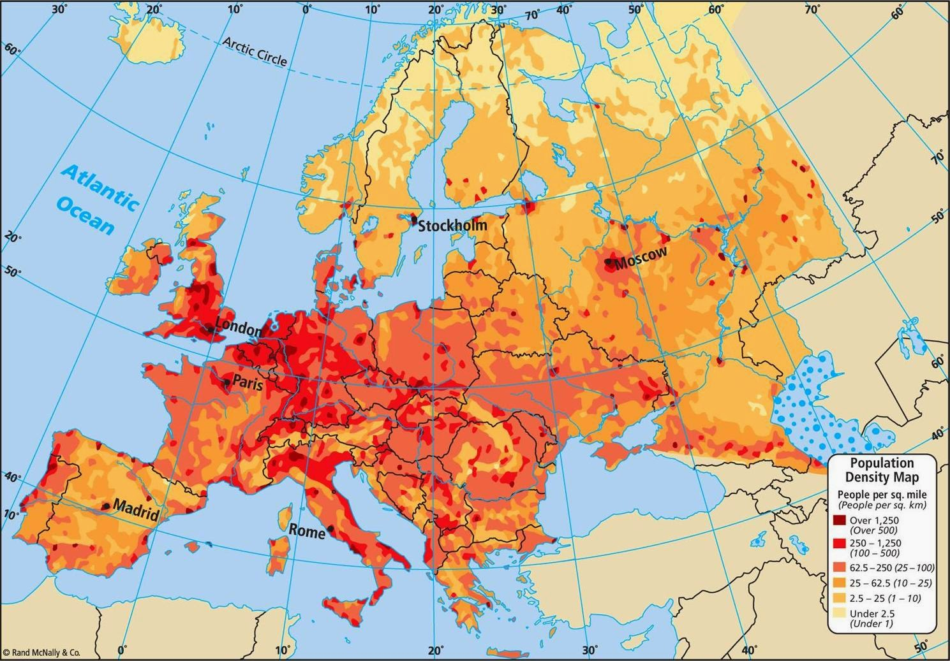
Population density of Europe
https://onlinemaps.blogspot.com/2014/09/europe-population-density-map.html

Slide 5
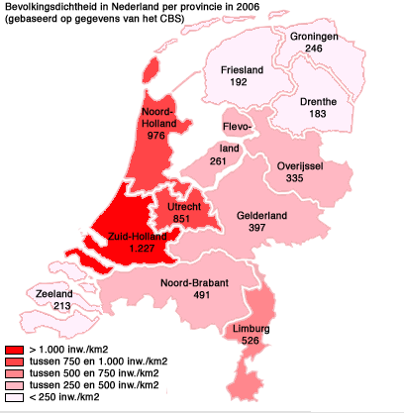
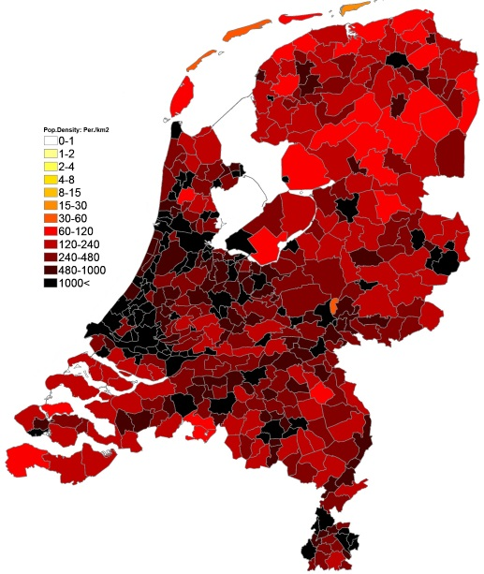
Population density of Netherlands
By Province By Eurostat Div.

Slide 6
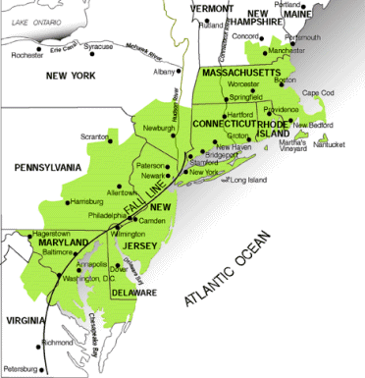
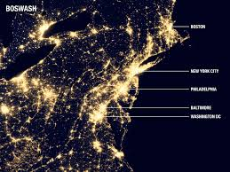
The northeast megalopolis of “Bosnywash”

Slide 7
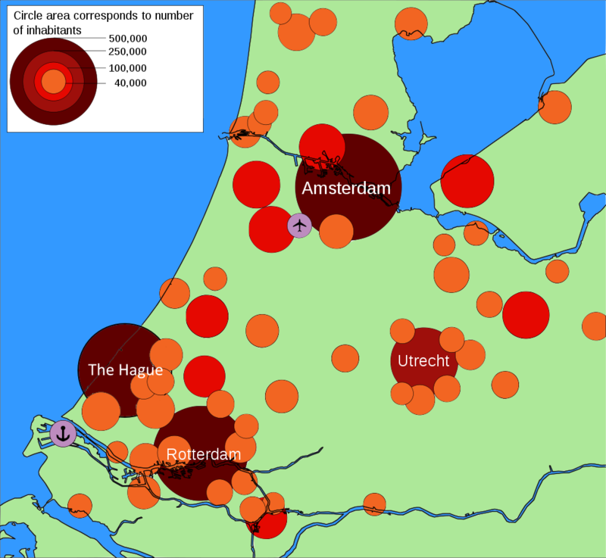
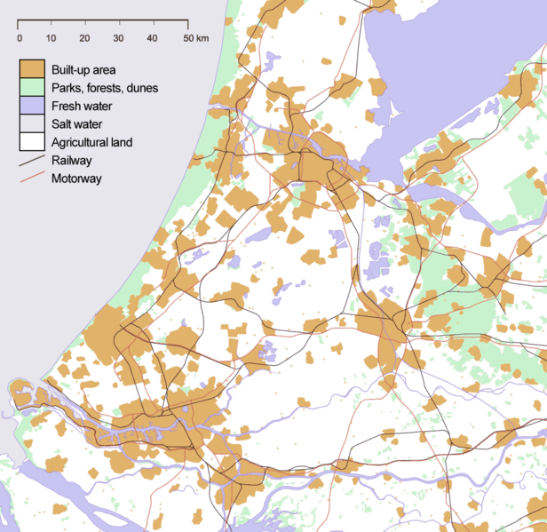
Randstad

Slide 8
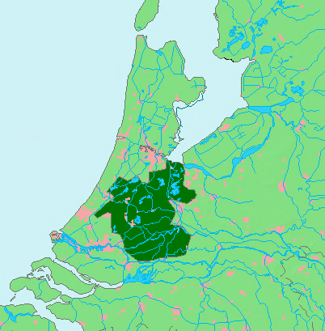
The “Green Heart” of Ranstad (Groene Hart)

Slide 9
Urbanization in context
Country | Percent population in urban areas
Belgium | 97.9
Netherlands | 91.5
United States | 82.0
France | 80.0
Germany | 75.7
Italy | 69.3
Portugal | 64.6
China | 57.9

Slide 10
Netherlands most populated cities
 | Name | Population
1 | Amsterdam, North Holland | 741,636
2 | Rotterdam, South Holland | 598,199
3 | The Hague, South Holland | 474,292
4 | Utrecht, Utrecht | 290,529
5 | Eindhoven, North Brabant | 209,620
6 | Tilburg, North Brabant | 199,613
7 | Groningen, Groningen | 181,194
8 | Almere Stad, Flevoland | 176,432
9 | Breda, North Brabant | 167,673
10 | Nijmegen, Gelderland | 158,732
http://www.geonames.org/NL/largest-cities-in-netherlands.html

Slide 11
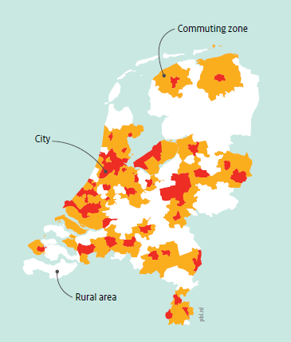
The Netherlands’
City Cores, Commuter Sheds, and
Rural Areas
Source: PBL Netherlands Environmental Assessment Agency, Cities in the Netherlands, 2016

Slide 12
Growing urban inequalities:
Market-oriented urban policies
Events and spectacles to attract the middle class
Promotion of home ownership
Integration into the global economy
University students graduate and remain

Slide 13
Population Growth and Change

Slide 14
Historical trends in European population growth:
Year | Population (in millions) | Notes
400 BC | 20 | Greeks and their colonies
200 AD | 36 | Roman Empire
800 | 29 | Fall of Rom Empire; pandemics
1300 | 80 | Black Death in 1340s
1500 | 80
1800 | 160 | Industrial Revolution; Great Migration
1940 | 515
2010 | 600 | In-migration

Slide 15
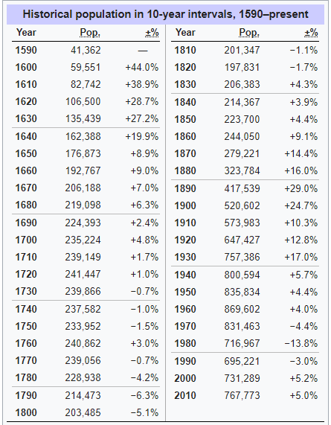
Understanding the Population Trend in Amsterdam

Slide 16
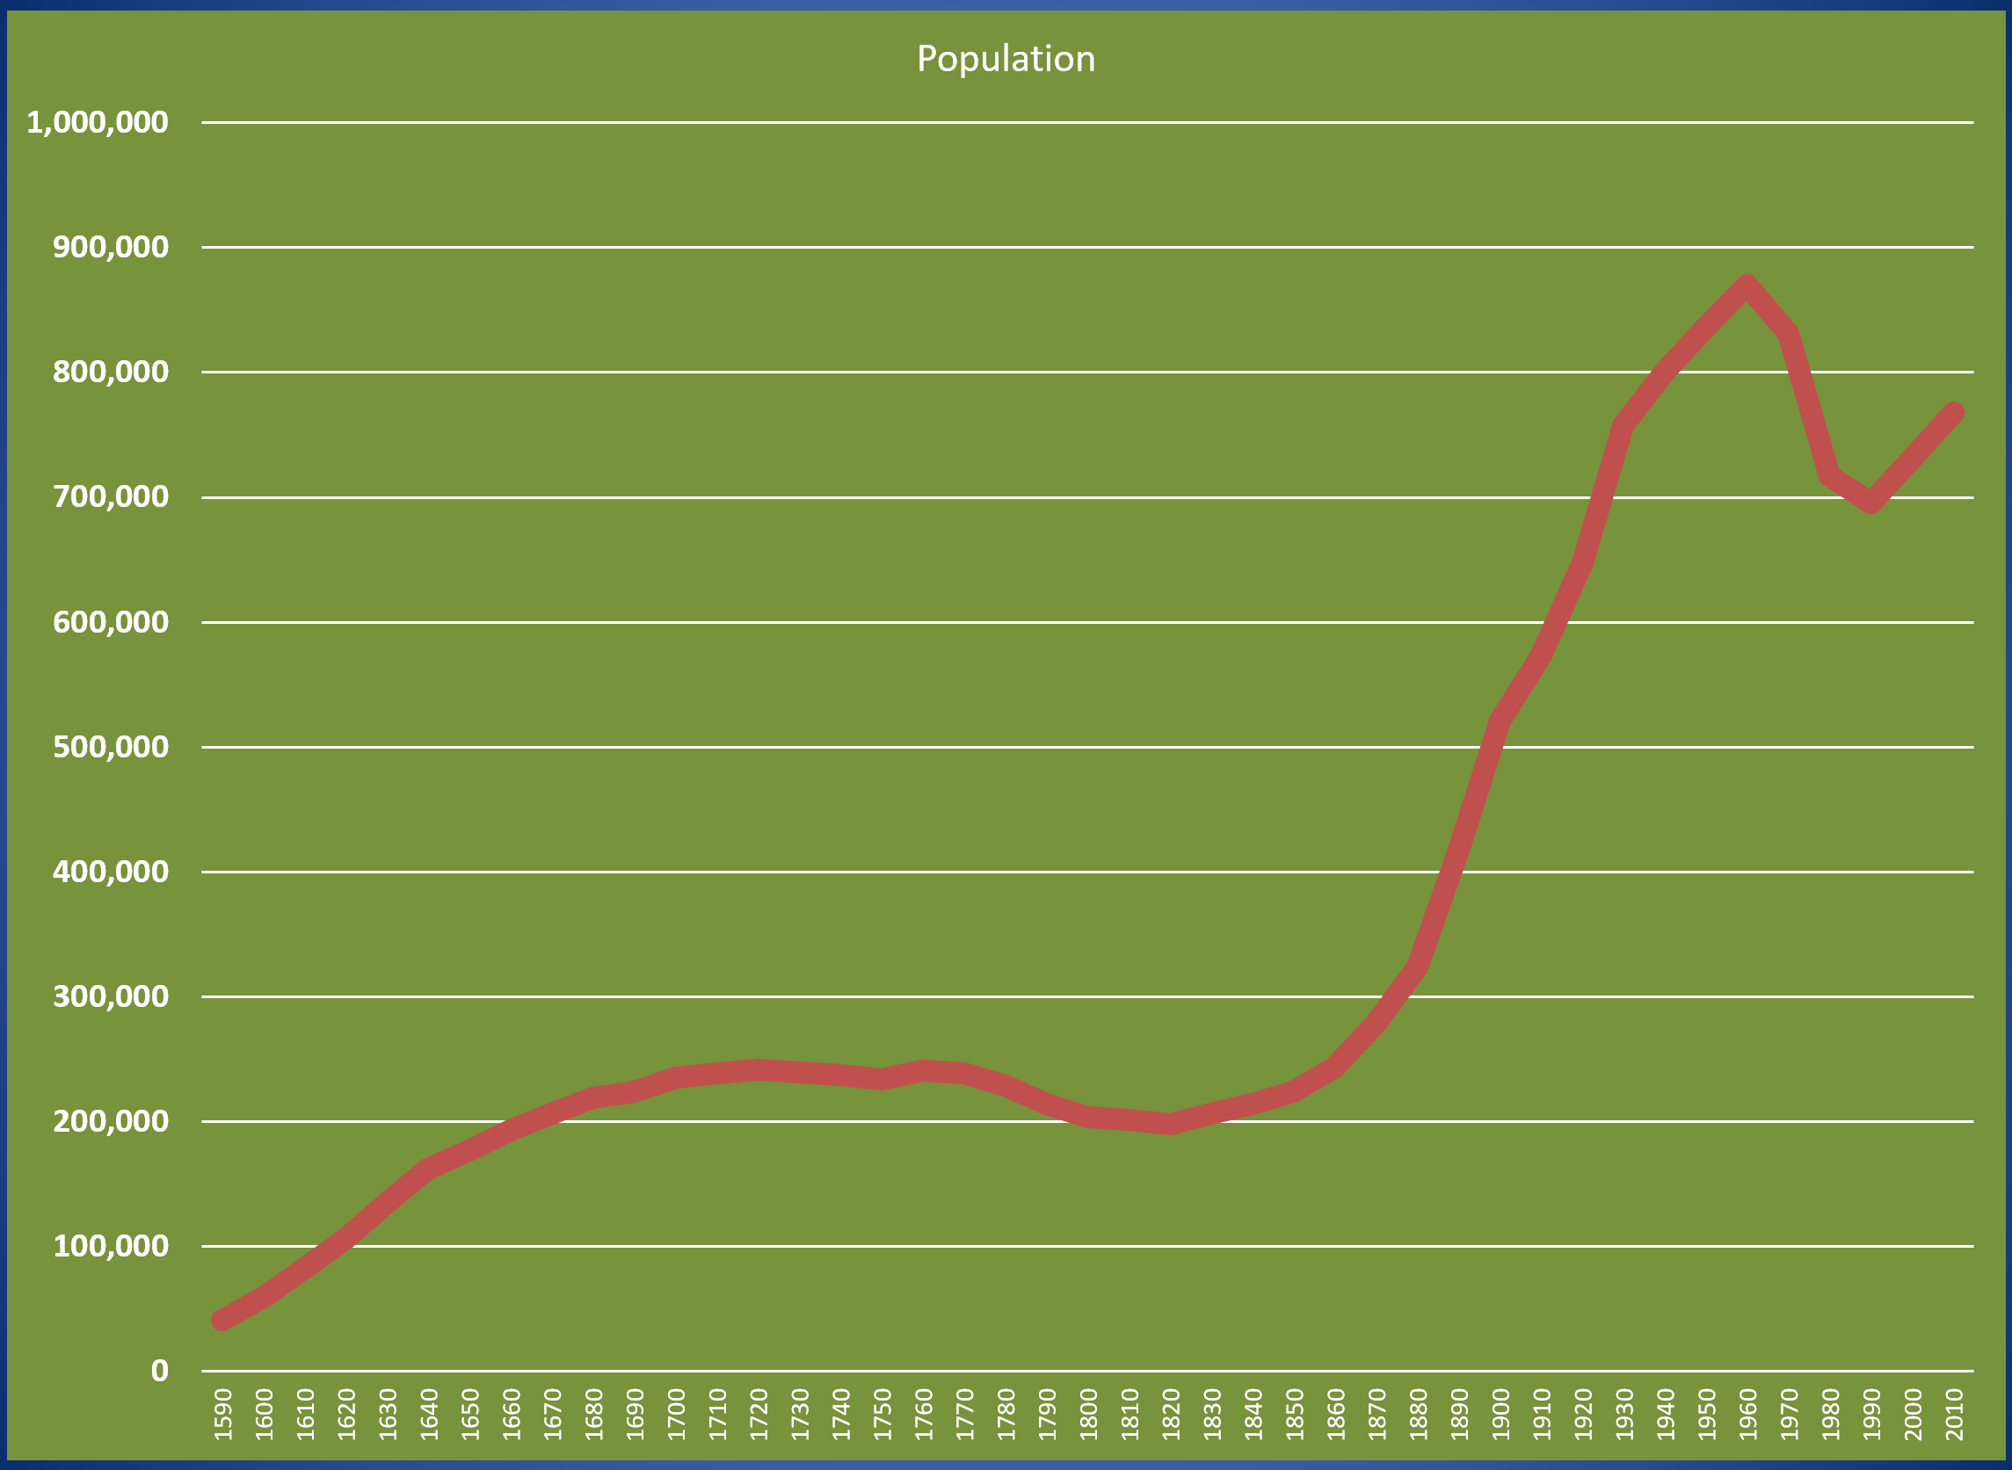

Slide 17
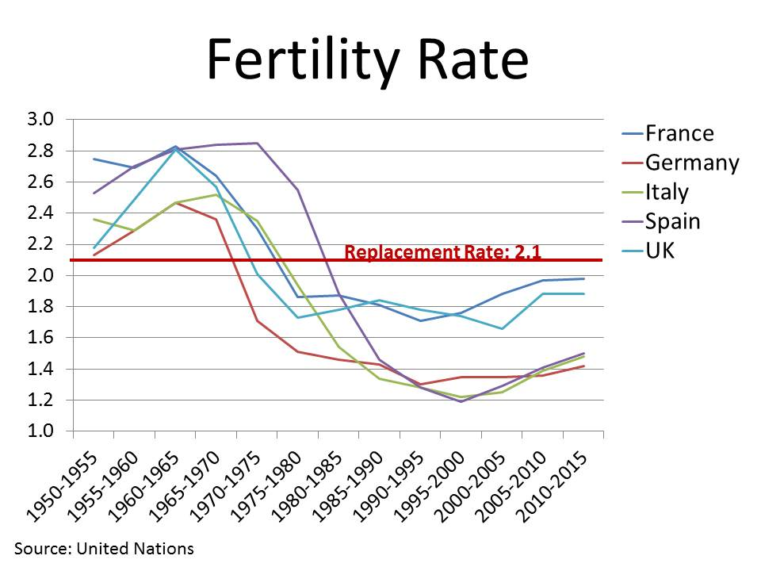
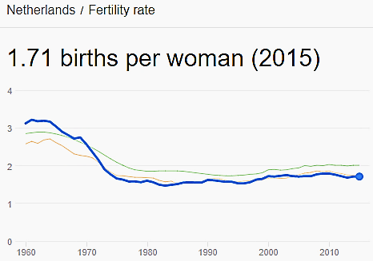
Fertility rates over time

Slide 18
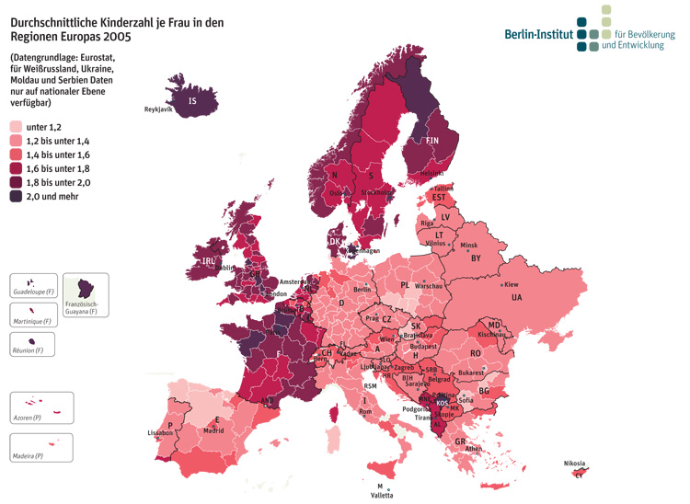
Fertility rates by European NUTS regions
Under 1.2
1.2 up to 1.4
1.4 up to 1.6
1.6 up to 1.8
1.8 up to 2.0
2.0 and over

Slide 19
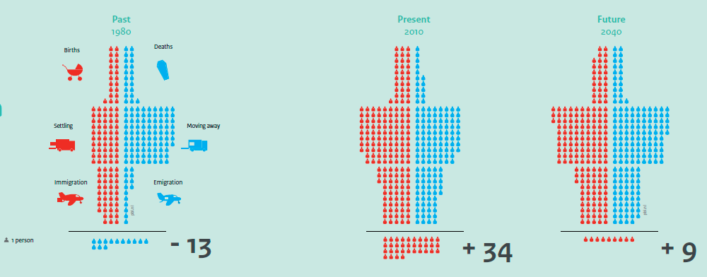
Demographic change in Amsterdam
Births/
Deaths
Settling/
Moving Away
Immigration/
Emigration
1980 2010 2040

Slide 20
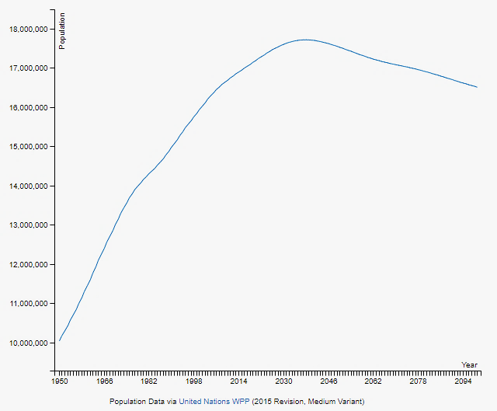
Forecasted Population Change in NL
Source: UN, World Population Projections, http://worldpopulationreview.com/countries/netherlands-population/

Slide 21
Population Structure:
Age and Sex

Slide 22
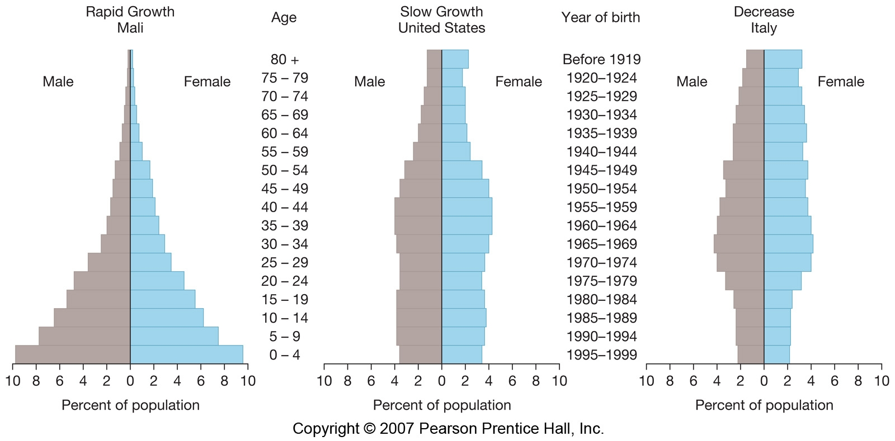
Population Pyramids

Slide 23
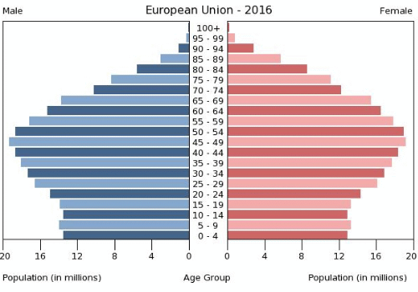
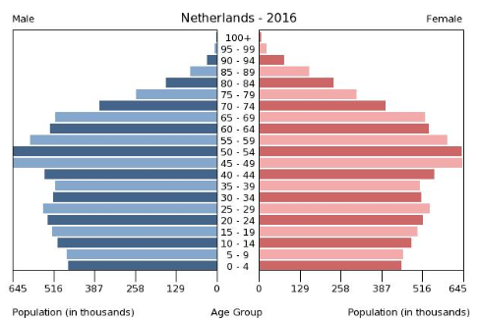

Slide 24
Comparative dependency ratios
 | Total % | Youth | Elderly
Netherlands | 53.1 | 25.6 | 27.4
France | 59.2 | 29.1 | 30.2
Italy | 56.5 | 21.5 | 35.0
United States | 51.2 | 29.0 | 22.1
China | 37.7 | 24.3 | 13.3
South Sudan | 83.7 | 77.3 | 6.4
Youth (0-14) + Elderly (65+)
Working Population (15-64)

Slide 25
End of show

Slide 26
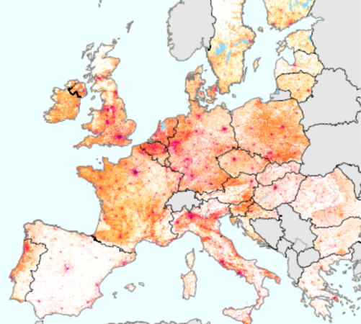

Slide 27
