Slide 1
Social Well-being:
Health, Education, Gender, and Social Welfare

Slide 2
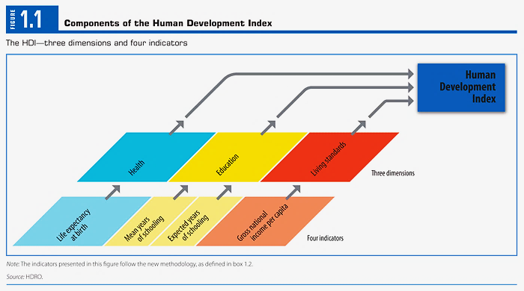
The Human Development Index, HDI
How does the UN measure ED?

Slide 3
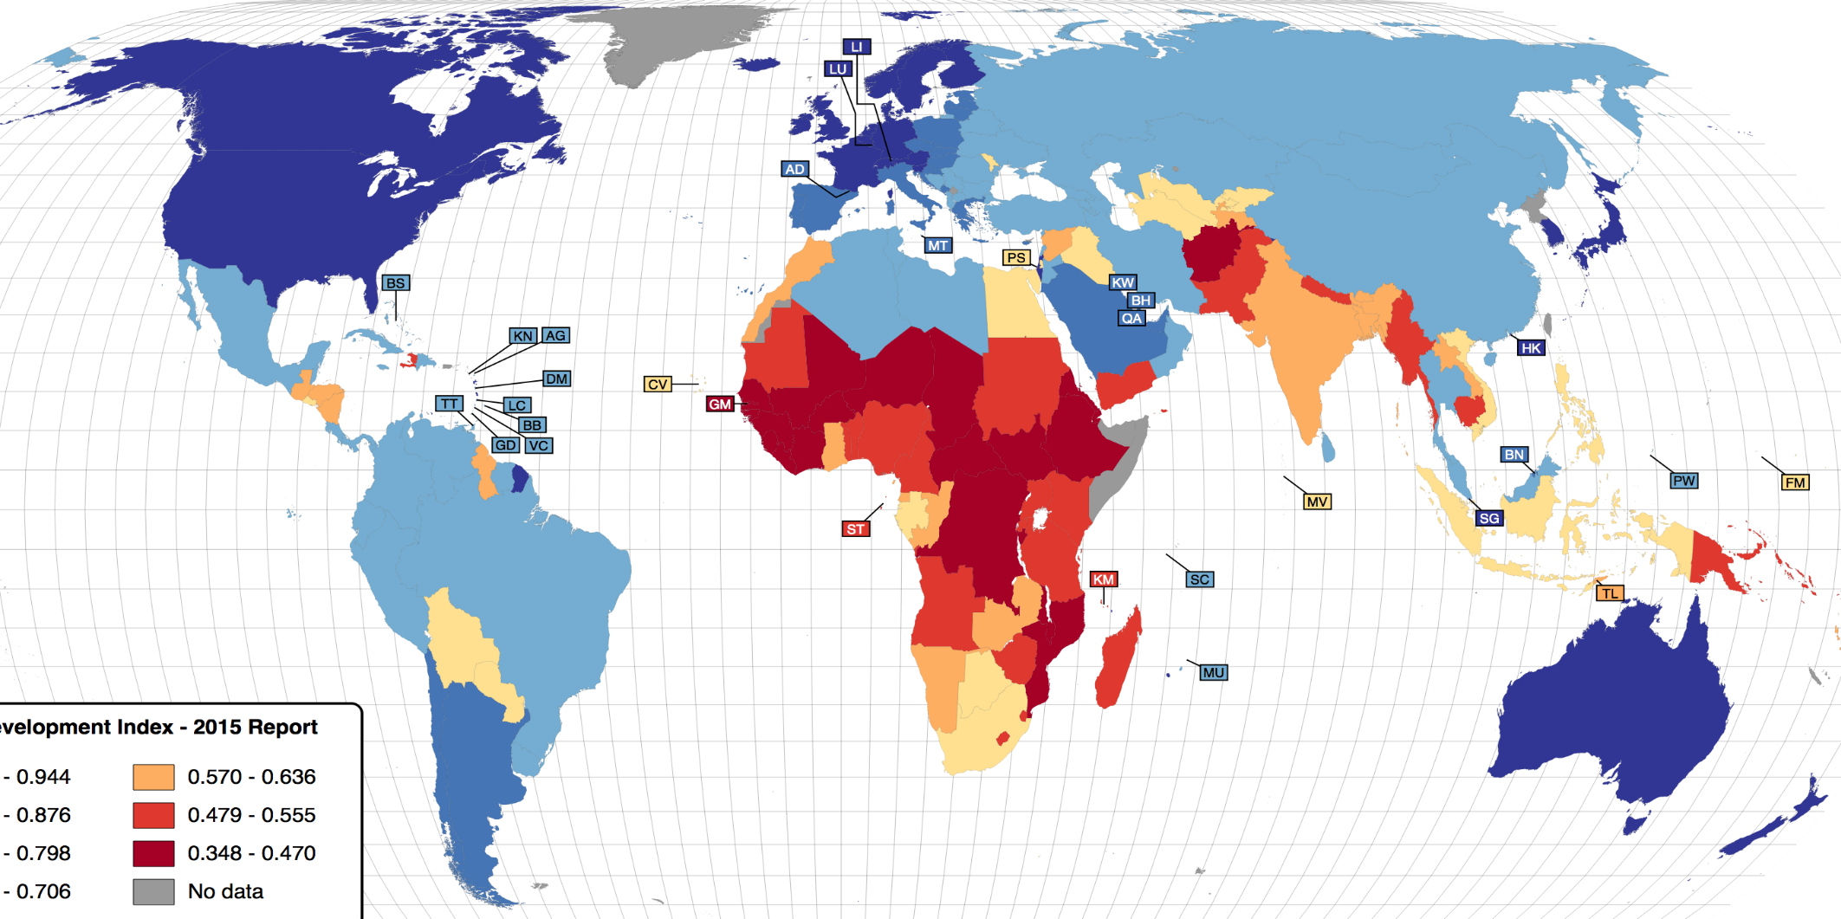

World HDI (UN 2015)

Slide 4
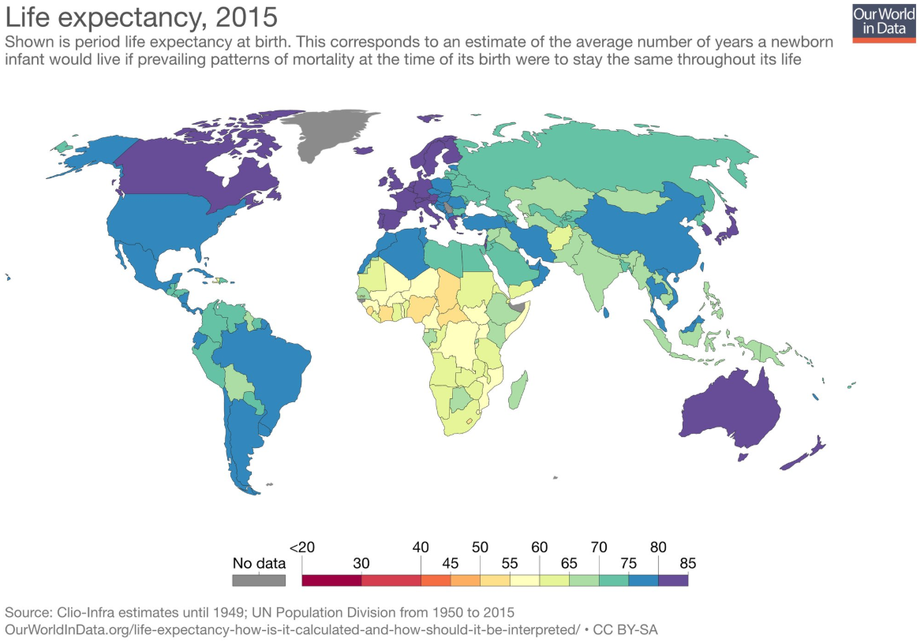
Life Expectancy at Birth (2015)
https://ourworldindata.org/life-expectancy

Slide 5
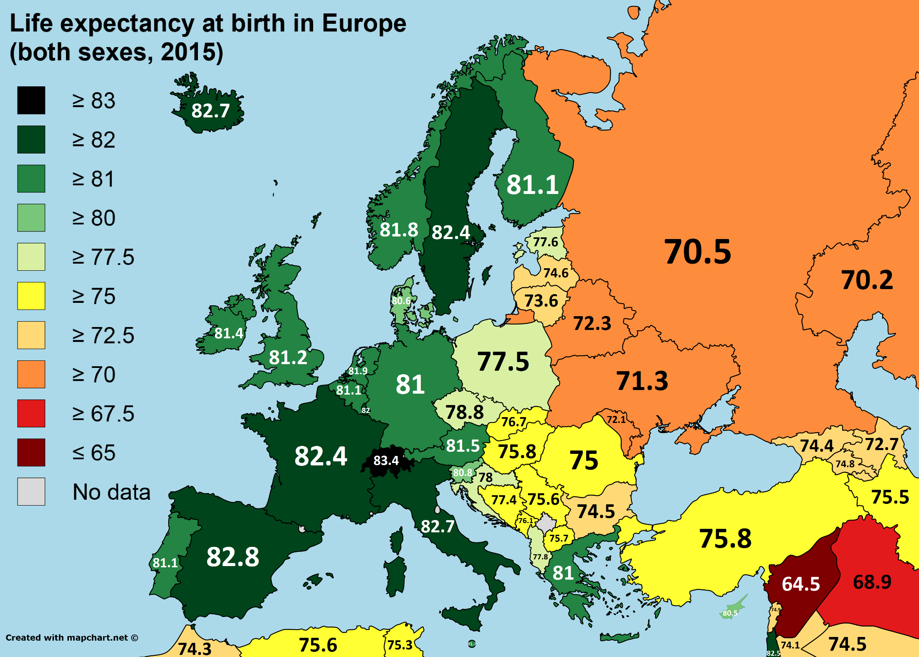
Europe Life Expectancy at Birth (2015)
https://www.reddit.com/r/europe/comments/4xd7fu/life_expectancy_at_birth_in_europe_2015/

Slide 6
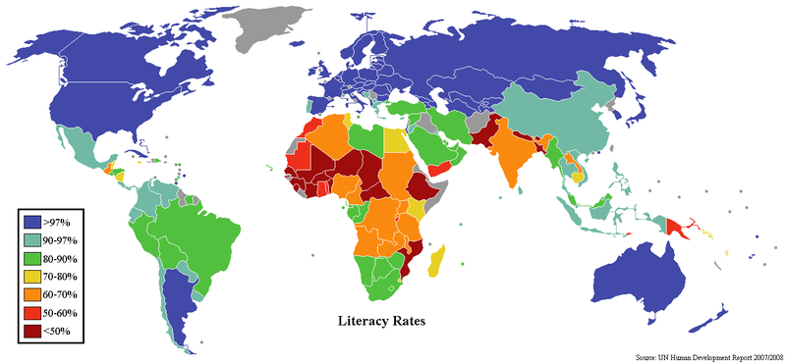
World Adult Literacy Rates (UN 2011)

Slide 7
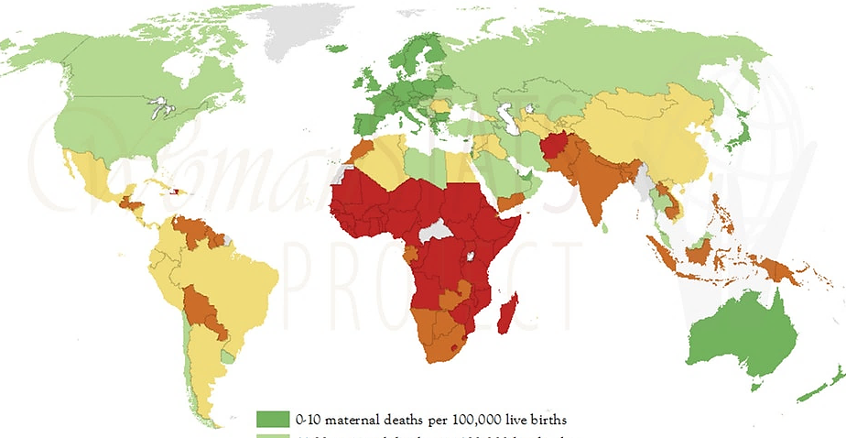
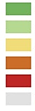
Maternal mortality rates per 100,000 live births
0-10
11-30
31-100
101-300
301+
No Data
http://mothersmonument.org/

Slide 8
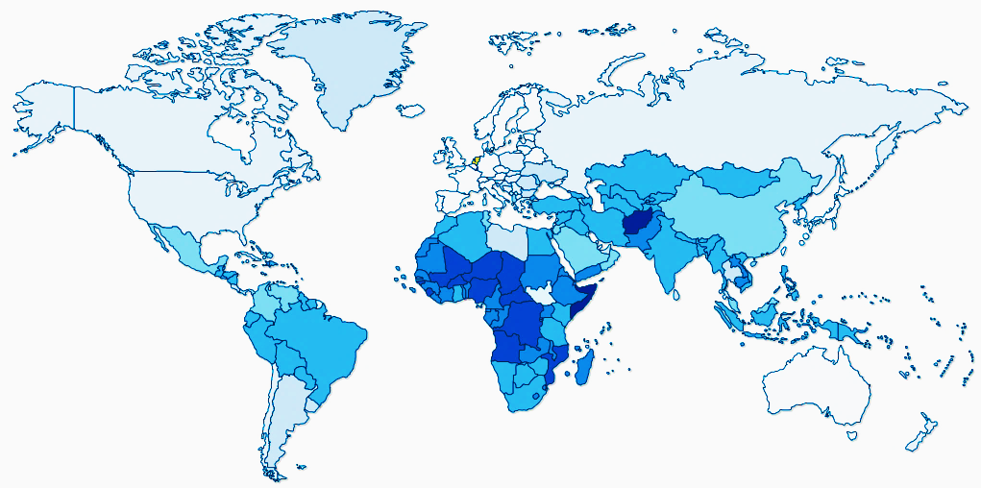
Infant mortality rates (< 1 yo) per 1000 live births
1 – 4.3
4.3 – 8
8 – 11
11 – 14
14 – 40
40 – 66
66 – 91
91 - 117
https://www.indexmundi.com/map/?v=29

Slide 9
Selected Health Metrics
 | Netherlands | United States | Chad
MMR (deaths/100,000 live births | 7 | 14 | 856
Infant mortality rate (/1,000 live births | 3.6 | 5.8 | 85.4
Physicians/1,000 of population | 3.5 | 2.6 | 0.04
Hospital beds/1,000 of population | 4.7 | 2.9 | NA
HIV prevalence in population, percent | 0.2 | NA | 1.3
Obesity in population, percent | 20.4 | 36.2 | 6.1
Health expenditures, percent of GDP | 10.9 | 17.1 | 3.6

Slide 10
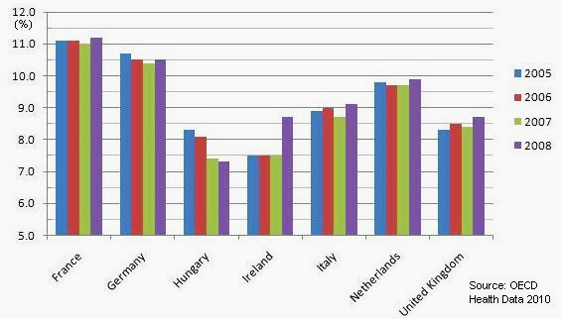
Health Care Spending as a Percentage of GDP

Slide 11
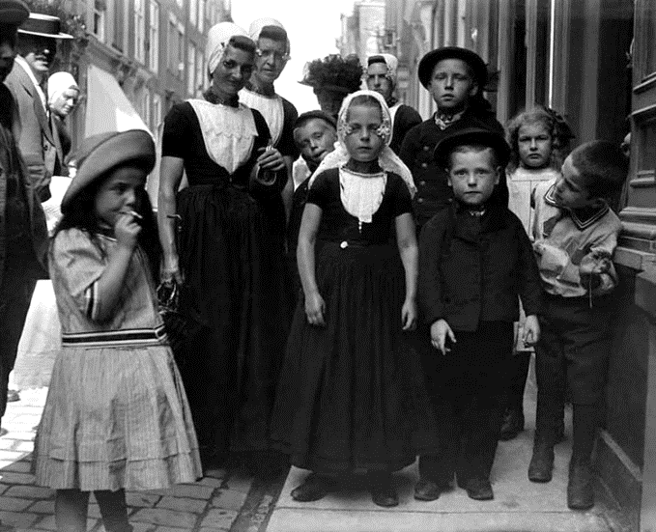
Netherlands as a leader in social wellbeing policies
1870: capital punishment abolished
1874: children under 12 years old
not allowed to work
1889: restrictions on work hours
for women and children
1901:
  Social insurance (aka Social Security)
  Workers compensation program

Slide 12
Education

Slide 13
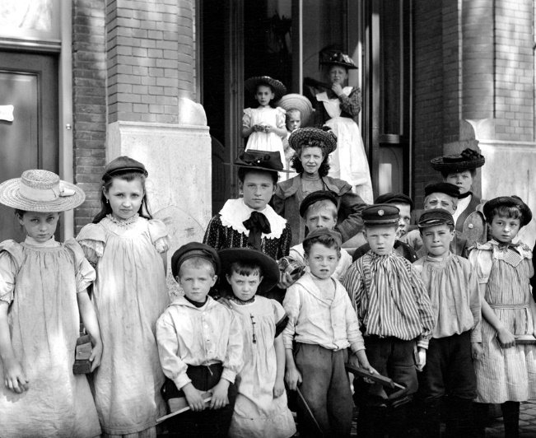

Organization of Education
Affiliation:
  Public
  Special (religious)
  General-special (all religions equal)
Grade levels:
  Elementary (“basic school”),
  ages 4-12, grades “1-8”
  Secondary (3 types, 4-6 years),
  with bridge year in “9th grade”
  Tertiary (3 types)

Slide 14

Educational system flow chart

Slide 15
Gender Issues

Slide 16
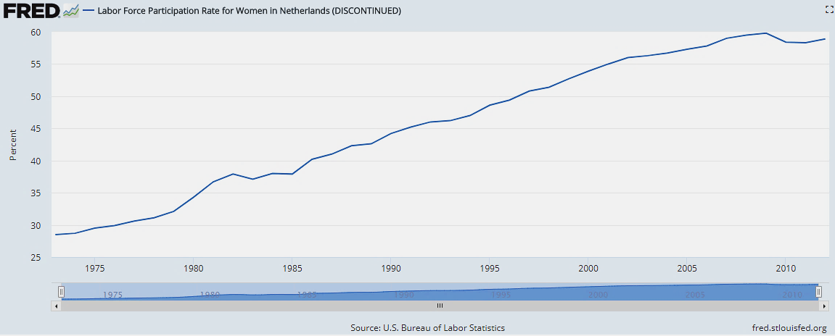
Labor force participation

Slide 17
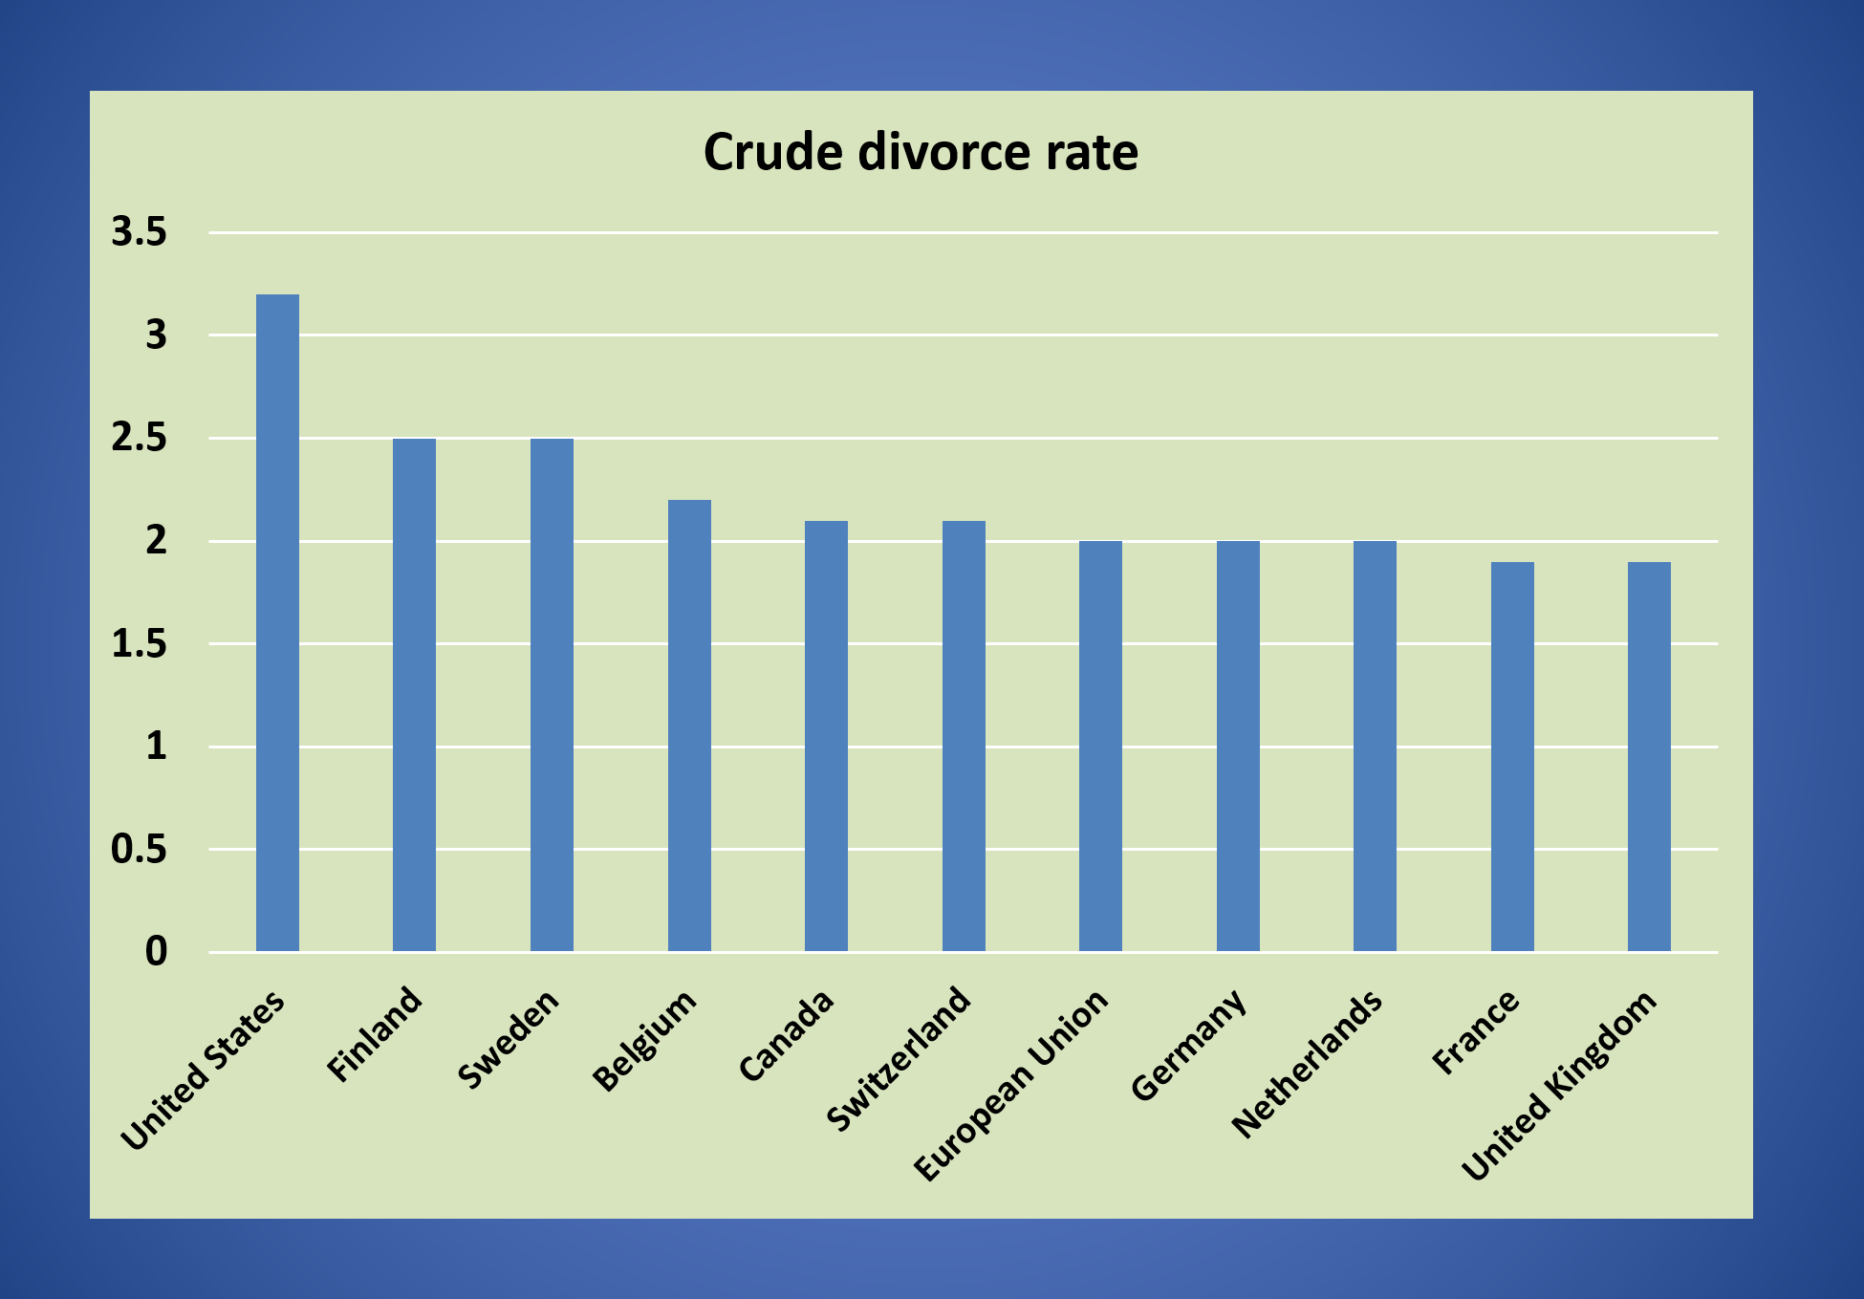

Slide 19



Sex Education in the Netherlands
https://www.youtube.com/watch?v=YD-Hckohzh0 Interview with a teacher
runtime 4:33
https://www.youtube.com/watch?v=AA1HDFH9OaU
Young kids discussing being in love in school (sub-titled)
runtime 3:08
https://www.youtube.com/watch?v=Yz59The52xU
being in love part 2; young kids in class, parents at workshop runtime 22:52

Slide 20
Comparative Teen Pregnancy Rates

Slide 21
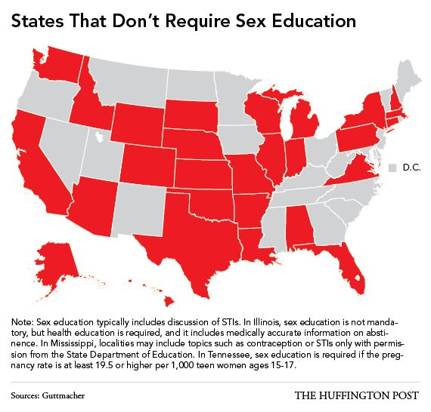
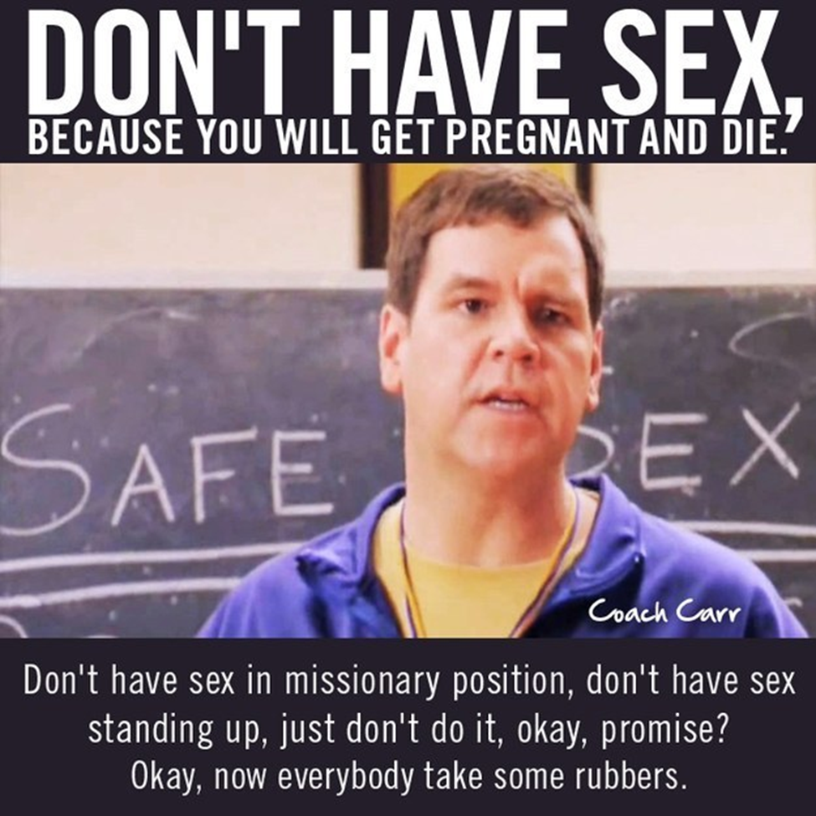
The Birds and the Bees
Rutgers: For sexual and reproductive health and rights 2017
http://www.rutgers.international/what-we-do/comprehensive-sexuality-education/what-comprehensive-sexuality-education
Rutgers is the Dutch sexuality research institute behind the mandated curriculum. This source explains the idea of comprehensive sexuality education and how it has been developed to include guidance on both the physical and emotional side of relationships. Rutgers not only develops the curriculum that Dutch children receive, but they also works towards providing accessible sexuality information for young people all around the world.
Klein, Rebecca. "These Maps Show Where Kids In America Get Terrifying Sex Ed."
The Huffington Post. TheHuffingtonPost.com, 08 Apr. 2014. Web. 28 Mar. 2017.
http://www.huffingtonpost.com/2014/04/08/sex-education-requirement- maps_n_5111835.html
This source provided me with great visual of a U.S. map that represents and shows where sexually education is not mandated and not considered part of the curriculum. This map allowed me to show and explain how the U.S. sexual education is different from the Netherlands and is not considered important or as crucial in some states.
Thanks to:
Kelley Lindquist
Julie LeBlanc
Tanner Gresham

Slide 22

Hans Rosling: Economic Development
http://www.youtube.com/watch?v=jbkSRLYSojo Health/Wealth of the World over Time
runtime 4:47

Slide 23
End of show

Slide 24
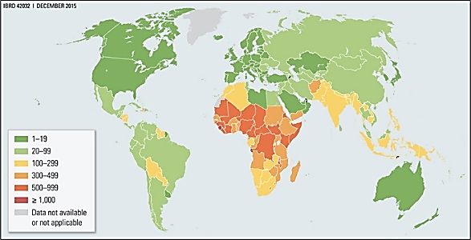
Maternal mortality rates per 100,000 live births

Slide 25
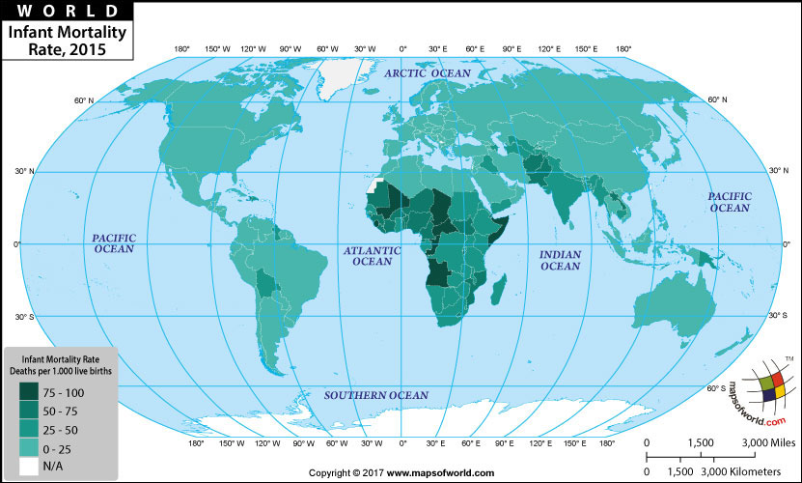
Infant mortality rates (< 1 yo) per 1000 live births

