Slide 1
Urban Development, Planning, and Architecture in Amsterdam

Slide 2
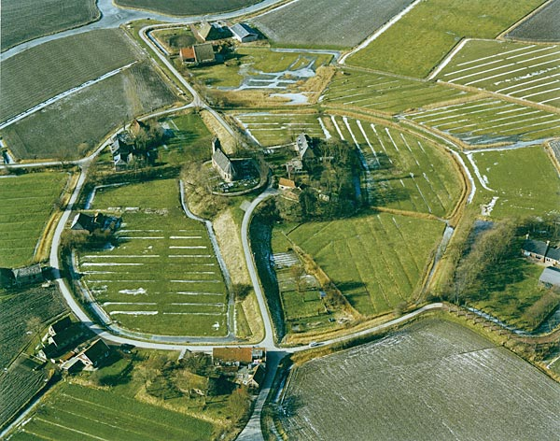
Terp, Friesland

Slide 3
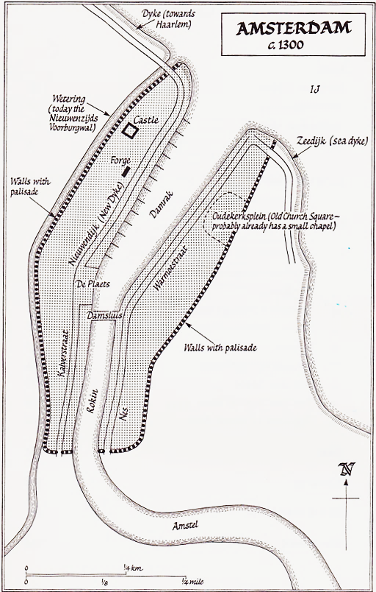
Amsterdam around 1300

Slide 4
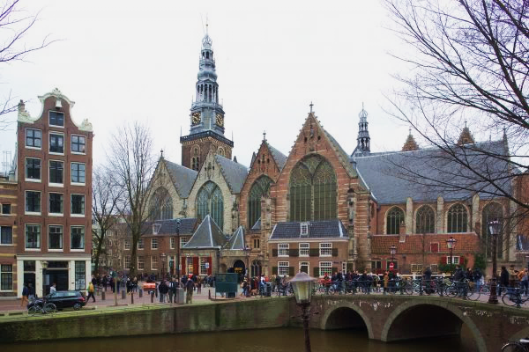
Oude Kerk (Old Church)

Slide 5
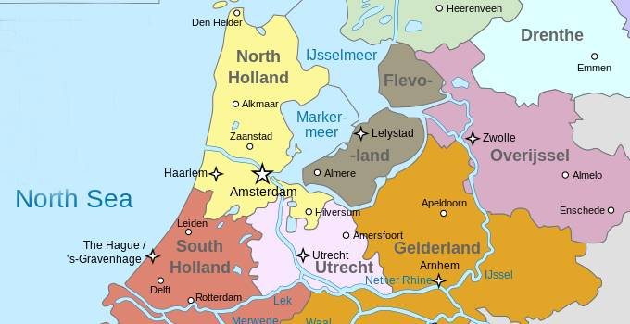
Central Netherlands
North Sea

Slide 6
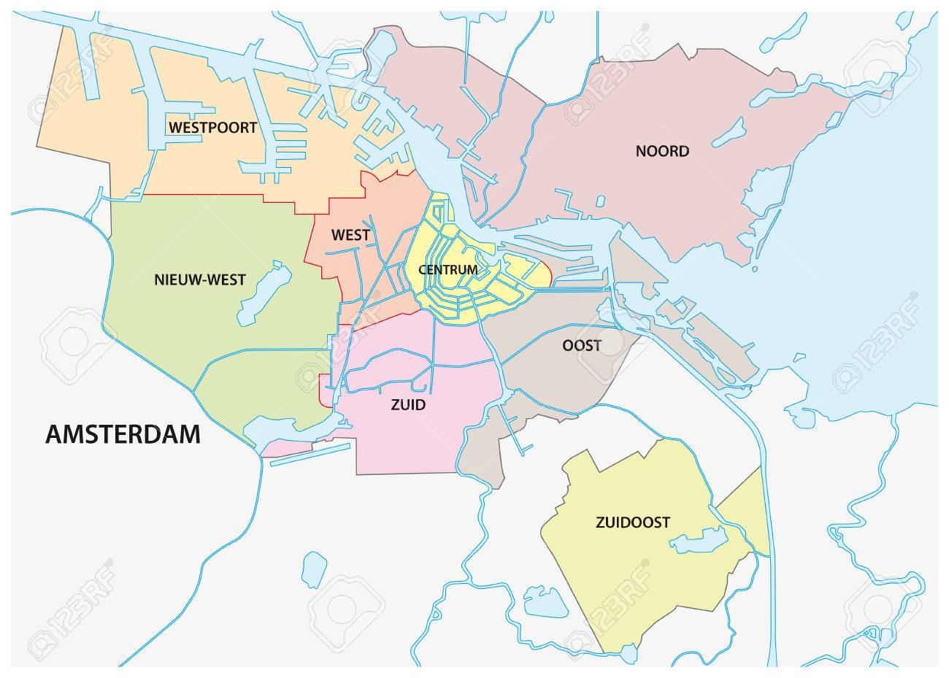
Administrative Districts

Slide 7
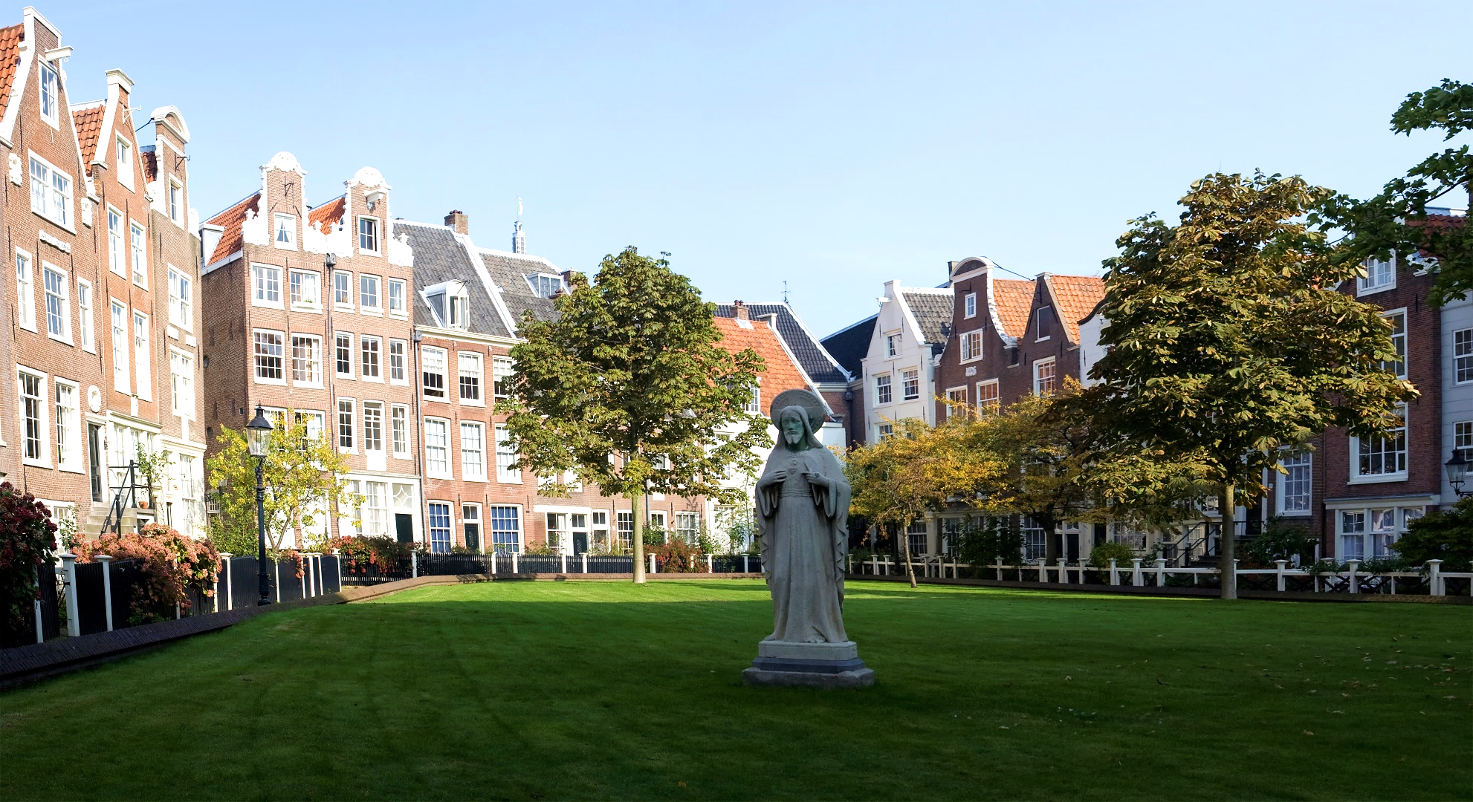
Begijnhof

Slide 8
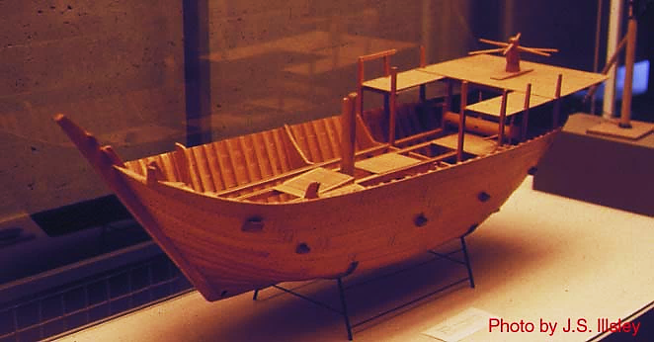
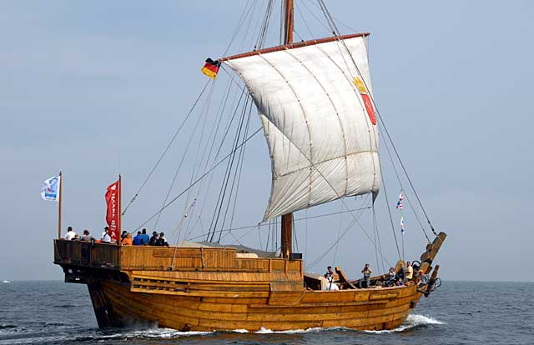
Shipbuilding Technology: the Cog

Slide 9
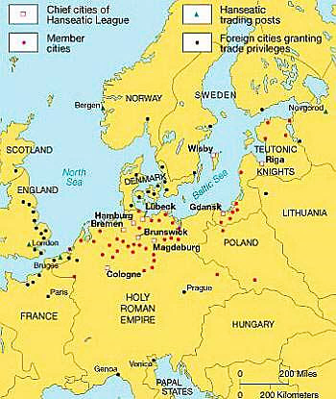
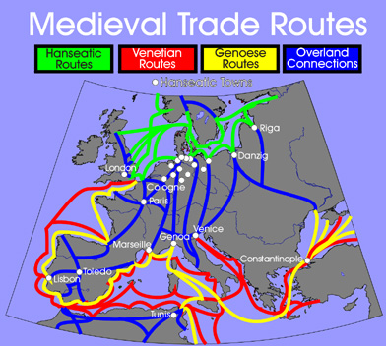

Hanseatic League and Trading Routes

Slide 10
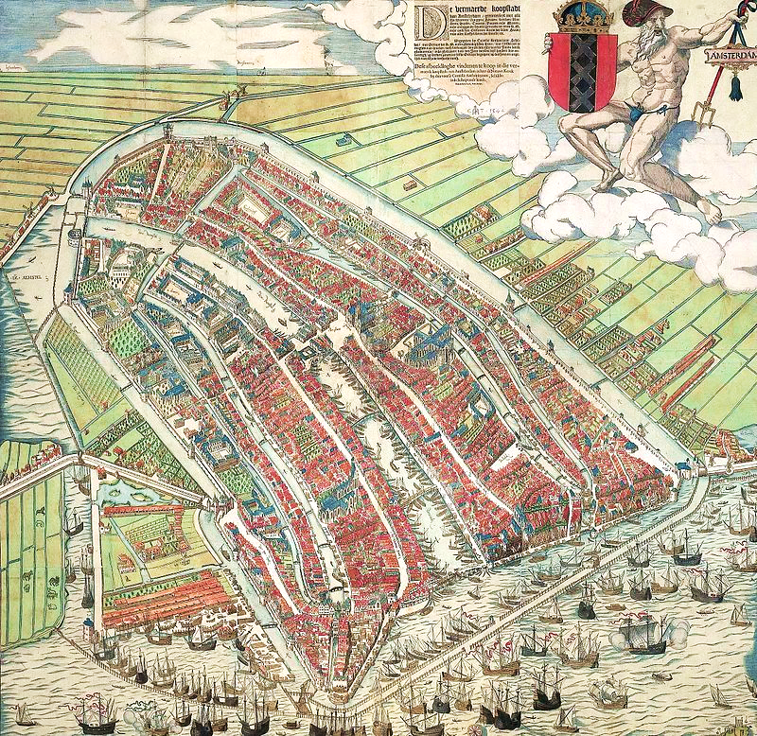

Slide 11
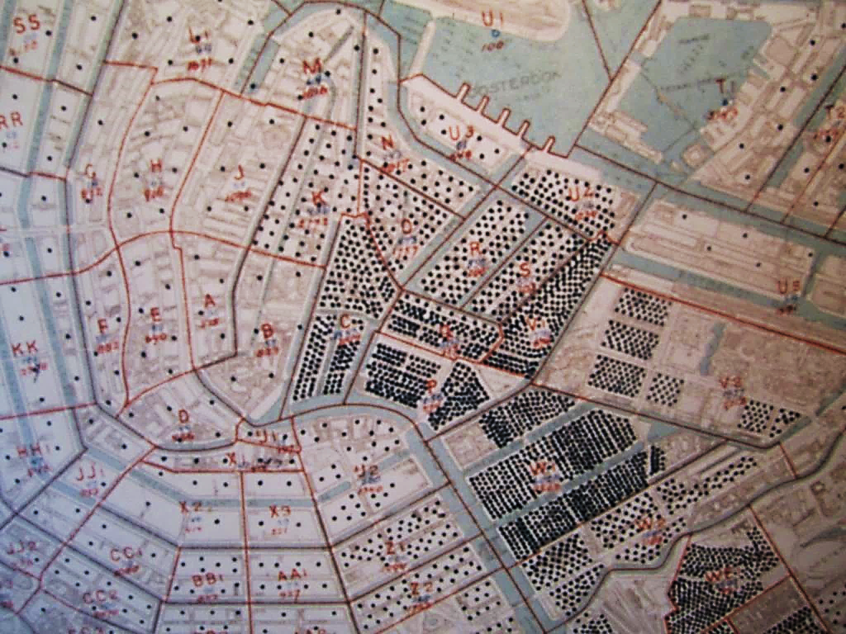
Jewish Settlements

Slide 12
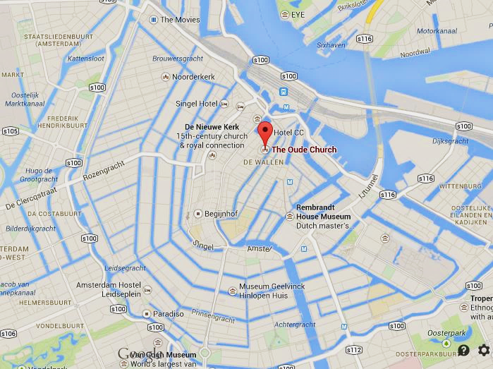
The Grachtengordel Concentric girdle of canals

Slide 13
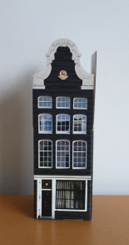
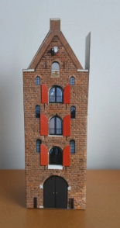
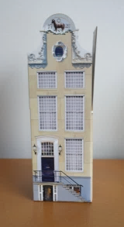
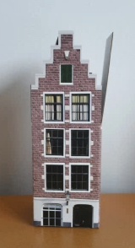
Typical gable-end styles
The Bell Gable 1660-1790
The Tuit Gable 1620-1720
The Neck Gable 1640-1775
The Step Gable (trapgevel) 1620-1790
Amsterdam Oriole: https://amsterdamoriole.com/2012/10/09/amsterdam-gables-galore/

Slide 14
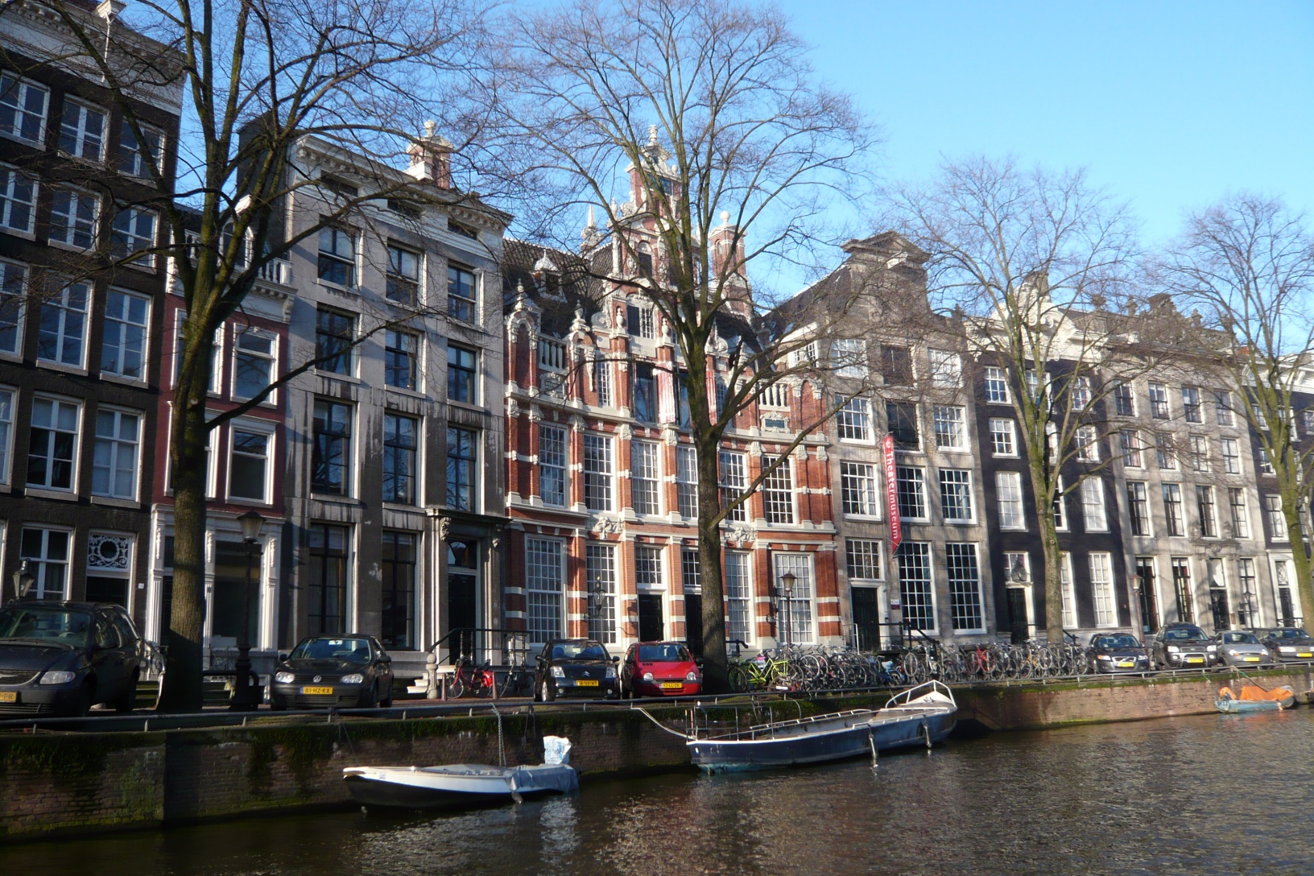
Urban design regulation

Slide 15
The Jordaan District

Slide 16
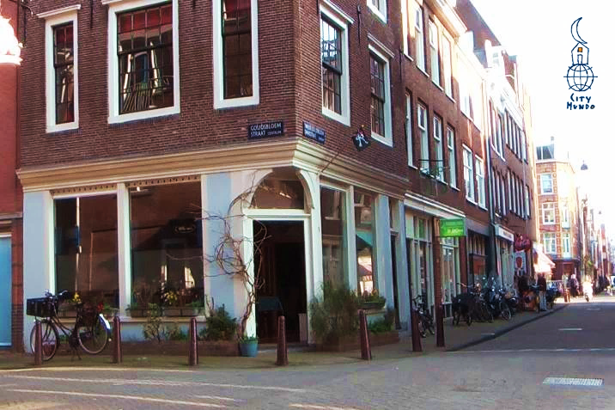
Jordaan

Slide 17
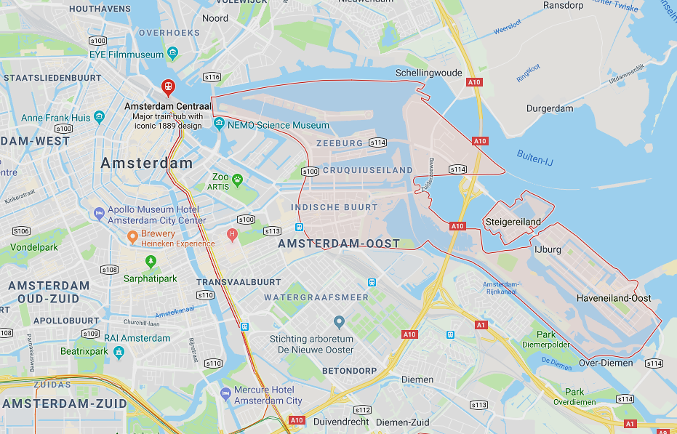
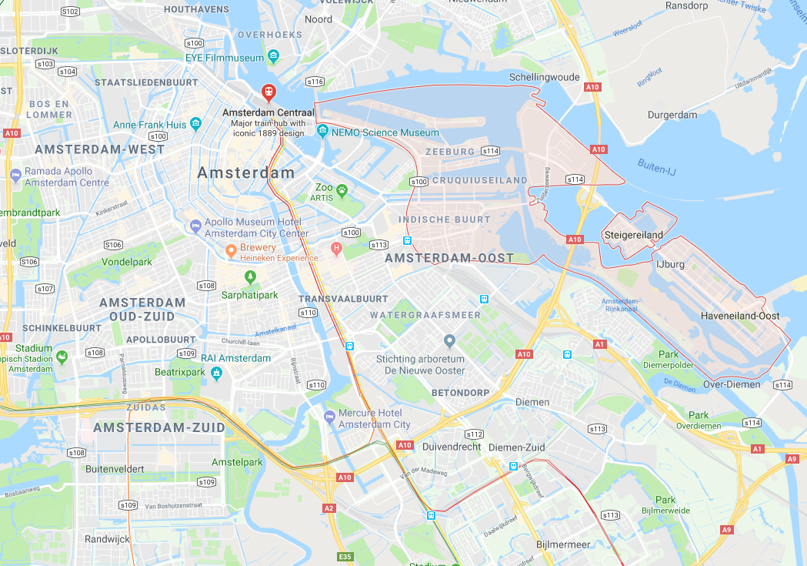
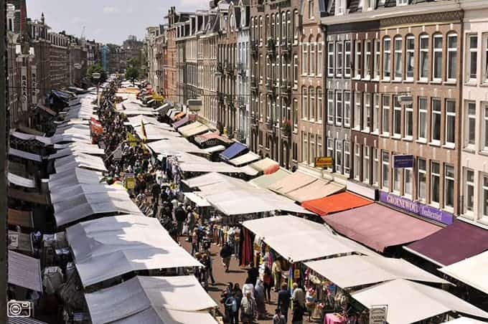
De Pijp
De Pijp

Slide 18
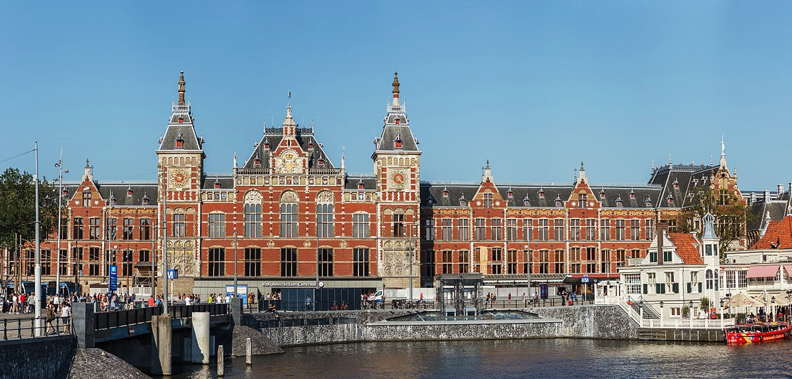
Central Station (RR)
Amsterdam
Centraal

Slide 19
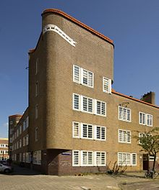
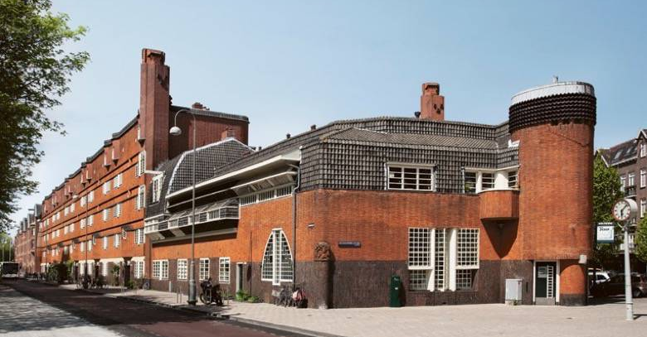
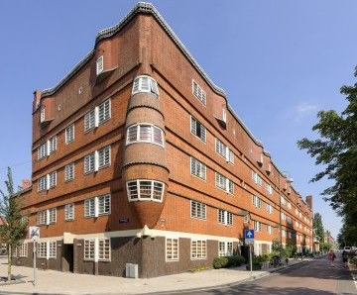
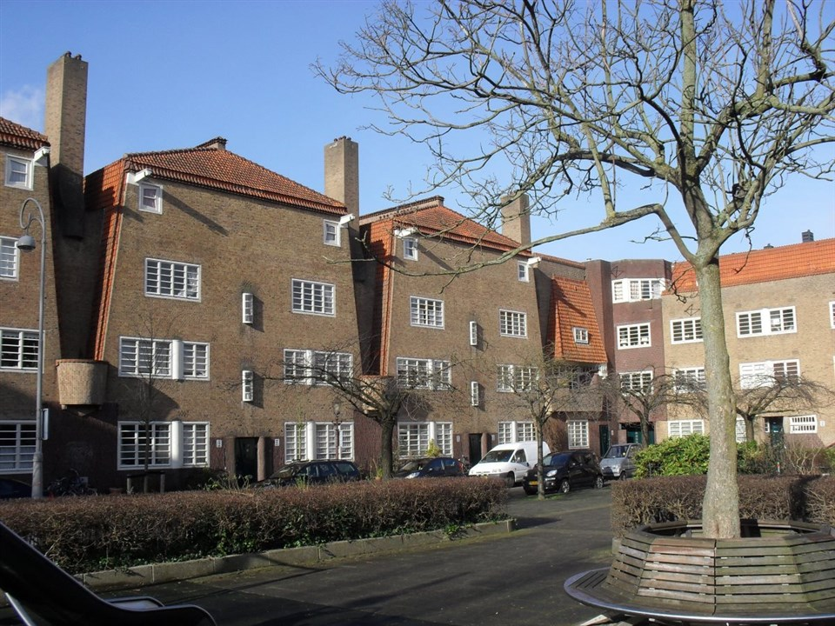
Het Schip and de Dageraad

Slide 20
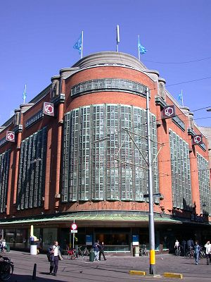
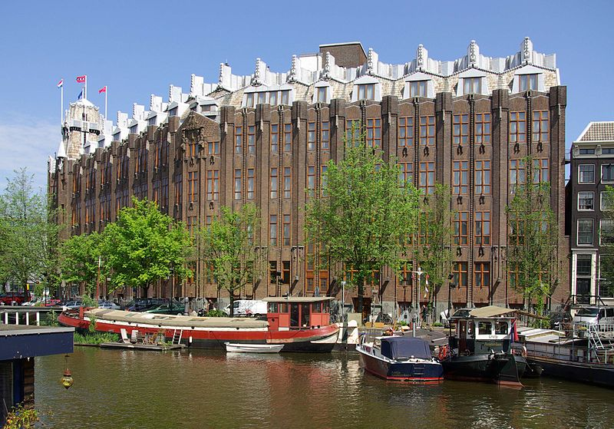
Dutch Expressionism in architecture

Slide 21
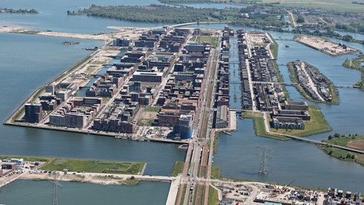
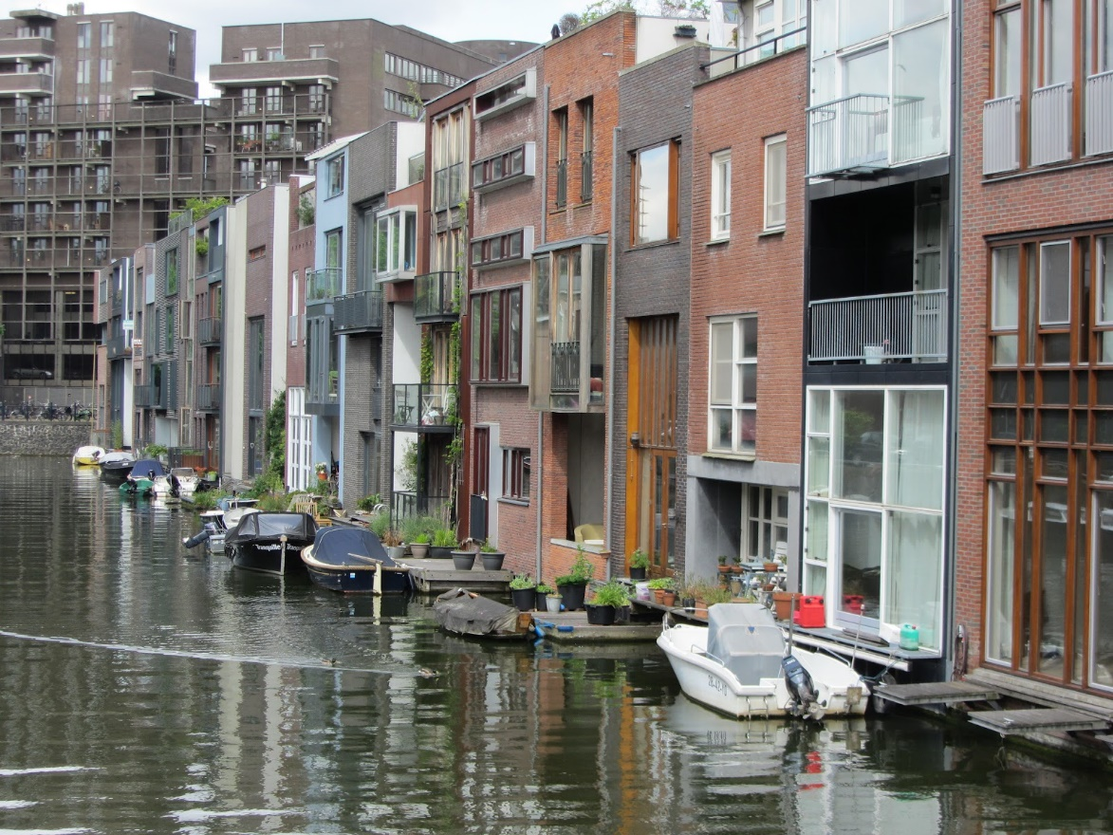
Ongoing redevelopment, Zeeburg
Zeeburg

Slide 22
End of show

