Slide 1
A Geopolitical and Economic History of the Netherlands

Slide 2
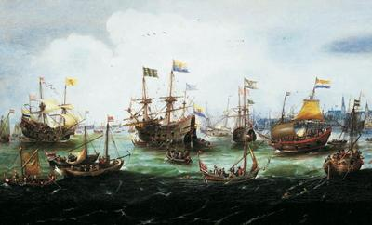
Takeways:
Lack of arable land and excellent sea access privileged trade and the development of a strong urban merchant class
Territory was subject to land grabs from all sides
17th century “Golden Age” was apogee of Dutch wealth; since then it has been an economic backwater

Slide 3
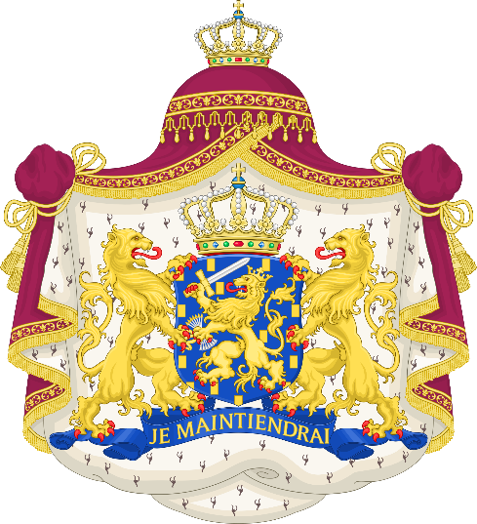

Shifting Territorial Possession:
Roman Empire (until ~400 AD)
Frankish invasion and control (400-800)
Holy Roman Empire
Frankish (800-1395)
Burgundian State (1395-1482)
Hapsburg Empire (1482-1556)
Kingdom of Spain (1556-1648)
Dutch Revolt 1568
Eighty-Years War 1568-1648 (Treaty of Munster)
Republic of the United Netherlands (1579–1795)
Batavian Republic (1795-1806)
Part of First French Empire (1810-1813)
Restoration of the House of Orange (1813 to present)

Slide 4
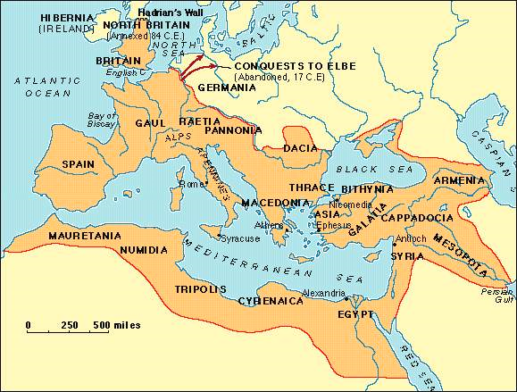
Maximum extent of Roman Empire

Slide 5
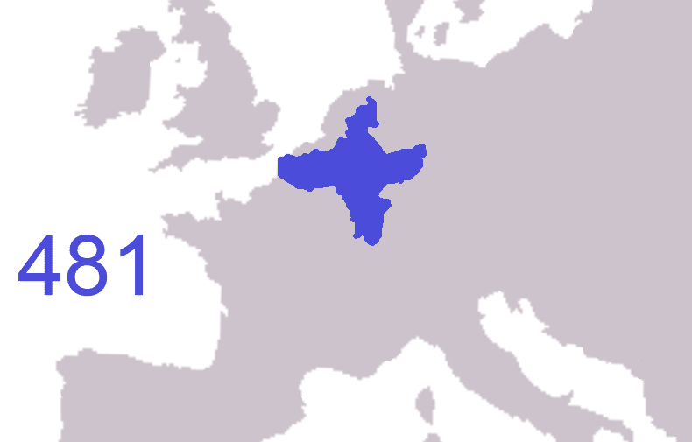
Expansion of Frankish control

Slide 6
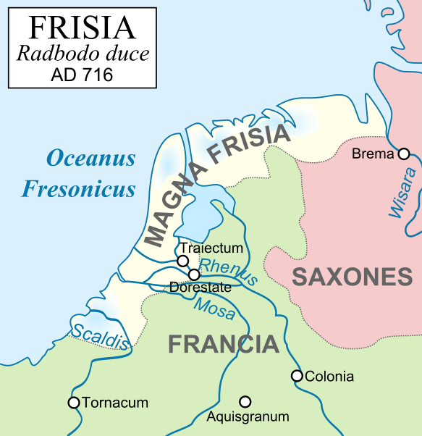

Slide 7
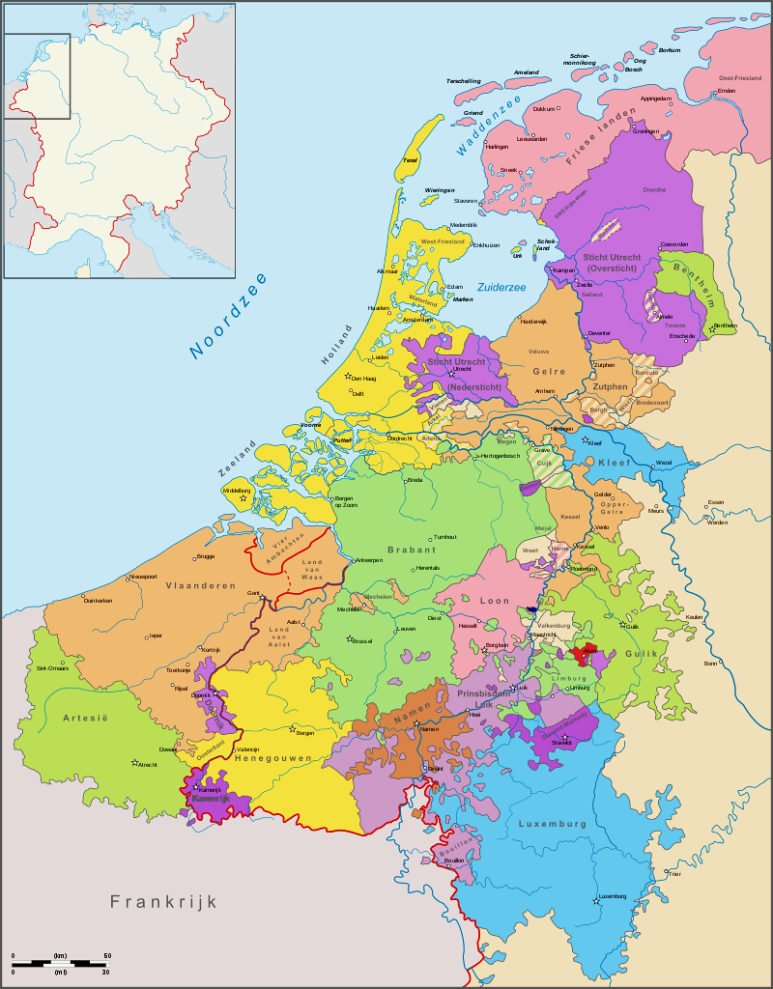
Frankish Low Countries c. 1400

Slide 8
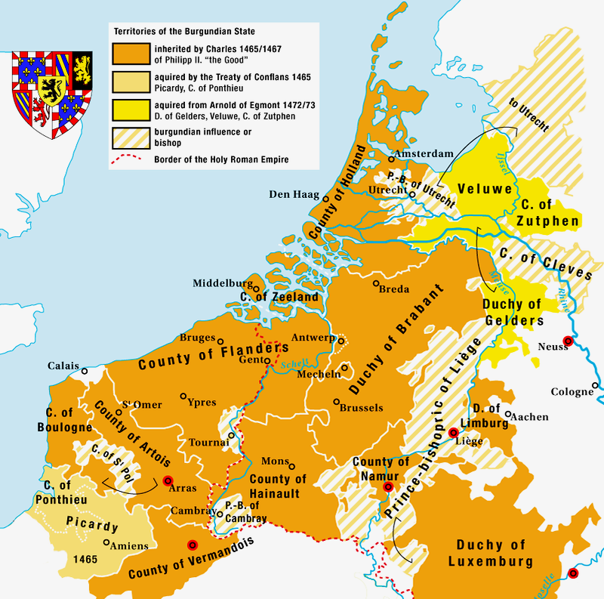
Territories of the Burgundian State

Slide 9
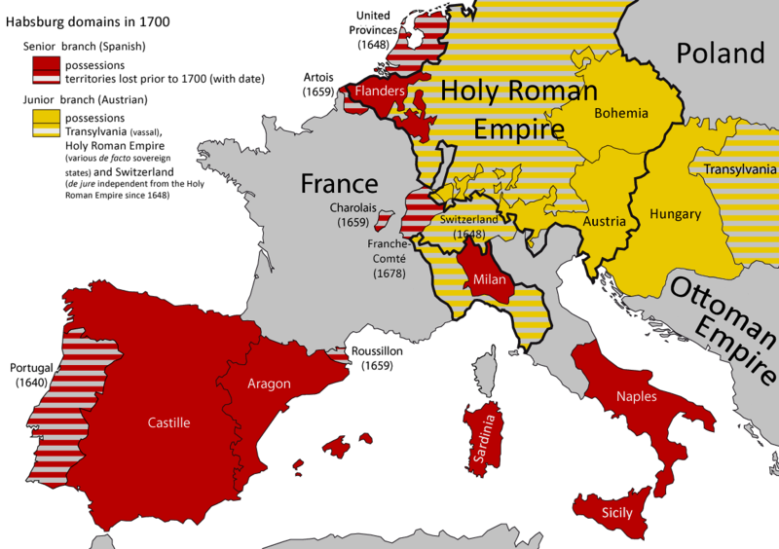
Habsburg Empire c. 1700

Slide 10
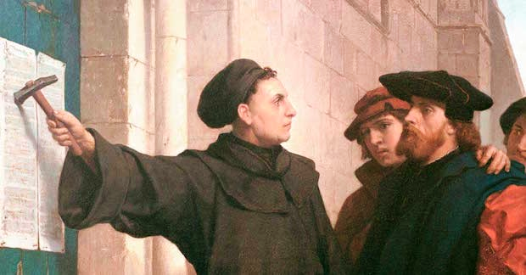
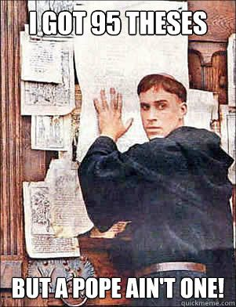
Luther nails his 95 Theses to the Church door Igniting the flame of the Reformation: the split between the Catholic and Protestant churches

Slide 11
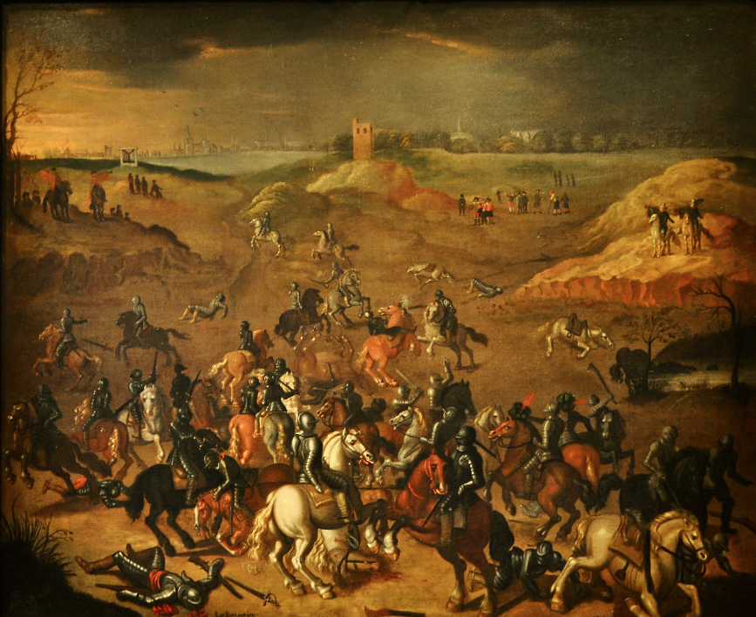
Eighty-Years War
Abuses of Philip II of Spain
Rise of a new merchant group opposed to the entrenched, corrupt oligarchy
Theological and political differences between Protestant sects
Power-hungry, opportunist nobles
Strong anti-Catholic sentiments

Slide 12
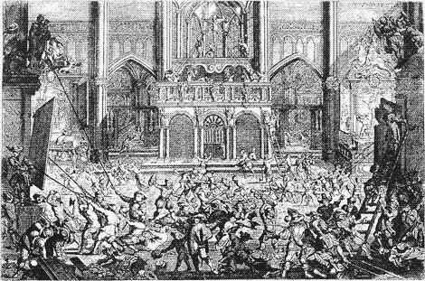
The Iconoclastic Fury (Beeldenstorm)

Slide 13
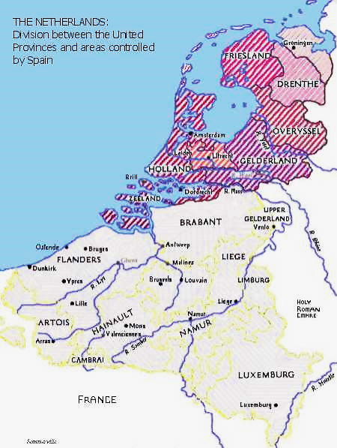
Union of Utrecht, 1579

Slide 14


The Golden Age of the Netherlands
Population growth
Exploration and development of global trade
Civic building and canal construction
Free flow of trade information
City Exchange Bank
Flowering of literature and philosophy
Golden Age of Dutch painting
Tulipmania!

Slide 15

Dutch Trading Companies
https://youtu.be/zPIhMJGWiM8?t=1m21s East India Company (VOC) Total runtime 15:39
West Indies Company
Noordse of Groenlandse

Slide 16
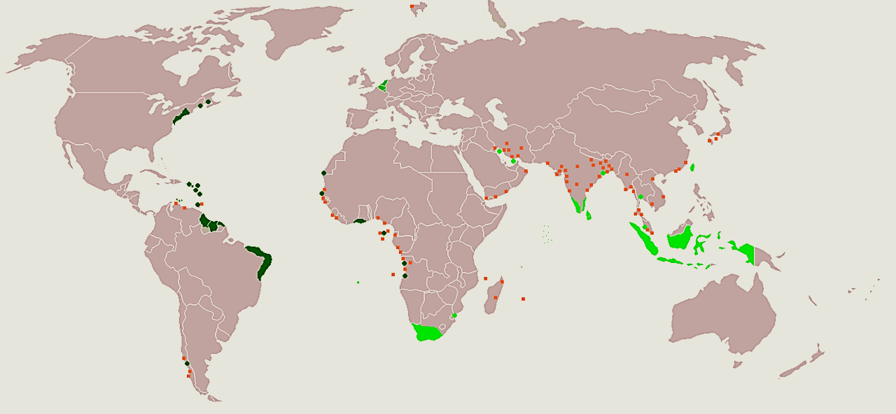
The Dutch Empire

Slide 17
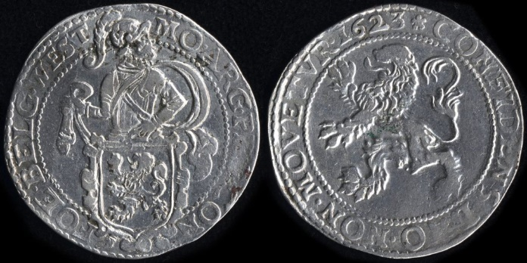
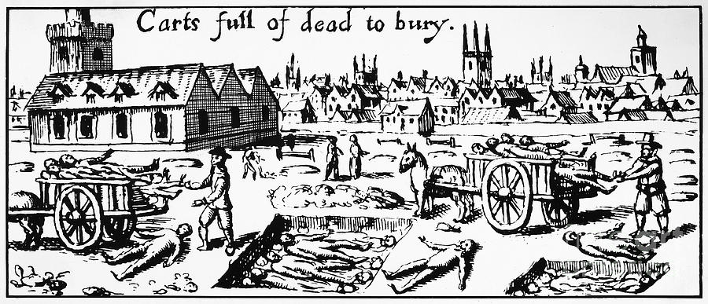
Late 17th century decline of Amsterdam
Lack of financing opportunities for investment bankers
Threats of invasion from England, Germany, and France
Competition from more modern ports
Tariffs on foreign goods
Outbreak of Black Plague 1663-4

Slide 18
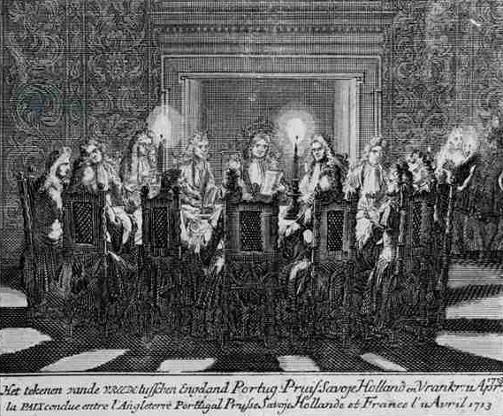
Continued decline in early 18th century
Treaty of Utrecht (Netherlands and England)
High taxes on the poor
End of Seven Years War
Internal conflicts

Slide 19
Further decline of trade and wealth
Amsterdam | 1794 | 1795 | 1796 | 1815
Profits from trade | 719,000 f | 321,000 f | 55,000 f
Assets of City Exchange Bank | 22m f | 11m f
Population |  | 221,000 | 190,000

Slide 20
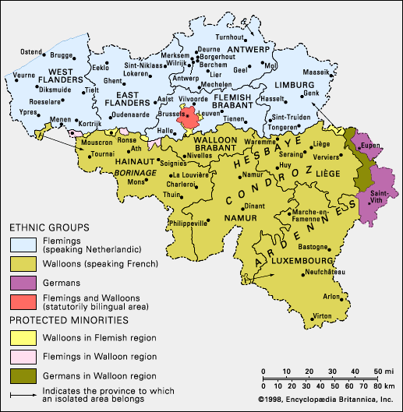
Belgium

Slide 21
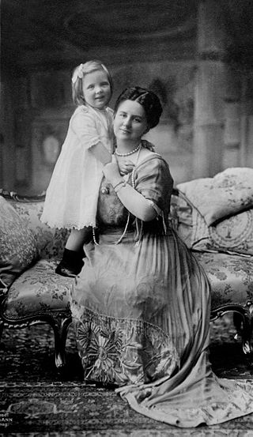
Queen Wilhelmina with Princess Juliana

Slide 22
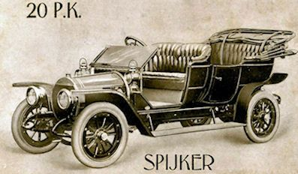
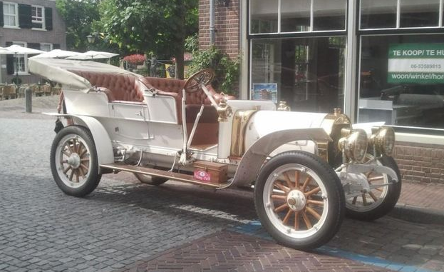


Spijker autos (now Spyker)

Slide 23


KLM, Royal Dutch Airlines, the national airline

Slide 24
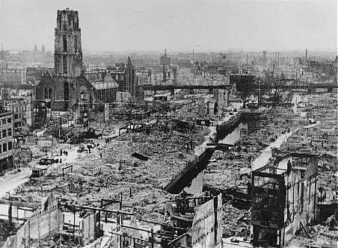
Rotterdam in ruins

Slide 25
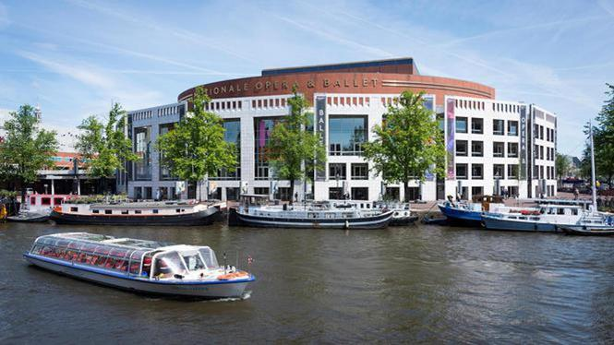
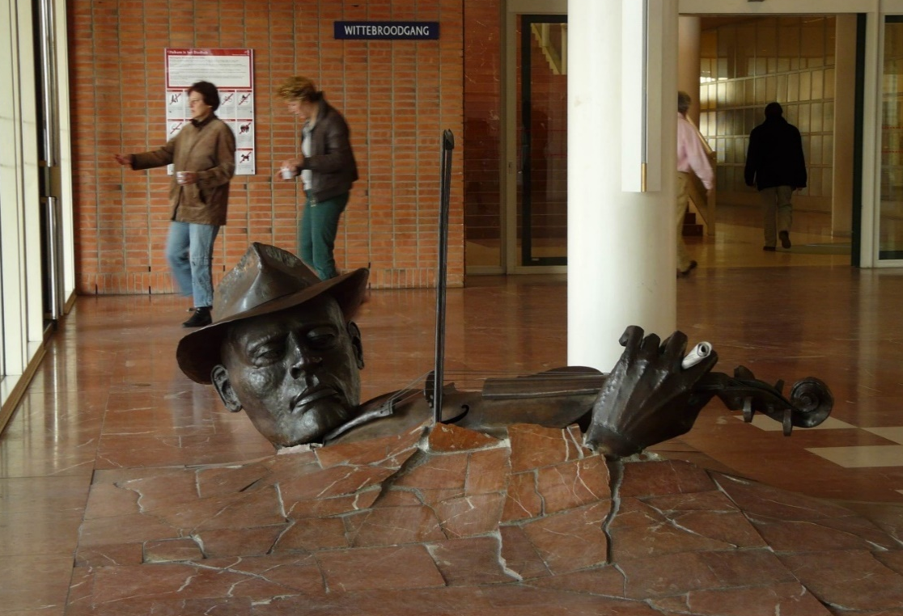
Stopera (State Opera)

Slide 26
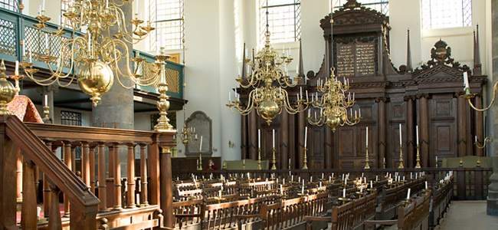
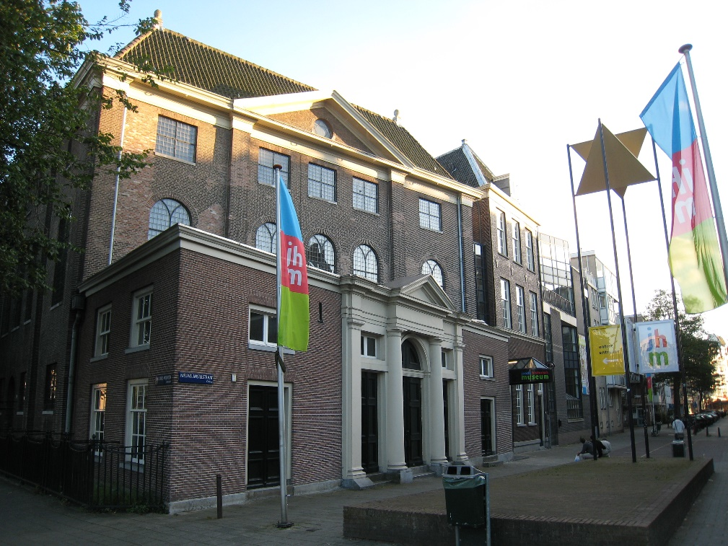
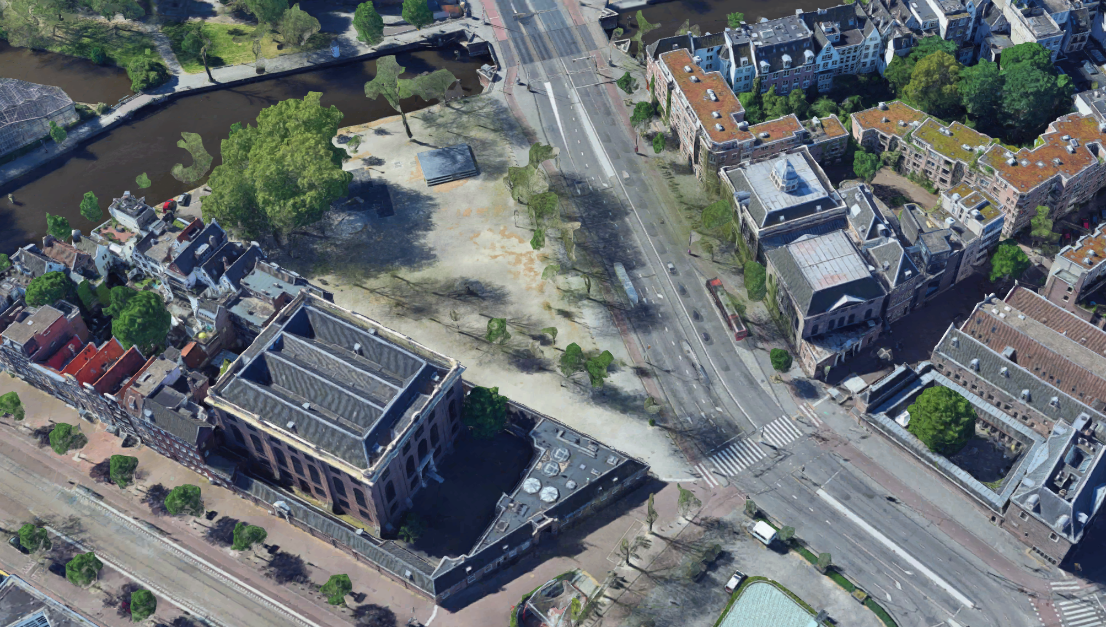
Esnoga and Jewish History Museum

Slide 27
Dutch Decolonization
1956: Indonesia
1976: Suriname
1986: Aruba seceded from Dutch Antilles and became a country in the Dutch Kingdom
2010: Dutch Antilles were dissolved, and the new municipalities of Bonaire, Sint Eustatius, and Saba were established
2010: the new countries of Curacao and Sint Maarten were established

Slide 28
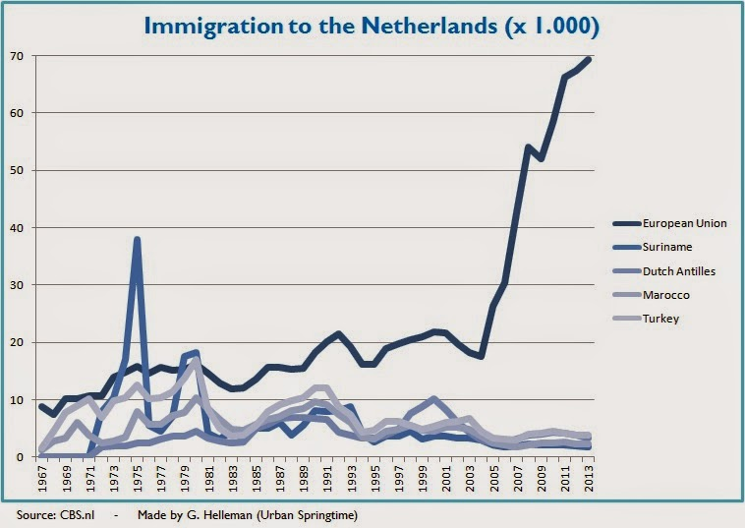
Immigration History to the Netherlands

Slide 29
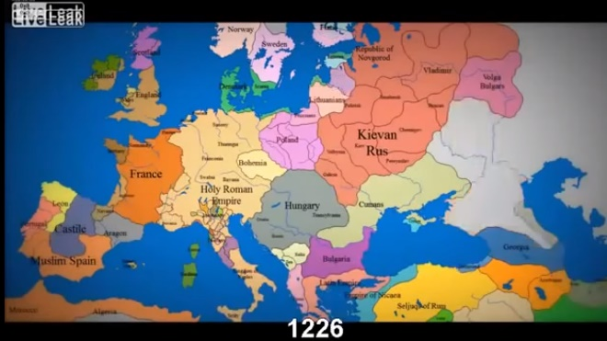
1000 years of Changing Borders in Europe
https://www.youtube.com/watch?v=Iha3OS8ShYs Animation of European Border changes over time runtime 3:23

Slide 30
End of show

Slide 31
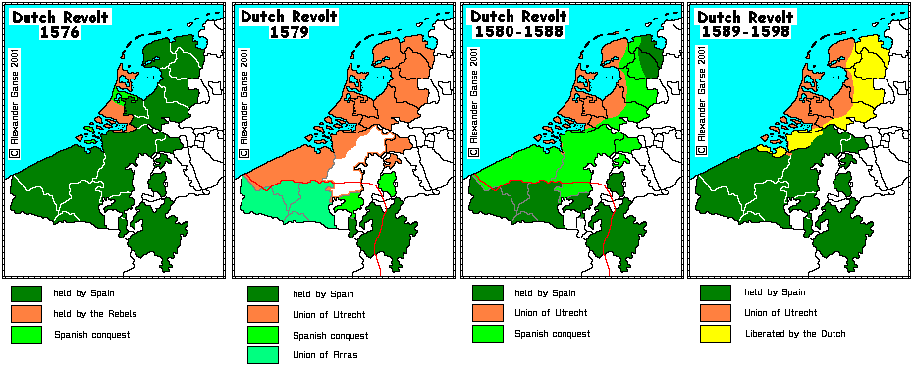
Burgundian expansion

